Slide 1
The programming process
A program performs computations on data. The purpose of data is to represent meaningful information. What information does this problem contain? How do we represent this information as data? What computation needs to be performed on this data to produce new meaningful information?

Slide 2
documentation
software documentation - information about various aspects of the intended operation of the programming language

Slide 3
glossary
function: a mathematical object that takes in some inputs and produces an output
domain: the type of data that a function expects
range: the type of data that a function produces
contract: a statement of the name, domain, and range of a function
consume: to take in values to compute an expression
produce: to compute a value from an expression

Slide 4
Böhm and Jacopini's insight:
3 actions needed to do anything
sequence:
first do this; then do that
selection:
IF such-&-such is the case,
THEN do this
ELSE do that
repetition:
WHILE such & such is the case DO this

Slide 5
Functional vs. Procedural Languages
A. Procedurals languages mirror machine code
B. Functional programs allow you to program what you mean
C. Procedural languages are more common in the software engineering industry

Slide 6
How do compilers and interpreters help develop programs?
A. They give the programmer access to specific functions designed for a specific purpose.
B. They make programs run faster.
C. They allow programmers to write programs without using machine code.

Slide 7
glossary cont’
expression: a computation written in the rules of some language (such as arithmetic, code, or a Circle of Evaluation)
function: a mathematical object that takes in some inputs and produces an output
interactions window: the text box at the top of the Editor (DrRacket or WeScheme), where we enter expressions to evaluate
legal expression: code that follows the Code Rules for a language
mathematical expression: a computation in arithmetic
programming language: a set of rules for writing code that a computer can evaluate

Slide 8
What is a program
a program performs computations on data
Try to think of a program that doesn’t fit this definition.

Slide 9
Leibniz's, Boole's, Turing's, Shannon's, & Morse's insight:
There are only 2 objects that a computer has to deal with in order to represent "anything."
What are they?

Slide 10
Alan Turing's insight: 4 actions a computer must do
* move left one location
* move right one location
* read symbol at current location
* print 0 at current location
* print 1 at current location

Slide 11
Glossary
apply: use a given function on some inputs
arguments: the inputs to a function; expressions for arguments follow the name of a function
circle of evaluation: a diagram of the structure of an expression (arithmetic or code)
definitions window: the text box at the top of the Editor (DrRacket or WeScheme), where definitions for values and functions are written
editor: software in which you can write and evaluate code
evaluate: perform the computation in an expression, producing an answer
evaluates to: the result of computing an expression

Slide 12
glossary cont’
error message: information from the computer about errors in code
image: a type of data for pictures
identifier: how we refer to a function or value defined in a language (examples: +, *, star, circle)
string: any sequence of characters between quotation marks (examples: "hello", "42", "this is a string!")
type: refers to a general kind of data, like Number, String, Image, or Boolean
value: a specific piece of data, like 5 or "hello"

Slide 13
Review the Rules for Brainstorming
1. Defer Judgment. Don’t block someone else’s idea if you don’t like it…put it on the whiteboard and maybe you’ll be able to build on it later.
2. Go for quantity. Getting to 100 ideas is better than 10, no matter what you initially think about the “quality”. Try setting a goal for the number of ideas you’ll get to in a certain amount of time to provide some stoke.
3. One conversation at a time. When different conversations are going on within a team, no one can focus.
4. Be visual. Sketch your ideas out for your teammate. It will communicate them more clearly than words alone, plus you might inspire some crazy new ideas.
5. Headline your idea. Make it quick and sharp, then move on to the next one.
6. Build on the Ideas of others. This leverages the perspectives of diverse teams and can be especially useful when you feel like you’re stuck.
7. Stay on topic. Your idea for an edible cell phone is awesome, but not during a brainstorm on making opera more exciting for children.
8. Encourage wild ideas. The crazier the better…you never know where your team might be able to take it. (See #1 and #6).

Slide 14
iteration, n.
1. the act of repeating; a repetition.
2. a problem-solving or computational method in which a succession of approximations, each building on the one preceding, is used to solve the problem

Slide 15
The Big Ideas of CS Principles
Creativity
Abstraction
Algorithms
Data
Programming
Internet
Global Impact

Slide 16
Brainstorming
What sorts of things could people make with computers?
Write as many ideas as you can in 1 minute.

Slide 17
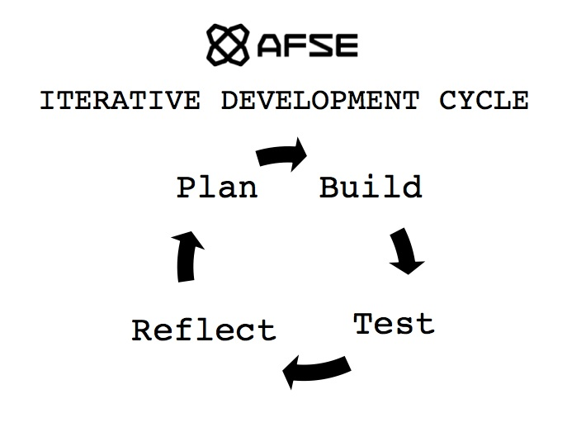

Slide 18
iterate
the act of repeating a process with the aim of reaching a goal
the act of repeating a process with the aim of reaching a goal

Slide 19
formal vs. informal language

Slide 20
How are programming languages similar to natural languages?
defining a variable is like defining a noun
defining a function is like defining a verb

Slide 21
Algebra
just another language

Slide 22




many names
Racket - the actual language we will be using
WeScheme - a cloud-based programming environment for Racket
Bootstrap - a curriculum for teaching mathematics with Racket
Scheme - the parent of Racket

Slide 23
What is research?
Can we learn math from computer programming?
What is a phD?

Slide 24
Style
"You know you are done when your code is as beautiful as the flag it creates," Emmanuel Schanzer, creator of WeScheme

Slide 25
Exact versus inexact
Racket has two kinds of numbers
⅓ is exact
#i0.333333333 is inexact

Slide 26
Data Types
Numbers
Strings
Booleans
Images

Slide 27
Human - Computer Interface
; circle takes a radius a mode and a color and produces a circle image
; circle : Number String String -> Image
name domain range
S
Human
Computer

Slide 28
Functions and Types

Slide 29
Four types
Numbers
Strings
Booleans
Images

Slide 30
Numbers
4
0.1
pi
⅓

Slide 31
Strings
“title”
“name”
“hello”
“21”

Slide 32
Booleans
true
false

Slide 33
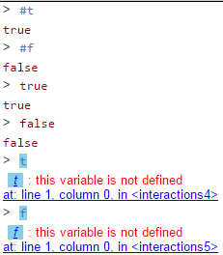
Booleans
true
false

Slide 34
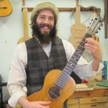
Images

Slide 35
Functions that combine data
Numbers
(+ 3 2)

Slide 36
Functions that combine data
Numbers
(+ 3 2)
5

Slide 37
Functions that combine data
Strings
(string-append “hello_” “world”)

Slide 38
Functions that combine data
Strings
(string-append “hello_” “world”)
“hello_world”

Slide 39
Functions that combine data
Booleans
(and true false)

Slide 40
Functions that combine data
Booleans
(and true false)
false

Slide 41
Functions that combine data
Images
(above )

Slide 42
Functions that combine data
Images
(above
)

Slide 43
Functions and Types
Humans
Computer

Slide 44
Angles
Data Types | Functions that produce this data type | Functions that use this data type as arguments
numbers | +, -, /, *, string-length | circle, star, rectangle
strings | string-append | string-length
images | circle, place-image, star | above, below, beside
angles |  | rotate

Slide 45
Notes 2/5 - Data Types Table
Copy this table into your notes. We will use it today in our lesson
Data Types | Functions that produce this data type

Slide 46
Types | Functions

Slide 47
Types | Functions
Number | + - * / sqr sqrt expt

Slide 48
language table
Data Types | Functions
Notes:
What types of data have we worked with so far? What are some functions that work on those data types?

Slide 49
numbers
everything you already think of

Slide 50
what is the difference between a type and a value?
Units in science, sets/intervals in math, datatypes in computer science.
We need to be able to talk about ideas in general terms
Types are general
Values are specific

Slide 51
Objectives
Knowledge:
How do function signatures help us to solve problems?
Skills:
Evaluate expressions in Racket by identifying signature information and evaluation order.

Slide 52
Program by Design API
Name | Input Types | Output Type | Example | Example Output

Slide 53
Write the contract for
(circle 50 "solid" "red")

Slide 54
Draw the circle of evaluation
(put-image
(circle 50 “solid” “red”)
100 0
(square 100 “solid” “blue”))

Slide 55
Image Primitive Contracts
; circle : Numer String String -> Image
; star : Number String String -> Image
; rectangle : Number Number String String -> Image

Slide 56
Image Combiner Contracts
; above : Image Image ... -> Image
; beside : Image Image … -> Image
; overlay : Image Image ... -> Image
; put-image : Image Number Number Image -> Image

Slide 57
Image Property Contracts
; image-height : Image -> Number
; image-width : Image -> Number

Slide 58
more about contracts
; rotate: angle image -> image
what goes into the function is what the function consumes. This is called the domain.
What comes out of the function is what the function produces. This is called the range.

Slide 59
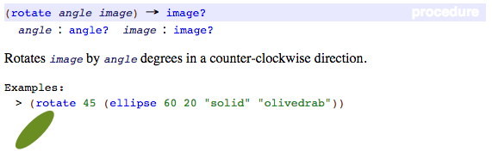
Contract Review
; rotate: angle image -> image
; consumes a number between 1 and 360 and produces an image rotated counterclockwise
This page from the documentation becomes the entry in our contract library below.
Compare them to review how to write a contract.

Slide 60
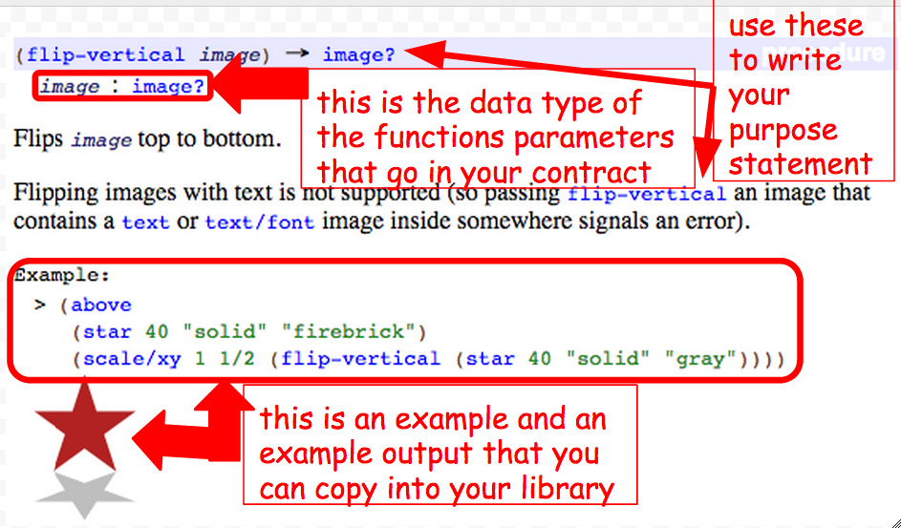
Documentation to Contracts

Slide 61
Contracts - Values vs. Types
Here is the contract for a new function:
; rectangle: Number Number String String -> Image
Here is an example of the function being used
(rectangle 300 400 “solid” “blue”)
Contracts refer to a parameters type. Types are general.
Functions are applied an arguments values. Values are specific.

Slide 62
+
Here is the contract for a new function:
; +: Number Number -> Number
Here is the purpose statement for the function:
; + consumes two or more numbers and produces the sum of those numbers

Slide 63
Here is the contract for a new function:
; rectangle: Number Number String String -> Image
Here is the purpose statement for the function:
; consumes a width, height, mode, and ; color and produces an rectangle

Slide 64
Describe how the function + works.

Slide 65
contracts (API)
(circle radius mode color)
; circle : number string string -> image
name domain range

Slide 66

expectation
What will the Racket code
(circle 50 "solid" "red") return?
Is (circle 50 "solid" "red") a contract or an example?

Slide 67
make a connection
can you match each part of the contract with part of the example?
; circle : number string string -> image
(circle 50 "solid" "red")

Slide 68
nested place-image functions
What is the domain of place image?

Slide 69
Contracts
How do we create our library of functions?

Slide 70
Contracts Day 2
How do we create our library of functions?

Slide 71
additional functions
you are required to learn these additional functions and enter them into your contract library
string-length
image-width
image-height
bitmap/url
rotate
scale
scale/xy
flip-vertical
flip-horizontal

Slide 72
Given an example write the contract
(and true true)
(circle 59 “solid” “red”)
(+ 54 30)
(+ 5 (* 4 3))
(string=? “ab” “bc”)

Slide 73
Other math function
Here are some of the operations on numbers that our language provides: +, -, *, /, abs, add1, ceiling, denominator, exact->inexact, expt, floor, gcd, log, max, numerator, quotient, random, remainder, sqr, and tan.

Slide 74
Problem statement
;Develop an expression to compute the distance of a point from the origin.
?
4
3

Slide 75
Exercise 0
The direct goal of this exercise is to create an expression that computes the distance of some specific Cartesian point (x,y) from the origin (0,0). The indirect goal is to introduce some basic programming habits.

Slide 76
Order of evaluation
(+ 1 (+ 1 (+ 1 1) 2) 3 (+ 2 2) 5)
==
(+ 1 (+ 1 2 2) 3 4 5)
==
(+ 1 5 3 4 5)
==
18
Notes:
What are we learning about the + function?

Slide 77
Order of evaluation
(+ 1 (+ 1 (+ 1 1) 2) 3 (+ 2 2) 5)
==
(+ 1 (+ 1 2 2) 3 4 5)

Slide 78
Order of evaluation
(+ 1 (+ 1 (+ 1 1) 2) 3 (+ 2 2) 5)

Slide 79
From last class:
(image-width (circle 10 "solid" "red"))
;circle : Number String String -> Image
;takes in radius, mode, color and produces a circle
Notes:
What do we need to know about the 10 to evaluate this expression?

Slide 80
From last class:
(image-width (circle 10 "solid" "red"))
;circle : Number String String -> Image
;takes in radius, mode, color and produces a circle
Notes:
What do we need to know about the 10 to evaluate this expression?

Slide 81
From last class:
(image-width (circle 10 "solid" "red"))
;circle : Number String String -> Image
Notes:
What do we need to know about the 10 to evaluate this expression?

Slide 82
From last class:
(image-width (circle 10 "solid" "red"))
Notes:
What do we need to know about the 10 to evaluate this expression?

Slide 83
Practice 1
(+ 1 (+ 1 (+ 1 1) 2) 3 (+ 2 2) 5)

Slide 84
Practice 2
(+ (string-length "hello world") 60)

Slide 85
Practice 3
(+ (string-length (number->string 42)) 2)

Slide 86
Practice 4
(+ (string-length 42) 1)

Slide 87
Practice 5
(image-width (circle 10 "solid" "red"))

Slide 88
Practice 6
(+ (image-width (circle 10 "solid" "red"))
(image-height (rectangle 10 20 "solid" "blue")))

Slide 89
Other math function
Here are some of the operations on numbers that our language provides: +, -, *, /, abs, add1, ceiling, denominator, exact->inexact, expt, floor, gcd, log, max, numerator, quotient, random, remainder, sqr, and tan.

Slide 90
From last class:
(and (or (= (string-length "hello world") (string->number "11"))
(string=? "hello world" "good morning"))
(>= (+ (string-length "hello world") 60) 80))
How does indenting work in Racket?
How does indenting help us to read Racket code?
How does order help us to evaluate Racket code?
How does data type information help us to evaluate Racket code?
Notes:
How does indenting affect readability, clarity, understanding?
The only rule is the innermost expression is evaluated first.

Slide 91
Evaluate the following expression
(and (or #true
#false)
(>= 71 80))
Notes:
How does indenting affect readability, clarity, understanding?
The only rule is the innermost expression is evaluated first.

Slide 92
Evaluate the following expression
(and #true
#false)
Notes:
How does indenting affect readability, clarity, understanding?
The only rule is the innermost expression is evaluated first.

Slide 93
Evaluate the following expression
#false
Notes:
How does indenting affect readability, clarity, understanding?
The only rule is the innermost expression is evaluated first.

Slide 94
Objectives
Knowledge:
How are expressions evaluated in Racket?
Skills:
Evaluate expressions using the rules of syntax and evaluation

Slide 95
Evaluate the following expression
(and (or (= (string-length "hello world") (string->number "11"))
(string=? "hello world" "good morning"))
(>= (+ (string-length "hello world") 60) 80))
Notes:
How does indenting affect readability, clarity, understanding?
The only rule is the innermost expression is evaluated first.

Slide 96
Evaluate the following expression
(and (or (= 11 11)
#false)
(>= (+ 11 60) 80))
Notes:
How does indenting affect readability, clarity, understanding?
The only rule is the innermost expression is evaluated first.

Slide 97
Circles of Evaluation
Function Names: or identifiers, are like the verbs in a sentence, they are written above the line.
place-image
circle
square
25
100
50
"solid"
"red"
100
"solid"
"blue"
Arguments: like the object of a verb, arguments are given to functions to help functions do their work. They are written below the line.

Slide 98
Circles of evaluation
(* 5 10)
*
5
10

Slide 99
Circles of evaluation
(circle 50 “solid” “red”)
circle
50
“solid”
“red”

Slide 100
name: or the identifier, always comes right after the opening parenthesis
arguments: what the function needs to do its job
(circle 50 "solid" "red")
each expression has an open and close parenthesis

Slide 101
parts of a expression
arguments
name
(circle 50 "solid" "red")

Slide 102
parts of a function
(circle 50 "solid" "red")

Slide 103
notes 1/4
definitions window: the text box at the top of the Editor (DrRacket or WeScheme), where definitions for values and functions are written
identifier: how we refer to a function or value defined in a language (examples: +, *, star, circle)
parametrization: the process of deciding and defining the parameters

Slide 104
composition of expressions
to consume the result of one expression as the argument of another

Slide 105
Arguments vs. Parameters
When we define a function or discuss its contract we refer to the functions parameters. Parameters are general.
Here is the contract for a new function:
; rectangle: Number Number String String -> Image
Here is an example of the function being used
(rectangle 300 400 “solid” “blue”)
When we use a function we are applying that function to its arguments. Arguments are specific values.

Slide 106
name: or the identifier, always comes right after the opening parenthesis
arguments: what the function needs to do its job
(circle 50 "solid" "red")
each function has an open and close parenthesis

Slide 107
Circles of Evaluation
Function Names: or identifiers, are like the verbs in a sentence, they are written above the line.
place-image
circle
square
25
100
50
"solid"
"red"
100
"solid"
"blue"
Arguments: like the object of a verb, arguments are given to functions to help functions do their work. They are written below the line.

Slide 108
Evaluating expressions
What would Racket say to the following lines of code?
> (+ 1 4)
> (/ 4 2)
> (- 0 9)
> (* 3 4)

Slide 109
Image Functions
What do we need to know to write image functions in Racket?

Slide 110
parts of an expression
arguments
name
(circle 50 "solid" "red")

Slide 111
Write the code for this circle of evaluation.
define
gtrc
put-image
triangle
circle
25 "solid" "green"
50 "solid" "red"
50 50

Slide 112
circles of evaluation
Math
Circle of Evaluation
Racket Code

Slide 113
composition of functions: putting one function inside of another
Interpret the following line of code.
(* 5 (+ 3 2))
...and this one?
(rotate 45
(triangle 50 "solid" "green"))
How many parameters does rotate have? How do we answer this question?

Slide 114
Formal Language
What do we need to know to write expressions in WeScheme?

Slide 115
expression
anything that can be evaluated

Slide 116
Composition of Functions
How can one expression be the argument of another?
(+ 3 (* 5 7))
(rotate 45 (square 50 “solid” “red”))

Slide 117
Common Errors
Leaving out the beginning left-parenthesis
Leaving out the ending right-parenthesis
Misspelling the operation name
Too few or too many arguments
Putting the operation and arguments in the wrong order
Doing something different from what you meant

Slide 118
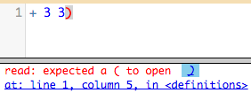
Error messages
error message: information from the computer about errors in code
How does this error message try to help you fix your program?
Write an explanation in your notes

Slide 119
Bug Finding
Directions
Open your bug program.
Click run.
Read the error message.
Fix the bug.
Click run again.
Repeat until you have found all of the bugs and the program runs without errors.
Write a sentence explaining each bug on the space provided.

Slide 120
error messages
enter the following code exactly how it is written
(circle 50 "solid" "red"
What does the message say?

Slide 121
how about this one?
(circle "solid" 50 "red")
What is the message telling us?

Slide 122
This code is broken. Can you fix it?
(define rtrr (put-image triangle 25 “solid” “red”)
50 50
(rectangle 100 100
solid”
“red”)))
What should it do?

Slide 123
Unit 00 - Lesson 01 - Objectives
Knowledge
Reading: List active reading strategies for college level CS textbooks and explain why they are useful
CS: Describe the rules Java follows when performing mathematical and casting operations on different numerical types
Skills
Reading: In a CS textbook match specific sections of text to example code; create a concept map; utilize a concept map to generate related questions; test related questions in code
CS: Evaluate expressions involving ints, doubles, casting, and basic mathematical operators ( +, -, *, / )

Slide 124
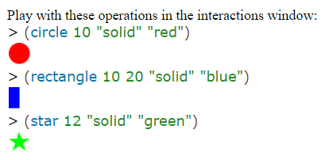
Images represent symbolic data somewhat like strings. To work with images, use the 2htdp/image library. Like strings, you used DrRacket to insert images wherever you would insert an expression into your program, because images are values just like numbers and strings.0 Your programs can also manipulate images with primitive operations. These primitive operations come in three flavors. The first kind concerns the creation of basic images:1 circle produces a circle image from a radius, a mode string, and a color string; ellipse produces an ellipse from two radii, a mode string, and a color string; line produces a line from two points and a color string; rectangle produces a rectangle from a width, a height, a mode string, and a color string; text produces a text image from a string, a font size, and a color string; and triangle produces an upward-pointing equilateral triangle from a size, a mode string, and a color string.2 The names of these operations mostly explain what kind of image they create. All you need to know is that mode strings means either "solid" or "outline" and color strings are strings such as "orange", "black", etc.3

Slide 125
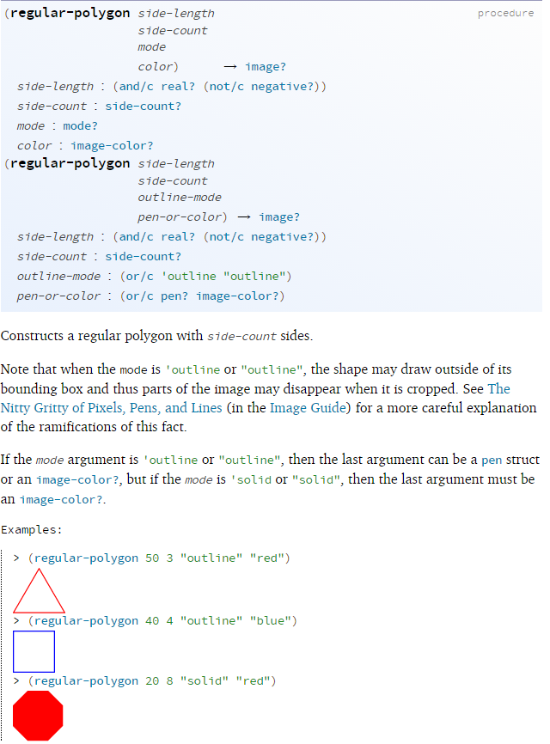
Stop! The above uses a previously-unmentioned operation. Look up its documentation and find out how many more image creation operations there are in BSL. Look up the documentation for regular-polygon. Experiment!

Slide 126
Stop! The above uses a previously-unmentioned operation. Look up its documentation and find out how many more image creation operations there are in BSL. Look up the documentation for regular-polygon. Experiment!

Slide 127
Signature
Purpose statement
Examples

Slide 128
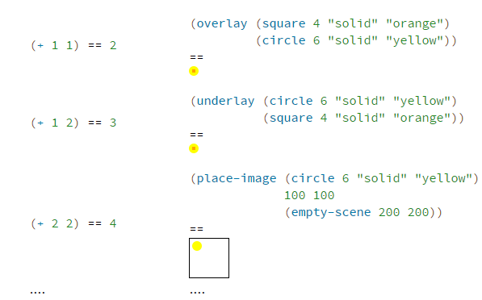
The laws of arithmetic for images are analogous to those for numbers: Again, no image gets destroyed or changed. Like +, these image combinations just make up new images that combine the given ones in the requested manner.

Slide 129
Code | Predicted | Actual
(image-width (circle 10 "solid" "red")) (image-height (rectangle 10 20 "solid" "blue")) (+ (image-width (circle 10 "solid" "red")) (image-height (rectangle 10 20 "solid" "blue")))

Slide 130
Code | Predicted | Actual
(image-width (circle 10 "solid" "red")) (image-height (rectangle 10 20 "solid" "blue")) (+ (image-width (circle 10 "solid" "red")) (image-height (rectangle 10 20 "solid" "blue")))

Slide 131
Important Vocabulary
image symbolic data values anchor point image-primitive type name | flavor

Slide 132
Concept Map (from wikipedia)
A concept map or conceptual diagram is a diagram that depicts suggested relationships between concepts.
It is a graphical tool that designers, engineers, technical writers, and others use to organize and structure knowledge.

Slide 133
image
is an image function example
is an image primitive
(circle 10 “solid” “red”)
circle
is the same kind of function as
image producing operation
rectangle
function name

Slide 134
Related Questions
Question | Code To Test

Slide 135
Objective
Knowledge:
How do we produce our own images in Racket?
Skills:
Compose image producing expressions to solve problems

Slide 136
Where is the origin?
2nd
1st
3rd
4th

Slide 137
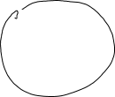
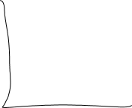

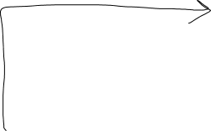

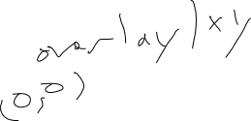


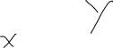





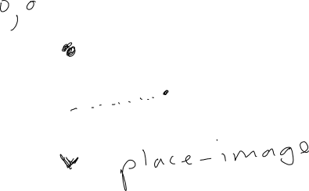
Origins

Slide 138
Programming images
You don’t have to use Google to find images
> (circle 10 "solid" "red")
> (rectangle 30 20 "outline" "blue")

Slide 139
Order of Operations - Arithmetic of Images
> (overlay (circle 5 "solid" "red")
(rectangle 20 20 "solid" "blue"))

Slide 140
Order of Operations - Arithmetic of Images
> (overlay (rectangle 20 20 "solid" "blue")
(circle 5 "solid" "red"))
What is different?
Describe the image this expression will produce.

Slide 141
Order of Operations - Arithmetic of Images
> (overlay (rectangle 20 20 "solid" "blue")
(circle 5 "solid" "red"))

Slide 142

Where is the origin?
(place-image (circle 5 "solid" "green")
50 80
(empty-scene 100 100))

Slide 143
Objectives
Knowledge:
How do we plan a complex program?
How do we use documentation?
Skills:
Analyze complex image arrangements.
Plan composition of image expressions.

Slide 144
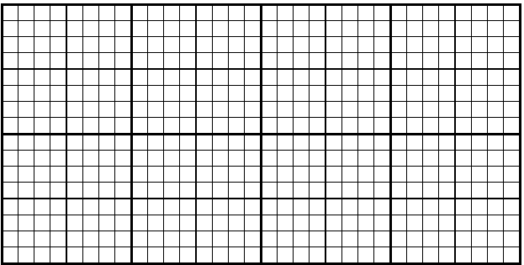
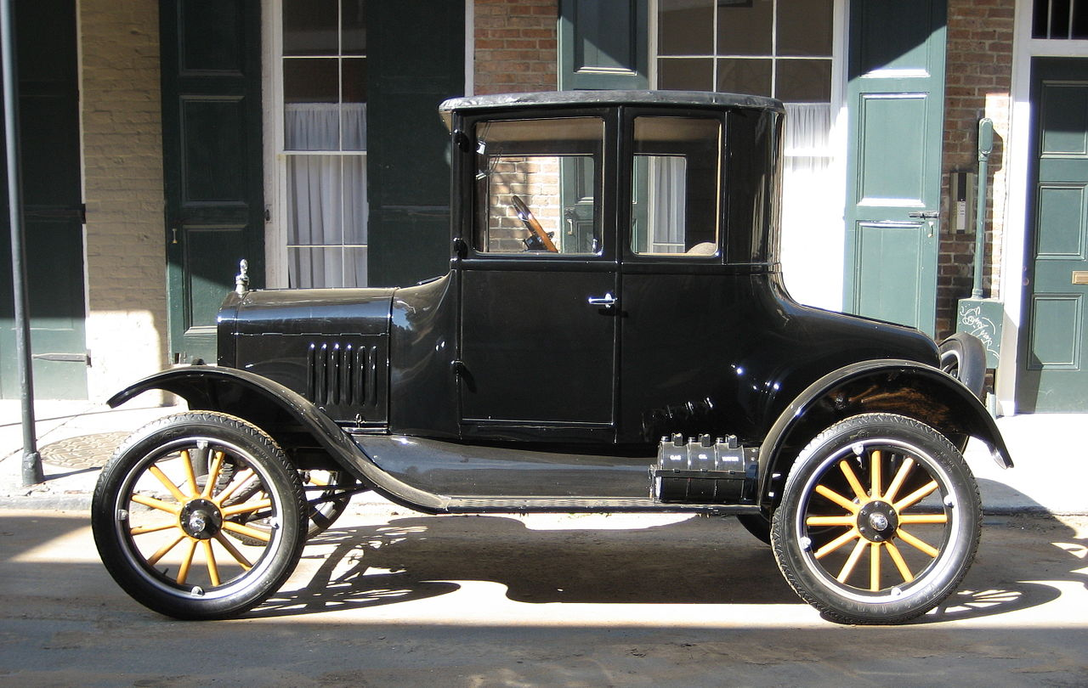
Draw a sketch

Slide 145
Make a scale drawing

Slide 146
Which functions?

Slide 147
Pair programming task 1
Write an expression to display the following image.
Bind the expression to a constant and evaluate it in the REPL

Slide 148
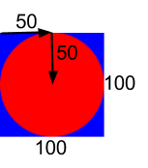
connect each argument to the diagram
#Example
EXAMPLE = place-image(
circle(50, “solid”, “red”),
50, 50,
rectangle(100, 100, “solid”, “blue”))

Slide 149
connect each argument to the diagram
include image
#Example
EXAMPLE = I.place-image(
I.circle(50, “solid”, “red”),
50, 50,
I.rectangle(100, 100, “solid”, “blue”))

Slide 150
place-image review
2
1/3
1
1/4

Slide 151
notes 2/4 - Copy the example into your notebook, type the code into WeScheme and draw a picture of the output.
(place-image
(circle 25 “outline” “yellow”)
0 0
(rectangle 100 50 “solid” “green”))

Slide 152
place image takes 4 arguments
(place-image
(circle 50 “solid” “red”)
25 100
(square 100 “solid” “blue”))
Argument 1
Arg 2
Arg 3
Argument 4

Slide 153
What is the data type of the 1st argument?
(place-image
(circle 50 “solid” “red”)
25 100
(square 100 “solid” “blue”))
image
Arg 2
Arg 3
Argument 4

Slide 154
what other expressions could be Argument 1?
(place-image
(place-image
IMAGE1 x y IMAGE2)
25 100
(square 100 “solid” “blue”))
Arg 2
Arg 3
Argument 4

Slide 155
What is the data type of the 3rd argument?
(place-image
(circle 50 “solid” “red”)
25 100
(square 100 “solid” “blue”))
Argument 1
Arg 2
number
Argument 4

Slide 156
what is the data type of the 3rd argument?
(place-image
(circle 50 “solid” “red”)
25 (* (+ 6 4) 100)
(square 100 “solid” “blue”))
Argument 1
Arg 2
Argument 4

Slide 157
Think deeper
If the range of a place-image function is an image, could one place image expression be the argument of another place-image expression?

Slide 158
notes 1/4 - place-image example
(place-image
(circle 50 “solid” “red”)
25 100
(square 100 “solid” “blue”))

Slide 159
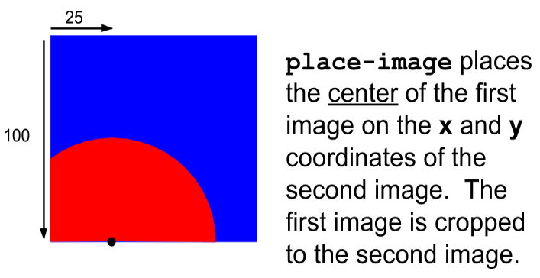
notes 3/4
which evaluates to...

Slide 160
Example 1
(place-image
(circle 50 “solid” “red”)
25 100
(square 100 “solid” “blue”))

Slide 161
Example 1
(place-image
(circle 50 “solid” “red”)
25 100
(square 100 “solid” “blue”))

Slide 162
place-image circle of evaluation
place-image
circle
50 “solid” “red”

Slide 163
place-image circle of evaluation
place-image
circle
50 “solid” “red”
25
100

Slide 164
place-image circle of evaluation
place-image
circle
square
50 “solid” “red”
25
100
100 “solid” “blue”
number
number
image
image

Slide 165
origin (0, 0) - top left corner
which evaluates to...

Slide 166
origin (0, 0) - top left corner
which evaluates to...

Slide 167
What is the data type of the 1st argument?
(place-image
(circle 50 “solid” “red”)
25 100
(square 100 “solid” “blue”))
Argument 1
Arg 2
Arg 3
Argument 4

Slide 168
What is the data type of the 1st argument?
(place-image
(circle 50 “solid” “red”)
25 100
(square 100 “solid” “blue”))
Argument 1
Arg 2
Arg 3
Argument 4

Slide 169
what other expressions could be Argument 1?
(place-image
(place-image
IMAGE1 x y IMAGE2)
25 100
(square 100 “solid” “blue”))
Argument 1
Arg 2
Arg 3
Argument 4

Slide 170
What is the data type of the 3rd argument?
(place-image
(circle 50 “solid” “red”)
25 100
(square 100 “solid” “blue”))
Argument 1
Arg 2
Arg 3
Argument 4

Slide 171
what other expressions could be passed as the third argument?
(place-image
(circle 50 “solid” “red”)
25 100
(square 100 “solid” “blue”))
Argument 1
Arg 2
Arg 3
Argument 4

Slide 172
three new functions
scale/xy
text
ellipse

Slide 173
place-image circle of evaluation
place-image

Slide 174
place-image circle of evaluation
place-image
circle
50 “solid” “red”
image

Slide 175
place-image circle of evaluation
place-image
circle
50 “solid” “red”
image

Slide 176
place-image circle of evaluation
place-image
circle
square
50 “solid” “red”
25
100
100 “solid” “blue”

Slide 177
place-image circle of evaluation
place-image
image
circle
square
50 “solid” “red”
25
100
100 “solid” “blue”

Slide 178
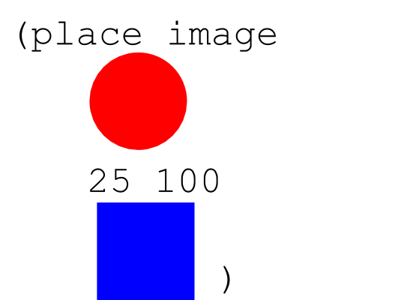
notes 2/4
is the same as...

Slide 179
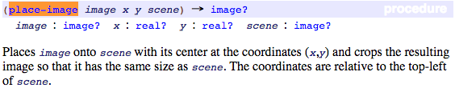
place-image

Slide 180
Today’s New Function
Here is the contract for a new function:
; rectangle: Number Number String String -> Image
Here is the purpose statement for the function:
; consumes a width, height, mode, and ; color and produces a rectangle
Here is an example of the function being used
(rectangle 300 400 “solid” “blue”)

Slide 181
Problems are made of smaller problems
Assignment 01.00 - Requirement 1: Write an expression which displays four copies of a picture in a two-by-two square, each flipped differently: the top-right one should be flipped upside down, the bottom-left one flipped sideways, and the top-left and bottom-right should be right side up.
What are the smaller problems that make up this larger problem?

Slide 182
let's remember the contracts for above and beside

Slide 183
This makes an image...
(place-image
(circle 60 "solid" "red")
150 100
(rectangle 300 200 "outline" "black"))

Slide 184
locating images relative to each other
Go to the Designing Structure Worksheet

Slide 185
Review of computer screen coordinates
How are they slightly different from math coordinates?
(0,0)
x increases to the right
y increases going down

Slide 186
computer screen coordinates
slightly different from math coordinates
(0,0)

Slide 187
What about this?
(put-image
(put-image (rectangle 500 100 "solid" "red")
250 250
(rectangle 500 100 "solid" "yellow"))
150 250
(rectangle 500 100 "solid" "black"))

Slide 188
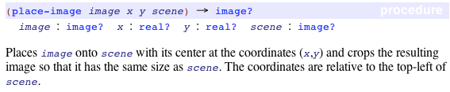
search the documentation for place-image
enter place-image into your contract library

Slide 189
what is a scene?
Enter the following code in wescheme:
(place-image
(circle 50 "solid" "red") 25 25
(rectangle 100 100 "solid" "blue"))

Slide 190
overlay/xy
for an image that is not cropped by a scene use overlay/xy
other function to incorporate in your program:
flip-horizontal, flip-vertical, scale, scale/xy, above, below, rotate, bitmap/url

Slide 191
What does it do?
(require bootstrap2012/bootstrap-teachpack)
(put-image (rectangle 500 100 "solid" "red")
250 250
(put-image (rectangle 500 100 "solid" "black")
250 150
(put-image (rectangle 500 100 "solid" "yellow")
250 50
(rectangle 500 300 "outline" "black")
)
)
)

Slide 192
What is the error?
(string-length 42)

Slide 193
What is the error?
(string-length 42)
string-length: expects a string, given 42

Slide 194
What type of data?
(define any ...)
(string-length any)

Slide 195
Predicates
> (number? 4)
#true
> (number? pi)
#true
> (number? #true)
#false
> (number? "fortytwo")
#false

Slide 196
Predicates in use
(define in ...)
(if (string? in) (string-length in) ...)

Slide 197
Applications
(define current-color ...)
(define next-color (if (string=? "green" current-color) "yellow" ...))

Slide 198
Predicates in use
(define any...)
(if (string? any) (string-length any)
(if (number? in) ... ...))

Slide 199
Practice
Add the following line to the definitions area of DrRacket:
(define any "hello")
Then create an expression that converts whatever any represents to a number. For a string, it determines how long the string is; for a number, it decrements the number, unless it is already 0 or negative; for #true it uses 10 and for #false 20.

Slide 200
Objectives
Knowledge:
a predicate is a function that consumes a value and determines whether or not it belongs to some class of data
Skills:
Use predicates in conditional functions to prevent misuse of data

Slide 201
Is this surprising?
(and #true #true #true)
== #true
(and #true #true #true #false)
== #false

Slide 202
and
(and expression expression expression ...)
Evaluates to true if all the expressions are true. If any expression is false, the and expression evaluates to false (and the expressions to the right of that expression are not evaluated.)
If any of the expressions evaluate to a value other than true or false, and reports an error.

Slide 203
Will this produce an error?
(and #true #false (/ 1 0))

Slide 204
What could be the problem?
(define x 2)
and then compute its inverse:
(define mult-inv-of-x (/ 1 x))

Slide 205
This would be a problem
(define x 0)
and then compute its inverse:
(define mult-inv-of-x (/ 1 x))

Slide 206
Programs can check
(define x 0)
(if (= x 0) 0 (/ 1 x))

Slide 207
Will this produce an error?
(define x 0)
(if (= x 0) 0 (/ 1 x))

Slide 208
Will this produce an error?
(define x 0)
(if (= x 0) 0 (/ 1 x))
Shouldn’t this expression produce an error?

Slide 209
(if (= x 0) 0 (/ 1 x))
rules of evaluation
This if expression contains the sub-expressions (= x 0), 0, and (/ 1 x). The evaluation of this expression proceeds in two steps:
The first expression is always evaluated. Its result must be a Boolean.
If the result of the first expression is #true, then the second expression is evaluated; otherwise the third one. Whatever their results are, they are also the result of the entire if expression.

Slide 210
Practice
Suppose you want to decide whether today is an appropriate day to go to the mall. You go to the movies if it is either not sunny or if today is Friday (because that is when discount tickets are available).
(define sunny #true)
(define friday #false)
Now create an expression that computes whether sunny is false or friday is true. So in this particular case, the answer is #false.

Slide 211
Practice
(define box (rectangle 50 100 “solid” “blue”))
Create an expression that computes whether the image is "tall" or "wide". An image should be labeled "tall" if its height is larger or equal to its width; otherwise it is "wide".
Hint: image-width returns the width of the image
image-height returns the height of the image

Slide 212
Objectives
Knowledge:
Boolean arithmetic is analogous to string arithmetic and number arithmetic.
Skills:
Evaluate expressions using Booleans in Racket.

Slide 213
6.
Sugar is sweet or Ice is cold.

Slide 214
4.
Sugar is sweet and Ice is hot.

Slide 215
2.
Ice is hot.

Slide 216
or
and
; and: Boolean Boolean -> Boolean
; Returns true if BOTH inputs are true
; or: Boolean Boolean -> Boolean
; Returns true if EITHER of the inputs are true.
Notes:
Sugar is sweet.
Ice is hot.
Sugar is sweet and Ice is cold.
Sugar is sweet and Ice is hot. Why is it false? Isn’t sugar still sweet?
Sugar is sweet or Ice is cold.
Sugar is sweet or Ice is hot. Why is it true? Ice isn’t hot!

Slide 217
boolean contracts
 | Function Name | Domain | Range
(> 0 5)
(= 1 9)
(<= 2 2)
(string=? "dog" "cat")

Slide 218
true or false
True or False
Mr. Allatta is wearing a tie.
Ice is hot.
Our classroom is on the 4th floor of the Washington Irving campus.
Notes:
So far, our language can only add, subtract, multiply and divide numbers. It can't compare them or decide whether something is true or false! We'll be adding the power of comparison to our language today.

Slide 219
7.
Sugar is sweet or Ice is hot.

Slide 220
5.
Sugar is sweet and Ice is hot.

Slide 221
AND OR EXAMPLES
1.
Sugar is sweet.

Slide 222
3.
Sugar is sweet and Ice is cold.

Slide 223
more booleans
how about these?
(> 0 5)
(= 1 9)
(<= 2 2)
(string=? "dog" "cat")

Slide 224
Booleans
teaching functions to compare

Slide 225
Applications
(define current-color ...)
(define next-color (if (string=? "green" current-color) "yellow" ...))

Slide 226
Opening question
Using string primitives compose an expression that solves the following problem:
Given any string, concatenate the first and last characters.
Start with the following line of code
(define str “anything”)

Slide 227
What do we expect?
(define str “anything”)
“should return”
“ag”

Slide 228
What do we expect?
(define str “anything”)
“should return”
“ag”
(string-append frst lst)

Slide 229
Last quiz
(string-append (string-append “A”
(string-append “F”
(string-append “S” “E”))))

Slide 230
Last quiz
(string-append (string-append “A”
(string-append “F”
(string-append “S” “E”))))
(string-append (string-append “A”
(string-append “F” “SE”)))

Slide 231
Last quiz
(string-append (string-append “A”
(string-append “F”
(string-append “S” “E”))))
(string-append (string-append “A”
(string-append “F” “SE”)))
(string-append (string-append “A” “FSE”))

Slide 232
Last quiz
(string-append (string-append “A”
(string-append “F”
(string-append “S” “E”))))
(string-append (string-append “A”
(string-append “F” “SE”)))
(string-append (string-append “A” “FSE”))
(string-append “AFSE”)
“AFSE”

Slide 233
Additional String Functions
add these to your class API
string-length consumes a string and produces a (natural) number;
string-ith consumes a string together with a natural number i and then extracts the 1String located at the ith position (counting from 0); and
number->string consumes a number and produces a string.
substring Extracts the substring starting at i up to j (or the end if j is not provided).
> (substring "hello world" 1 5)
"ello"
> (substring "hello world" 4)
"o world"

Slide 234
Practice
(define str "helloworld")
(define i 5)
Create an expression using string primitives that adds "_" at position i. In general this means the resulting string is longer than the original one; here the expected result is "hello_world".

Slide 235
Extra Note
Note We use 1String to refer to the keyboard characters that make up a String. For example, "red" consists of three such 1Strings: "r", "e", "d".

Slide 236
From last class
Exercise 1. Add the following two lines to the definitions area:
(define prefix "hello")
(define suffix "world")
Then use string primitives to create an expression that concatenates prefix and suffix and adds "_" between them. When you run this program, you will see "hello_world" in the interactions area

Slide 237
String
a String is a sequence of the characters that you can enter on the keyboard enclosed in double quotes

Slide 238
String Addition
(+ 1 1) == 2
(string-append "a" "b") == "ab"
(+ 1 2) == 3
(string-append "ab" "c") == "abc"
(+ 2 2 2) == 6
(string-append "a" " " "c") == "a c"
....

Slide 239
String Addition
> (string-append "what a " "lovely " "day" " for learning Racket")
"what a lovely day for learning Racket"

Slide 240
Exercise 1
Exercise 1. Add the following two lines to the definitions area:
(define prefix "hello")
(define suffix "world")
Then use string primitives to create an expression that concatenates prefix and suffix and adds "_" between them. When you run this program, you will see "hello_world" in the interactions area.

Slide 241
Exercise 1
Exercise 1. Add the following two lines to the definitions area:
(define prefix "hello")
(define suffix "world")
Then use string primitives to create an expression that concatenates prefix and suffix and adds "_" between them. When you run this program, you will see "hello_world" in the interactions area.

Slide 242
Extra Note
Note We use 1String to refer to the keyboard characters that make up a String. For example, "red" consists of three such 1Strings: "r", "e", "d". As it turns out, there is a bit more to the definition of 1String but for now, thinking of them as Strings of length 1 is fine. End

Slide 243
Additional String Functions
add these to your class API
string-length consumes a string and produces a (natural) number;
string-ith consumes a string together with a natural number i and then extracts the 1String located at the ith position (counting from 0); and
number->string consumes a number and produces a string.

Slide 244
Slide keyboard
This is the cue to switch partners, but you shouldn’t have to move anything except the keyboard.

Slide 245
Pair programming task 0
Write an expression to display the following image.

Slide 246
Slide keyboard
This is the cue to switch partners, but you shouldn’t have to move anything except the keyboard.

Slide 247
Pair programming task 1
Write an expression to display the following image.

Slide 248
Slide keyboard
This is the cue to switch partners, but you shouldn’t have to move anything except the keyboard.

Slide 249
Pair programming task 2
Write an expression to display the following image.

Slide 250
Slide keyboard
This is the cue to switch partners, but you shouldn’t have to move anything except the keyboard.

Slide 251
Pair programming task 3
Write an expression to display the following image.

Slide 252
Slide keyboard
This is the cue to switch partners, but you shouldn’t have to move anything except the keyboard.

Slide 253
Pair programming task 4
Write an expression to display the following image.

Slide 254
Slide keyboard
This is the cue to switch partners, but you shouldn’t have to move anything except the keyboard.

Slide 255
Pair programming task 5
Write an expression to display the following image.

Slide 256
Slide keyboard

Slide 257
Pair programming task 6

Slide 258
Slide keyboard

Slide 259
Pair programming task 7

Slide 260
Slide keyboard

Slide 261
Pair programming task 8

Slide 262
Slide keyboard

Slide 263
Pair programming task 9

Slide 264
Slide keyboard

Slide 265
Pair programming task 7

Slide 266
Slide keyboard

Slide 267
Pair programming task 10

Slide 268
Slide keyboard

Slide 269
Pair programming task 12

Slide 270
Slide keyboard

Slide 271
Pair programming task 13

Slide 272
Slide keyboard

Slide 273
Pair programming task 14
I LOVE CS!

Slide 274
Slide keyboard

Slide 275
Pair programming task 15
I LOVE CS!

Slide 276
Slide keyboard

Slide 277
Pair programming task 16
Create something cool. No, do not make these words into text. No seriously.

Slide 278
Objectives
Knowledge:
How do we define new identifiers in Racket?
Skills:
Create and use variables in Racket programs

Slide 279
notes 2/4
We can create a new identifier using the following syntax:
(define identifier value)
For example
(define x 5)
is the same as in Algebra
x = 5

Slide 280
notes 1/4
definitions window: the text box at the top of the Editor (DrRacket or WeScheme), where definitions for values and functions are written
identifier: how we refer to a function or value defined in a language (examples: +, *, star, circle)
parametrization: the process of deciding and defining the parameters

Slide 281
notes 3/4
In our programming language, variables are defined by:
(define x 4)
(define y (+ 4 9))
(define z (* x 2))
Values can be fixed (like the first example), the result of an expression (the second), or even be defined in terms of other variables (the third). We can do the same things in algebra:
x=4
y=4+9
z=x×2

Slide 282
on your hand-out: convert the code into algebra
Racket Code | Algebra
(define x 10) | x = 10
(define y (* x 2)) | y = x*2 or y=2x
(define z (+ x y))
(define age 14)
(define months (* age 12))
(define days (* months 30))
(define hours (* days 24))
(define minutes (* hours 60))

Slide 283
in Racket we define values this way:
we can even define values in terms of what has come before
(define x 4)
(define y (+ x 10))

Slide 284
8. book beside calendar
(beside book calendar)

Slide 285
10. book above calendar
(above book calendar)

Slide 286
11. book book
book book
(above
(beside book book)
(beside book book))

Slide 287
5. & 6. define variables
book and calendar
(define book
(bitmap/url "http://goo.gl/JOhWk"))
(define calendar
(bitmap/url "http://goo.gl/A1hFA"))

Slide 288
enter the following code and be prepared to discuss
1
1
(define width 100)
(define radius
(* width 1/2))
(define rc
(circle radius "solid" "red"))
3
4
6
7

Slide 289
Using Variables
How do write programs using variables?

Slide 290
notes 4/4 - Copy the example into your notebook, type the code into WeScheme and draw a picture of the output.
(place-image
(circle (/ (* 50) 2) "solid" "red")
(/ (* 50 2) 2) (/ (* 100 3) 2)
(rectangle (* 50 5) (* 50 3) "outline" "black"))

Slide 291
Writing a test
Why do we need a test for our example?

Slide 292
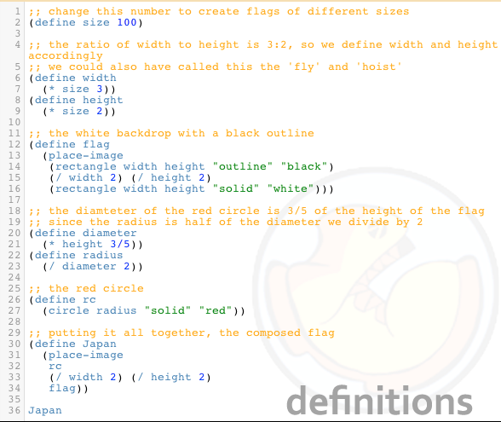
Flag of Japan Program

Slide 293
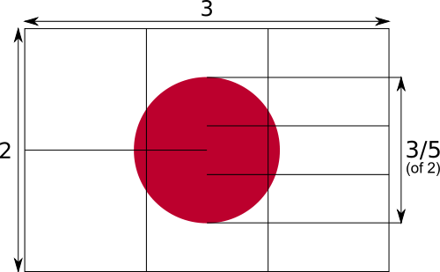
flag of japan
The width is 3 or a multiple of 3.
The height is 2 or a multiple of 2.
The diameter of the circle is three fifths of the height.

Slide 294
first we need to think about the pieces
The width is 3 or a multiple of 3.
The height is 2 or a multiple of 2.
The diameter of the circle is three fifths of the height.
A black outline
A white rectangle
A red circle

Slide 295
now we need to put it together
how does it fit together?
we place the circle onto the outline and place them both onto the white background

Slide 296
but this is a program.
Go to Japan Flag Good to see an example of program.

Slide 297
Mr. Allatta's U.S. Flag Program
Go to http://www.wescheme.org/openEditor?publicId=tCt9uyrglj
Extension: Look for a better way to create the stars.

Slide 298
lets write some code for each piece
1
;The black outlined rectangle
(rectangle 300 200 "outline" "black")
;The white solid rectangle
(rectangle 300 200 "solid" "white")
;The red solid circle
(circle 60 "solid" "red")
2
4
5
6
7

Slide 299
now that we know what to do, lets write the code
This place-image function is actually happening first.
(place-image
(circle 60 "solid" "red")
150 100
(place-image
(rectangle 300 200 "outline" "black")
150 100
(rectangle 300 200 "solid" "white")))
What is the type of value of this place-image function? An image.
This whole place-image function is the 4th parameter of the first place-image function.
What does the inside place-image function do?
What does the outside place-image function do?

Slide 300
add comments to help others understand your code
; a comment in Racket begins with a semi-colon.
; this place image-function place a red circle on a black outline, on a white background.
(place-image
(circle 60 "solid" "red")
150 100
(place-image
(rectangle 300 200 "outline" "black")
150 100
(rectangle 300 200 "solid" "white")))

Slide 301
make your own flag
write a program that displays a flag using two place-image functions. Plan your flag on the worksheet before you begin coding.

Slide 302

we want to create the following image
What do we need to know about it?
height, width, size, components

Slide 303
Objectives:
Knowledge:
What is program design? What might program design imply about the process we use.
Skills:
Reflect on your prior work in computer science. Consider the benefits of a design centered approach.

Slide 304
sqr-perim
# Header and Contract
fun sqr-perim(area :: Number) -> Number:
doc: “Consumes an area of a square and produces the perimeter”
where:
sqr-perim(4) is 8
sqr-perim(25) is 5 * 4
end
5
5
25
Notes:
Write more examples

Slide 305
sqr-perim
# Header and Contract
fun sqr-perim(area :: Number) -> Number:
doc: “Consumes an area of a square and produces the perimeter”
num-sqrt(area) * 4
where:
sqr-perim(4) is 8
sqr-perim(25) is 5 * 4
end
square root of area
square root of area
area
Notes:
Write more examples

Slide 306
sqr-perim
# Header and Contract
fun sqr-perim(area :: Number) -> Number:
doc: “Consumes an area of a square and produces the perimeter”
where:
sqr-perim(4) is 8
end
2
2
4
Notes:
Write examples

Slide 307
Step 1: Write contract and purpose statement
What is the Name of this function? How do you know?
How many inputs does it have in its Domain?
What kind of data is the Domain?
What is the Name given to this input?
What’s the Range of this function?
In your own words, what does this function do?
The Contract is a way of thinking about the function in a general way, without having to worry about exactly how it will work or how it will be used. Starting with simple questions such as these will make later steps mucheasier to think about.

Slide 308
Step 2: Give Examples
What happens to the function’s input?
Look at the two EXAMPLEs, written above.
What will happen if you type (double 5) into the interactions window? What about (double 7)?
What would happen if you changed the name of the input n to something else, such as x? What else would have to change?
Once we know a function’s contract, it becomes easy to write examples: we start by using the function with some input(s) ((double 5)), then writing in Racket code what we expect the computer to do with those inputs. (In this case, double will multiply the example input by 2.)
Now look at your two EXAMPLEs. What is the only thing that changes from one to the other?
In your workbook, circle what is changeable, or variable, between your two EXAMPLEs.
The only thing that changes is the Number being given to triple and multiplied by 3. Remember from Bootstrap 1 that once you’ve circled and labeled what changes in each example, it becomes incredibly easy to define the function! All you need to do is replace the thing that changes with its label!

Slide 309
Step 3: Define the function
Just as writing a Contract helps us write Examples, writing the Examples makes it easier to write the definition of a function. You will want to explicitly connect each step in the Design Recipe to every other step. Refer back to the Word Problem, justify each step of you Examples by referring back to the Word Problem and Contract, and finally to justify each step of the definition by referring to the Word Problem, Contract and Examples. The same variable name can be used in multiple functions, just as in math (where many functions use x as the variable name, for example)

Slide 310
double-width
Write a function called double-width, which takes in a height and a color. The function produces a solid rectangle, which is whatever height and color were passed in. Its width is twice the height.
Fill out the Contract for this function.
What is the function’s Name?
What is the function’s Domain?
What is the function’s Range?
Using the Contract you’ve written, write two Examples for the function.
What part of the Contract helps you fill in the left side of an Example?
What part of the Contract tells you what the function needs as input?
How can the Range of a function help you write the Example?
Looking at those two examples, circle the parts that are change-able, then label them with a good variable name.
Why is it helpful to choose a variable name before defining the function?
Now write the function definition, using the Examples you’ve written.

Slide 311
Write function body
# spot : String -> Image
# spot takes in a color and produces a solid circle, size 100 radius, with the color of String
import image as I
fun spot(color :: String) -> I.Image
I.circle(100, “solid”, color)
where:
spot(“blue”) is I.circle(100, “solid”, “blue”)
spot(“red”) is I.circle(100, “solid”, “red”)
end

Slide 312
Write examples
# spot : String -> Image
# spot takes in a color and produces a solid circle, size 100 radius, with the color of String
import image as I
fun spot(color :: String) -> I.Image
where:
spot(“blue”) is I.circle(100, “solid”, “blue”)
spot(“red”) is I.circle(100, “solid”, “red”)
end

Slide 313
Write function header
# spot : String -> Image
# spot takes in a color and produces a solid circle, size 100 radius, with the color of String
import image as I
fun spot(color :: String) -> I.Image
end

Slide 314
Design recipe for functions review
# spot : String -> Image
# spot takes in a color and produces a solid circle, size 100 radius, with the color of String

Slide 315
Step 1: Write contract and purpose statement
What is the Name of this function? How do you know?
How many inputs does it have in its Domain?
What kind of data is the Domain?
What is the Name given to this input?
What’s the Range of this function?
In your own words, what does this function do?
The Contract is a way of thinking about the function in a general way, without having to worry about exactly how it will work or how it will be used. Starting with simple questions such as these will make later steps mucheasier to think about.

Slide 316
Step 2: Give Examples
Step 2: Give Examples
What happens to the function’s input?
Look at the two EXAMPLEs, written above.
What will happen if you type (double 5) into the interactions window? What about (double 7)?
What would happen if you changed the name of the input n to something else, such as x? What else would have to change?
Once we know a function’s contract, it becomes easy to write examples: we start by using the function with some input(s) ((double 5)), then writing in Racket code what we expect the computer to do with those inputs. (In this case, double will multiply the example input by 2.)
Now look at your two EXAMPLEs. What is the only thing that changes from one to the other?
In your workbook, circle what is changeable, or variable, between your two EXAMPLEs.
The only thing that changes is the Number being given to triple and multiplied by 3. Remember from Bootstrap 1 that once you’ve circled and labeled what changes in each example, it becomes incredibly easy to define the function! All you need to do is replace the thing that changes with its label!

Slide 317
Step 3: Define the function
Now write the function header and body for triple. Don’t forget to replace the changing thing with a variable!
Just as writing a Contract helps us write Examples, writing the Examples makes it easier to write the definition of a function: circling what changes between the examples makes it obvious that the changeable thing is where we need to use a variable in our function. You will want to explicitly connect each step in the Design Recipe to every other step. Ask students to justify each part of their Contract by referring back to the Word Problem, to justify each step of their Examples by referring back to the Word Problem and Contract, and finally to justify each step of the definition by referring to the Word Problem, Contract and Examples. The same variable name can be used in multiple functions, just as in math (where many functions use x as the variable name, for example)
Try using the Design Recipe to solve the following word problems:
Write a function plus1, that takes in a number and adds one to it
Write a function mystery, that takes in a number and subtracts 4
Write a function red-spot, that takes in a number and draws a solid red circle, using the number as the radius

Slide 318
Lesson 01.01 - Function Design
How do we write examples that test all parts of the domain?

Slide 319
Step 1: Write contract and purpose statement
What is the Name of this function? How do you know?
How many inputs does it have in its Domain?
What kind of data is the Domain?
What is the Name given to this input?
What’s the Range of this function?
In your own words, what does this function do?
The Contract is a way of thinking about the function in a general way, without having to worry about exactly how it will work or how it will be used. Starting with simple questions such as these will make later steps mucheasier to think about.

Slide 320
Step 2: Give Examples
Step 2: Give Examples
What happens to the function’s input?
Look at the two EXAMPLEs, written above.
What will happen if you type (double 5) into the interactions window? What about (double 7)?
What would happen if you changed the name of the input n to something else, such as x? What else would have to change?
Once we know a function’s contract, it becomes easy to write examples: we start by using the function with some input(s) ((double 5)), then writing in Racket code what we expect the computer to do with those inputs. (In this case, double will multiply the example input by 2.)
Now look at your two EXAMPLEs. What is the only thing that changes from one to the other?
In your workbook, circle what is changeable, or variable, between your two EXAMPLEs.
The only thing that changes is the Number being given to triple and multiplied by 3. Remember from Bootstrap 1 that once you’ve circled and labeled what changes in each example, it becomes incredibly easy to define the function! All you need to do is replace the thing that changes with its label!

Slide 321
Step 3: Define the function
Now write the function header and body for triple. Don’t forget to replace the changing thing with a variable!
Just as writing a Contract helps us write Examples, writing the Examples makes it easier to write the definition of a function: circling what changes between the examples makes it obvious that the changeable thing is where we need to use a variable in our function. You will want to explicitly connect each step in the Design Recipe to every other step. Ask students to justify each part of their Contract by referring back to the Word Problem, to justify each step of their Examples by referring back to the Word Problem and Contract, and finally to justify each step of the definition by referring to the Word Problem, Contract and Examples. The same variable name can be used in multiple functions, just as in math (where many functions use x as the variable name, for example)
Try using the Design Recipe to solve the following word problems:
Write a function plus1, that takes in a number and adds one to it
Write a function mystery, that takes in a number and subtracts 4
Write a function red-spot, that takes in a number and draws a solid red circle, using the number as the radius

Slide 322
circle-diameter
Design a function called circle-diamter, which takes in a diameter, a mode (“solid” or “outline”) and a color and produces the appropriate circle.

Slide 323
counterchange
Design a function called counterchange, which takes in an two image and produces a four copies of that image in a two-by-two square. The copies are diagonal from each other.

Slide 324
abstraction
abstraction - generalizing patterns or removing detail to see the structure of a problem

Slide 325
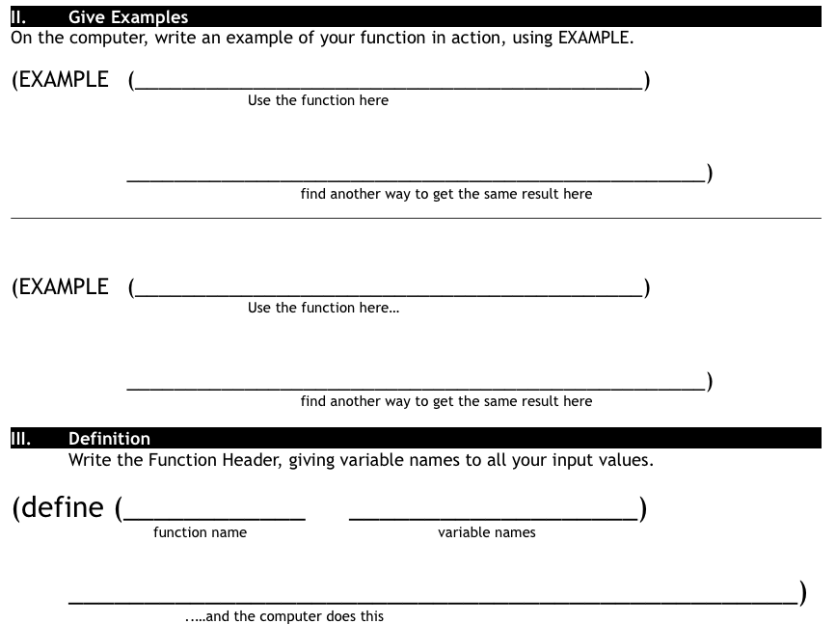
Finish the design recipe with two examples and a definition
Don't forget to circle your examples!

Slide 326
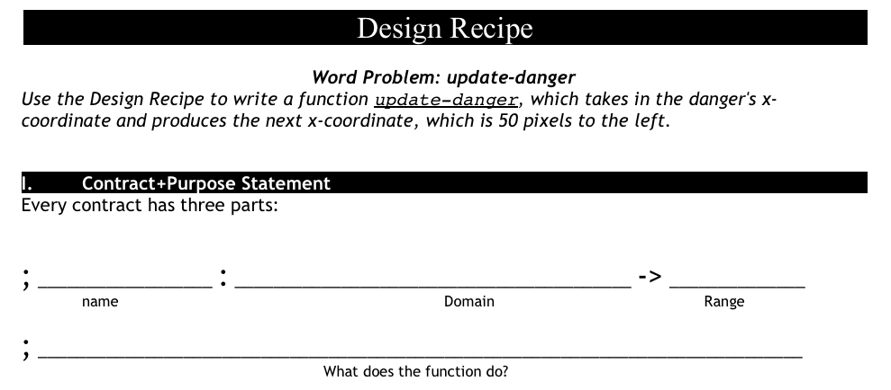
update-danger
what is the name of the function?
what are the inputs?
what are the outputs?

Slide 327
Rocket Height
Suppose we had a word problem that wanted to know how far the rocket traveled in 6 seconds: which one would we use?
What if we wanted to know how long it takes for the rocket to go a thousand miles?
What if I knew the train left at 1pm, and I wanted to know what time it arrives in Chicago, 800 miles away?
Would I want my time function, or my distance function?

Slide 328
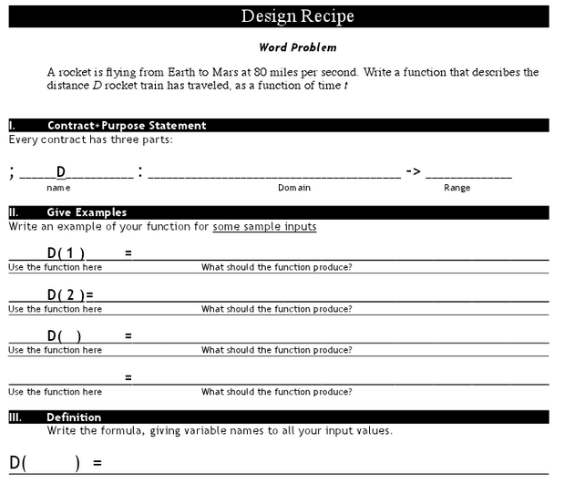
Distance

Slide 329
you also know how to define functions like this one
what is the name of this function?
(define (f x) (+ x 1))
How many variables does it take?
What is the name of that variable?
What does the function do to the variable x?
Notes:
tell me the name of this function?
How many variables does it take? What is the name of that variable?
What does the function do to the variable x?
Can you define a function g, which takes in a variable q and multiplies it by 20.

Slide 330
in algebra we define values using an equal sign
algebra
racket
and we can define values in terms of other values
x = 4
(define x 4)
y = x + 10
(define y (+ x 10))

Slide 331
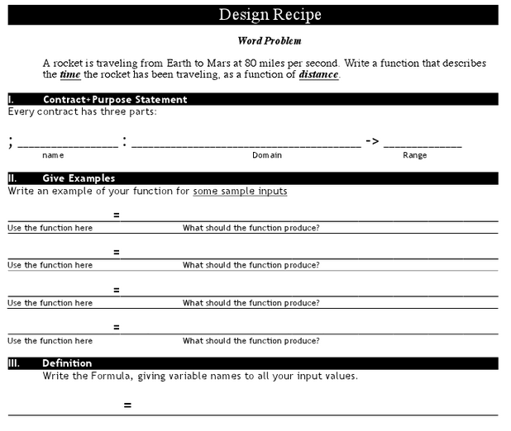

Slide 332
can you define a function g, which takes in a variable q and multiplies it by 20?
can you define a function h, which takes in a variable r and divides it by 2 then adds 5?
can you define a function f, which takes in a variable s and multiplies it by 1/3?
can you define a function g, which takes in a variable t and subtracts 13 from it?

Slide 333
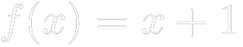
Review:
by replacing define with an equal sign
we can write
this is called functions notation.
it says the function "f of x" equals "x + 1"

Slide 334


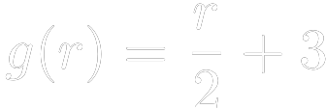

can you translate this algebra into code?
1)
2)
3)
4)

Slide 335
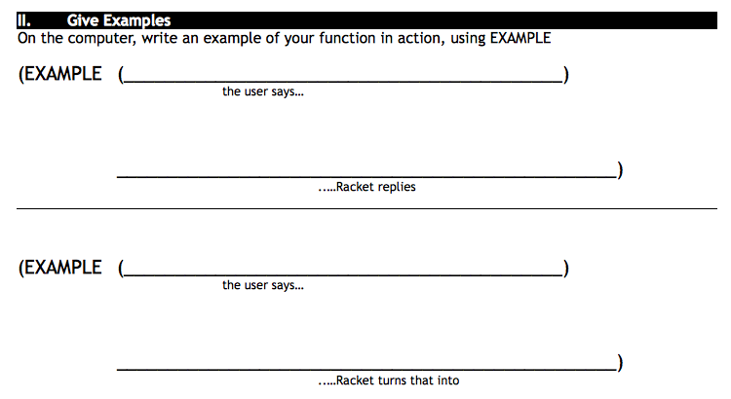
yard-area 50 60
(* 50 60)

Slide 336
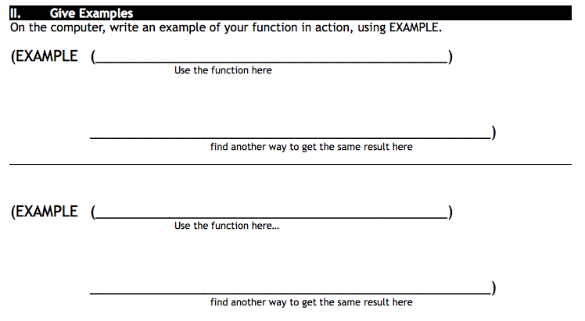

Slide 337
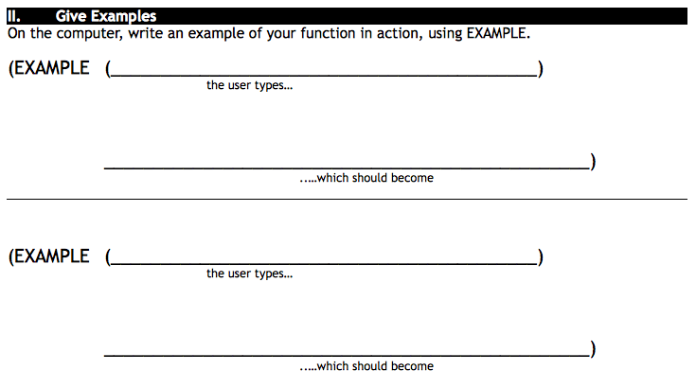
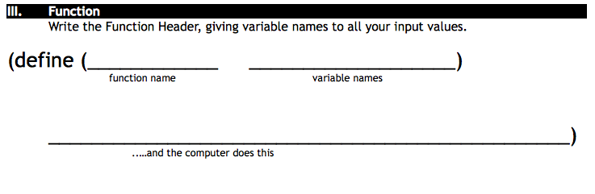

Slide 338
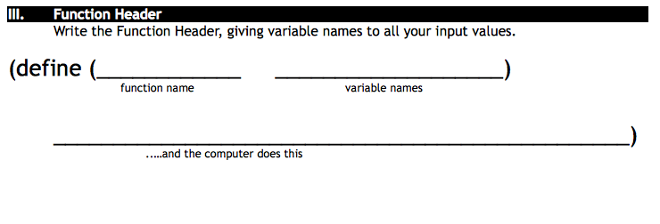

Slide 339
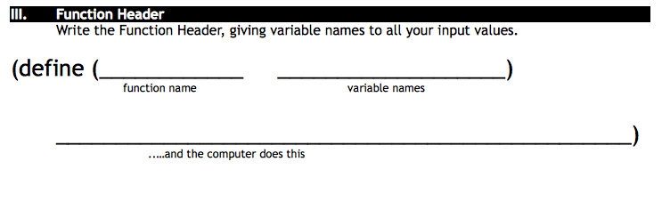

Slide 340
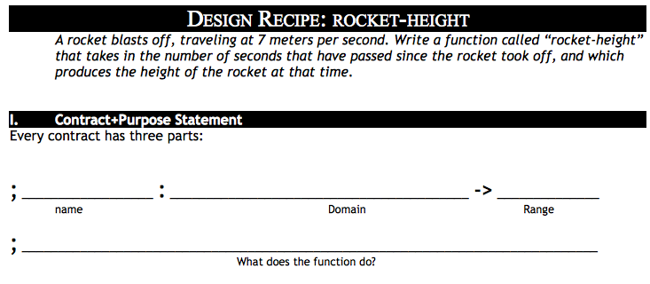

Slide 341
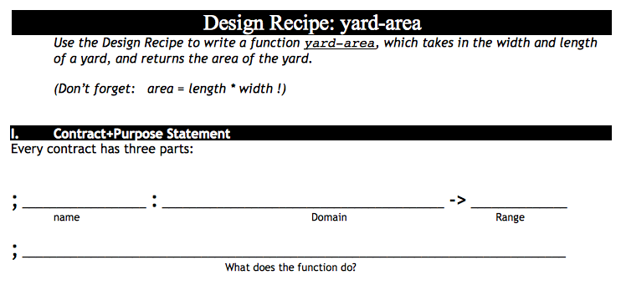
October 25th, 2012
B
Take out Lesson 4 Homework and your lesson 4 workbook
Write the contract for yard-area
Enter the contract into wescheme with your
A
Take out Lesson 4 Homework and your lesson 4 workbook
Write the contract for yard-area
Enter the contract into wescheme with your

Slide 342
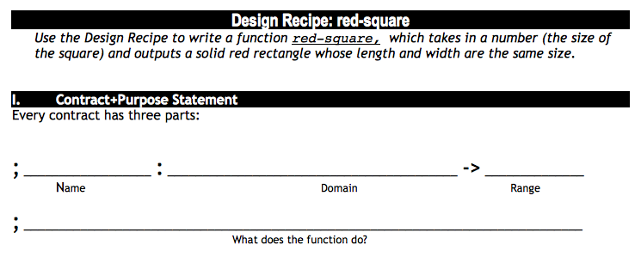

Slide 343
Tests show us how to define our functions.
A test is a way to do the same thing as our function using other functions that are already defined.
Complete the TESTS side of the worksheet.

Slide 344
let's finish this design recipe
the design recipe is a method to help us design our own functions
; double : number -> number
; takes in a number and multiplies it by 2
(check-expect (double ____) (* 20 2))
(check-expect (double 36) (* ____ ____))
(define (________ ________)
(* ________ ________))

Slide 345
Writing a test
Why do we need a test for our example?

Slide 346
Functions are like shortcuts
There is a long way to do things, but computer scientists are lazy!
Defining functions give us a shortcut for writing lots of code.

Slide 347
Defining Functions
Why do we want to write our own functions?

Slide 348
Writing examples
Look at both the contract and
purpose statement
Correct computer science type
Correct information
Complete the EXAMPLES side of the worksheet.

Slide 349
What do we need to write an example?
;rectangle: number string string -> image
If we had never seen rectangle would we be able to write an example for it? Why?

Slide 350
What is the big picture?
Design Recipe for defining functions.
Write a contract and purpose statement
Write an example and a test for that example
Look at what changed between the examples
Define the function using parameters

Slide 351
Writing Examples of Functions
What do we need to know to write an example of a function and a test from a contract and purpose statement?
Warm Up: Takes two minutes to answer the following question on your Warm Up slip:
What is the benefit of defining our own functions? Explain why you think this.

Slide 352
Double
Take a number and double it.

Slide 353
Design a functions called counterchange,
which takes in two images and produces a two by two quilt of images where the two images are facing each other on the top and bottom alternatively.

Slide 354
Design Recipe with Student Choice
How do we build confidence and feel successful with the design recipe?

Slide 355
Design a function called two-by-two,
which takes in an image and produces four copies of that image in a two-by-two square.

Slide 356
More Defining Functions
How do we define a function with multiple parameters?
Write the contract and purpose statement for red-circle.

Slide 357
Write two tests for double
(double 6)
"should be the same as"
(* 6 2)
(double 100)
"should be the same as"
(* 100 2)

Slide 358
Now write the function signature and body
(double 6)
"should be the same as"
(* 6 2)
(double 100)
"should be the same as"
(* 100 2)
(define (double number)
(* number 2))

Slide 359
Design Recipe for anything, version 0
Decide what you want to do.
Do it.
Check that you did it right.
Keep doing it.

Slide 360
Design Recipe for Functions, version 1
Write a function contract and purpose statement for the function you want to write.
Write several examples of how the function will be used, with their correct answers.
Look at what changed in your examples, that is where your parameters will go.
Write the head of the function definition.
Write the body of the function definition.

Slide 361
tests for bc
(bc 50)
"should be the same as"
(circle 50 "solid" "blue")
(bc 75)
"should be the same as"
(circle 75 "solid" "blue")

Slide 362
write a test for greenTri
(greenTri 50)
"should be a green triangle, side length 50"
(greenTri 75)
"should be a green triangle, side length 75"

Slide 363
Testing

Slide 364
circle what changes: this is where we will put our parameter
(double 6)
"should be the same as"
(* 6 2)
(double 100)
"should be the same as"
(* 100 2)

Slide 365
Blue Circle
Write a function that takes a number and returns a blue circle.

Slide 366
gt: Write a function called greenTri that takes in a number and returns a solid green triangle with the size of the parameter.
function signature
(define (gt size)
(triangle size "solid" "green"))
function body

Slide 367
Green Triangle
Write a function called greenTri that takes in a number and returns a solid green triangle with the size of the parameter.
Write a function that takes a number and gives a green triangle.

Slide 368
Can We Solve This?
Write a function called mySquare that takes in a size and returns a solid blue rectangle whose height and width are that size.

Slide 369
Work on #2!
Write a function called cc that takes in a color and returns a solid size 30 circle with that color.

Slide 370
Three Parts of Function Definition
NAME - WHAT IT'S CALLED
PARAMETER(S) - WHAT GOES IN
BODY - WHAT IS RETURNED
(define (name param)
(body_expression param))

Slide 371
How Did We Solve This Problem?
Write a function called gt that takes in a size and returns a solid green triangle with that size.
(define (gt size)
(triangle size "solid" "green"))

Slide 372
gt
function header
(define (gt side)
(triangle gt "solid" "green"))
function body

Slide 373
Double
Take a number and double it.

Slide 374
Blue Circle
Write a function that takes a number and gives back a blue circle.

Slide 375
Green Triangle
Write a function that takes a number and gives a green triangle.

Slide 376
composition of functions: putting one function inside of another
Interpret the following line of code.
(* 5 (+ 3 2))
...and this one?
(rotate 45
(triangle 50 "solid" "green"))
How many parameters does rotate have? How do we answer this question?

Slide 377
functions
all operations are functions, so + is a function.
5+4
+ takes 5, 4 and adds them

Slide 378
Finish this design recipe.
; double: Number → Number
(EXAMPLE ( )(* 20 2))
(EXAMPLE) (double 36)( ))
(define ( )
)

Slide 379
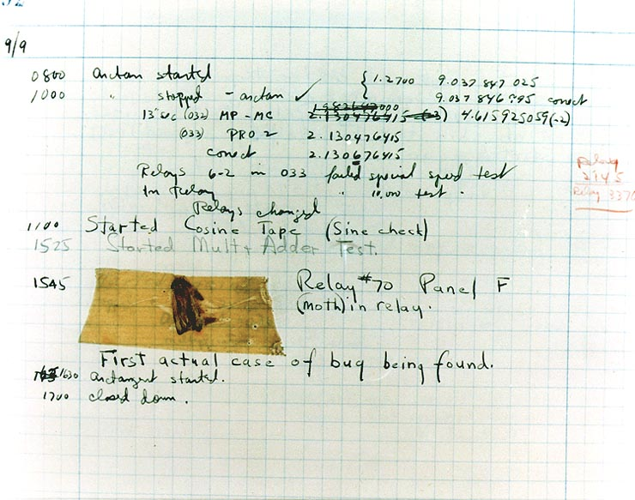
First actual case of bug being found.

Slide 380
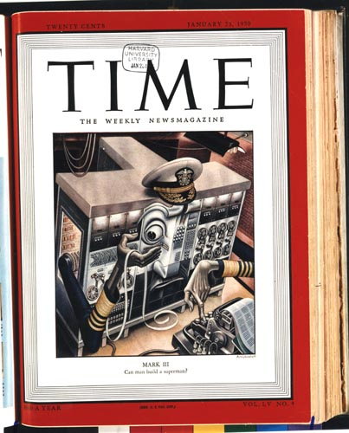
January, 1950
20¢
can man build a superman?

Slide 381
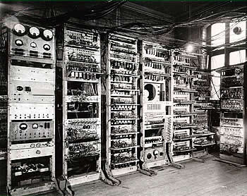
computers were once larger arrays of relay tubes--similar to light bulbs

Slide 382
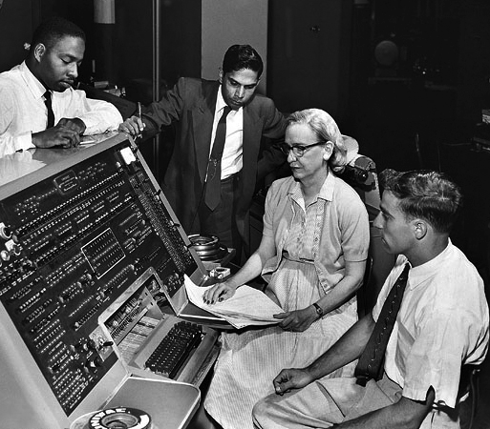
What is a bug?
Admiral Grace Hopper was one of the foremost computer scientists of her day

Slide 383
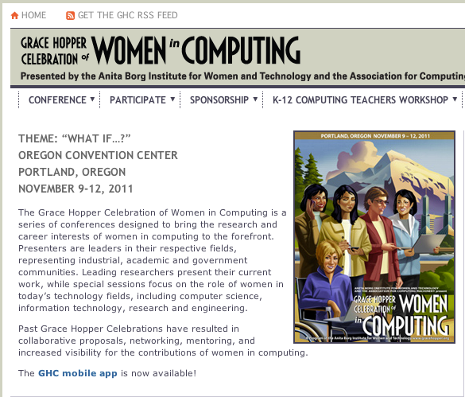
Grace Hopper Celebration of Women in Computing
Computer-scientists gather every year to honor Grace Hopper

Slide 384
World
What does the problem say about the world? What will change in our program?
Notes:
As for those aspects of the “world” that change, the problem statement mentions two. First, hitting the space bar adds a shot. Second, all the shots move straight up by one pixel per clock tick.

Slide 385
Data Representation of World
Do we know how many shots the player will “fire”?
What does this tell us about the data representation of world?

Slide 386
A List-of-shots
Since we don’t know how many shots the player will fire we use a list to represent them:
# A List-of-shots is one of:
# - empty
# - link(Shot, List-of-shots)
# interpretation: the collection of shots fired and moving straight up

Slide 387
Individual Shots
How do we represent individual shots?

Slide 388
Individual Shots
How do we represent individual shots?
# A Shot is a Number.
# interpretation the number represents the shot’s y coordinate
Notes:
The one remaining question is how to represent each individual shot. We already know that all of them have the same x coordinate and that this coordinate stays the same throughout. Furthermore, all shots look alike. Hence, their y coordinates are the only property in which they differ from each other. It therefore suffices to represent each shot as a number:
; A Shot is a Number.
; interpretation the number represents the shot's y coordinate

Slide 389
Putting this together
# A Shot-World is a List-of-Numbers.
# interpretation: each number represents the y coordinate of the shot
Notes:
After all, the above two definitions describe all list of numbers; we already have a definition for lists of numbers; and the name ShotWorld tells everyone what this class of data is about.

Slide 390
Event Handlers
Which events will we need to employ to solve the given problem?
Notes:
Once you have defined constants and developed a data representation for the states of the world, the key task is to pick which event handlers you wish to employ and to adapt their signatures to the given problem.

Slide 391
# :: Shot-World -> Image
# adds each y on w at (XSHOT, y) to the background image
fun to-image(w :: List<Number>) -> I.Image:
BACKGROUND
end
Notes:
the function that turns a world state into an image

Slide 392
# :: Shot-World -> Shot-World
# moves each shot up by one pixel
fun tock(w :: List<Number>) -> List<Number>:
w
end
Notes:
one for dealing with tick events

Slide 393
# :: Shot-World Key-Event -> Shot-World
# adds a shot to the world if the space bar was hit
fun key-press(w :: List<Number>, key :: String) -> List<Number>:
w
end
Notes:
one function for dealing with key events

Slide 394
The main function
# ShotWorld -> ShotWorld
fun main(w0):
W.big-bang(w0, [list:
W.on-tick(tock),
W.on-key(keypress),
W.to-draw(to-image)])
end
Notes:
We don’t need to design main(). It is standard form for all world programs.

Slide 395
Templates
# :: Shot-World -> Image
fun to-image(w :: List<Number>) -> I.Image:
cases (List) w:
| empty => …
| link(first, rest) =>
… first … to-image(rest)
end
end

Slide 396
to-image
first -> extracts the first y coordinate from the list
rest -> is the rest of the y coordinates
to-image(rest) -> adds each shot on w.rest to the background image
Notes:
From here it is straightforward to define the function. The key is to combine the examples with the template and to answer the questions from figure 39. Following those, you start with the base case of an empty list of shots and, from the examples, you know that the expected answer is BACKGROUND. Next you formulate what the template expressions in the second cond compute:
(first w) extracts the first coordinate from the list;
(rest w) is the rest of the coordinates; and
according to the purpose statement of the function, (to-image (rest w)) adds each shot on (rest w) to the background image.

Slide 397
to-image template
fun to-image(w :: List<Number>) -> I.Image:
cases (List) w:
| empty => …
| link(first, rest) =>
… first … to-image(rest)
end
end
Notes:
From here it is straightforward to define the function. The key is to combine the examples with the template and to answer the questions from figure 39. Following those, you start with the base case of an empty list of shots and, from the examples, you know that the expected answer is BACKGROUND. Next you formulate what the template expressions in the second cond compute:
(first w) extracts the first coordinate from the list;
(rest w) is the rest of the coordinates; and
according to the purpose statement of the function, (to-image (rest w)) adds each shot on (rest w) to the background image.

Slide 398
to-image(w.rest)
#renders the rest of the list as an image
place-image(SHOT,
XSHOT, w.first,
to-image(w.rest))
Notes:
In other words, (to-image (rest w)) renders the rest of the list as an image and thus does almost all the work. What is missing from this image is the first shot, (first w). If you now apply the purpose statement to these two expressions, you get the desired expression for the second cond clause:
(place-image SHOT XSHOTS (first w) (to-image (rest w)))

Slide 399
to-image(w.rest)
#renders the rest of the list as an image
I.place-image(SHOT,
XSHOT, w.first,
to-image(w.rest))
First image -> a constant that we defined at the beginning
Notes:
In other words, (to-image (rest w)) renders the rest of the list as an image and thus does almost all the work. What is missing from this image is the first shot, (first w). If you now apply the purpose statement to these two expressions, you get the desired expression for the second cond clause:
(place-image SHOT XSHOTS (first w) (to-image (rest w)))

Slide 400
to-image(w.rest)
#renders the rest of the list as an image
I.place-image(SHOT,
XSHOT, w.first,
to-image(w.rest))
X Coordinate of the first image -> a constant that we define at the beginning
Notes:
In other words, (to-image (rest w)) renders the rest of the list as an image and thus does almost all the work. What is missing from this image is the first shot, (first w). If you now apply the purpose statement to these two expressions, you get the desired expression for the second cond clause:
(place-image SHOT XSHOTS (first w) (to-image (rest w)))

Slide 401
to-image(w.rest)
#renders the rest of the list as an image
I.place-image(SHOT,
XSHOT, w.first,
to-image(w.rest))
The first y coordinate in the list used to place a SHOT image on the BACKGROUND
Notes:
In other words, (to-image (rest w)) renders the rest of the list as an image and thus does almost all the work. What is missing from this image is the first shot, (first w). If you now apply the purpose statement to these two expressions, you get the desired expression for the second cond clause:
(place-image SHOT XSHOTS (first w) (to-image (rest w)))

Slide 402
to-image(w.rest)
#renders the rest of the list as an image
I.place-image(SHOT,
XSHOT, w.first,
to-image(w.rest))
Adds each shot on w.rest to the background image. Basically as many nested place-image functions as their are items in the list.
Notes:
In other words, (to-image (rest w)) renders the rest of the list as an image and thus does almost all the work. What is missing from this image is the first shot, (first w). If you now apply the purpose statement to these two expressions, you get the desired expression for the second cond clause:
(place-image SHOT XSHOTS (first w) (to-image (rest w)))
The added icon is the standard image for a shot; the two coordinates are spelled out in the purpose statement; and the last argument to place-image is the image constructed from the rest of the list.

Slide 403
What about is-empty?
fun to-image(w :: List<Numbers>) -> I.Image:
ask:
| is-empty(w) then: …
| otherwise: … w.first … to-image(w.rest)
end
end
What should to-image(w.rest) produce when there are no more coordinates in the list?

Slide 404
What about keypress?
How should we structure the function keypress?

Slide 405
Your task
Add a template for tock to your program.
Follow the design recipe including examples to design the function for tock.
Finish fixing your program. You should have a program with shots that move when the space bar is pressed.

Slide 406
Challenges
After you get your program working:
If you run main, press the space bar (fire a shot), and wait for a good amount of time, the shot disappears from the canvas. When you shut down the world canvas, however, the result is a world that still contains this invisible shot.
Design an alternative tock function, which not just moves shots one pixel per clock tick but also eliminates those whose coordinates places them above the canvas. Hint: You may wish to consider the design of an auxiliary function for the recursive ask clause.
Remember extract-positives. How do we return a list with only some elements?

Slide 407
How do compilers and interpreters help develop programs?
A. They give the programmer access to specific functions designed for a specific purpose.
B. They make programs run faster.
C. They allow programmers to write programs without using machine code.

Slide 408
Constants vs. State
What changes and what stays the same?

Slide 409
Constants
import image as I
import world as W
# physical constants
HEIGHT = 300
WIDTH = 300
XSHOTS = WIDTH / 2
# graphical constants
BACKGROUND = I.empty-scene(WIDTH, HEIGHT)
SHOT = I.triangle(30, "solid", "red")

Slide 410
Constants
import image as I
import world as W
# physical constants
HEIGHT = 300
WIDTH = 300
XSHOTS = WIDTH / 2
# graphical constants
BACKGROUND = I.empty-scene(WIDTH, HEIGHT)
SHOT = I.triangle(30, "solid", "red")
What does XSHOTS represent?

Slide 411
2D Distance -> Pythagorean Theorem
In Pyret:
num-sqrt(num-sqr(A) + num-sqr(B))
To get C by itself, we take the square-root of the sum of the areas:
√(A²+B²) = C

Slide 412
Line-length
## line-length : number number -> number
## Finds 1D distance
fun line-length(num1 :: Number, num2 :: Number) -> Number:
ask:
| num1 > num2 then: num1 - num2
| num2 >= num1 then: num2 - num1
end
end

Slide 413
Distance
## distance : number number number number -> number
## Finds the 2D distance between two points
fun distance(x1 :: Number, y1 :: Number, x2 :: Number, y2 :: Number) -> Number:
num-sqrt(num-sqr(line-length(x1, x2)) + num-sqr(line-length(y1, y2)))
end

Slide 414
Collide
## collide : number number number number -> boolean
## determines whether two objects are within 50 pixels of each other
fun collide(x1, y1, x2, y2):
distance(x1, y1, x2, y2) < 80
end

Slide 415
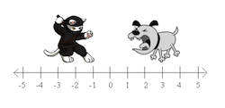
Distance along one axis -> 1D Distance
How far apart are the cat and the dog?

Slide 416
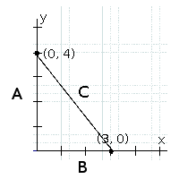
2D Distance -> Pythagorean Theorem
How could you find the length of line C?

Slide 417
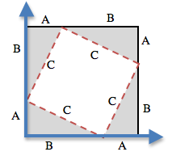
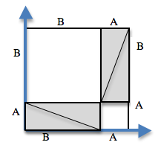
2D Distance -> Pythagorean Theorem
How could you find the length of line C?

Slide 418
2D Distance -> Pythagorean Theorem
How could you find the length of line C?
To get C by itself, we take the square-root of the sum of the areas:
√(A²+B²) = C

Slide 419
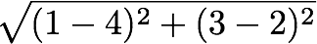
Convert the expression to circles of evaluation
The distance between the points (4, 2) and (1, 3) is given by:
sq
-
1 4

Slide 420
Collision Detection
line-length, distance, collide?

Slide 421
how to design programs?
There are two ways to go about solving this word problem:
(define (onscreen? x)
(and (> x -50) (< x 690)))
and...
(define (onscreen? x)
(and (safe-left? x) (safe-right? x)))
Notes:
Does it matter? Both will work just fine when you type them in...so why care?
There’s more to being a writer than putting down grammatically-correct sentences. There’s more to being an architect or an artist than building a bridge or coloring in a canvas. All of these disciples involved an element of design.
Likewise, there is more to being a Programmer than just writing code. You've gotten decent at writing code, and now you’re able to write sophisticated programs that include multiple functions - congratulations! But that also means you’re ready to consider what it means to design the code that you write.
The first solution puts all of the logic into one function: the left boundary and the right boundary are both tested by onscreen?. In the second solution, onscreen? uses both helper functions, each of which only tests one boundary at a time. Can you think of a reason why one might be better than another? Is it better to have a single, complex function that does all the work, or to have multiple simple functions that only do one thing apiece?
Suppose you just built a car, but it’s not working right. What would you do? Ideally, you’d like to test each part of the car (the engine, the transmission, etc) one at a time, to see which one was broken. The same is true for code! If you have a bug, it’s much easier to find when every function is simple and easy to test, and the only complex functions are just built out of simpler ones.
Another reason to like the second example is the fact that it lets programmers be lazy. Suppose you have a few characters in a videogame, all of which need to be kept on the screen. Some of them might only need safe-left?, others might only need safe-right?, and only a few might need onscreen?. What happens if the game suddenly needs to run on computers with differently-sized monitors, where the boundary is 1000 instead of 690? If you have simple and complex functions spread throughout your code, you’ll need to change them all. If your complex functions just use the simpler ones, you’d only need to change them in one place!
Badly designed programs can work just fine, but they are hard to read, hard to test, and easy to screw up if things change. As you grow and develop as a programmer, you’ll need to think beyond just "making code work". It’s not good enough if it just works - as artists, we should care about whether or not code is well designed, too.
This is what functions allow us to do! Everyone from programmers to mathematicians uses functions to carve up complex problems into simpler pieces, which make it possible to design elegant solutions to difficult problems.
So the next time you sit down to solve a problem, think about algebraic abstraction, and how you might design a beautiful solution out of simple functions, rather than a huge, complex one.

Slide 422
7 - Conditional Branching
partial functions

Slide 423
how to design programs?
There are two ways to go about solving this word problem:
(define (onscreen? x)
(and (> x -50) (< x 690)))
and...
(define (onscreen? x)
(and (safeleft? x) (saferight? x)))
Notes:
Does it matter? Both will work just fine when you type them in...so why care?
There’s more to being a writer than putting down grammatically-correct sentences. There’s more to being an architect or an artist than building a bridge or coloring in a canvas. All of these disciples involved an element of design.
Likewise, there is more to being a Programmer than just writing code. You've gotten decent at writing code, and now you’re able to write sophisticated programs that include multiple functions - congratulations! But that also means you’re ready to consider what it means to design the code that you write.
The first solution puts all of the logic into one function: the left boundary and the right boundary are both tested by onscreen?. In the second solution, onscreen? uses both helper functions, each of which only tests one boundary at a time. Can you think of a reason why one might be better than another? Is it better to have a single, complex function that does all the work, or to have multiple simple functions that only do one thing apiece?
Suppose you just built a car, but it’s not working right. What would you do? Ideally, you’d like to test each part of the car (the engine, the transmission, etc) one at a time, to see which one was broken. The same is true for code! If you have a bug, it’s much easier to find when every function is simple and easy to test, and the only complex functions are just built out of simpler ones.
Another reason to like the second example is the fact that it lets programmers be lazy. Suppose you have a few characters in a videogame, all of which need to be kept on the screen. Some of them might only need safe-left?, others might only need safe-right?, and only a few might need onscreen?. What happens if the game suddenly needs to run on computers with differently-sized monitors, where the boundary is 1000 instead of 690? If you have simple and complex functions spread throughout your code, you’ll need to change them all. If your complex functions just use the simpler ones, you’d only need to change them in one place!
Badly designed programs can work just fine, but they are hard to read, hard to test, and easy to screw up if things change. As you grow and develop as a programmer, you’ll need to think beyond just "making code work". It’s not good enough if it just works - as artists, we should care about whether or not code is well designed, too.
This is what functions allow us to do! Everyone from programmers to mathematicians uses functions to carve up complex problems into simpler pieces, which make it possible to design elegant solutions to difficult problems.
So the next time you sit down to solve a problem, think about algebraic abstraction, and how you might design a beautiful solution out of simple functions, rather than a huge, complex one.

Slide 424

estimate Sam's x coordinate
50
50
50
50
50
50
50
50
480
640

Slide 425
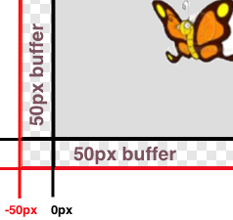
lesson 6
Sam is in a 640 x 480 yard. How far he can go to the left and right before he's out of sight?
Notes:
what data types do we know so far?
what are some functions that we know so far?
and we know how to define functions using functions in the computers language.
When Run is clicked, a window with a butterfly in it will pop up. You can use the arrow keys to move the butterfly around.
This butterfly is Sam - he’s a happy student like you! He likes to fly around outside and enjoy the fresh air.
His yard is 640 pixels wide and 480 pixels tall. If the bottom-left corner is (0, 0), what are the coordinates of the other corners?
Sam’s mom tells him that he should stay where she can see him - that means he can even step a little outside of the yard...as long as a piece of him is visible, his mom is okay.
Try moving him so he’s a little off the screen, but still safe. How far can he go?
Sometimes, however, Sam sneaks out of the box and just keeps going! He’s free! Free as a bird! (well, as a butterfly!) Look at his smile! He’s so happy to be free! Why shouldn’t he be?
Well...there’s some bad news.
Sam doesn’t realize that there’s a monster outside his yard, waiting to eat him! As long as ANY part of Sam is still in the yard, he is safe...but the moment he disappears completely his mom won’t be able to keep an eye on him!
It’s up to you to keep him safe!
Draw a 640x480 rectangle on the board to represent the screen, and have students help you identify the coordinates at the corners. Then turn students’ attention to the computers, and have them analyze the last function in the code, called onscreen?.
This file contains three function definitions. Can you find all three? What are the names of these functions?
(safe-left?, safe-right? and onscreen?)
Skit:
Have a volunteer stand up to be safe-left?. Ask them about their domain and range, and what they do according to the code (they always return true). Have students practice calling the function with sample values, then have another volunteer repeat the process as safe-right?. Finally, have a third volunteer do the same as onscreen?. Note that onscreen? must use safe-left? when evaluate an input!
The computer only talks to onscreen?, when deciding whether or not to let same keep moving. In turn, onscreen? will need to use both safe-left?and safe-right? to figure out if Sam is safe on both sides.
What are the Domain and Range of onscreen? What does the function do? What will happen when it’s given a sample input? (Answer: It calls the function ’safe-left?’ on the variable x)
We need to fix this code, to keep Sam safe. He can fly left or right and there is nothing to stop him from moving off the screen... yet!
How far can Sam go to the left before he disappears completely? (Answer: -50.) So he is onscreen as long as x is greater than -50!
Take some ideas from the class, then explain if necessary.
When the butterfly is drawn at some coordinate, it is centered at that coordinate. So if it’s drawn at 0, half of the butterfly is actually off the screen. We add the extra 50 pixels on all sides, because a piece of him is still visible as long as he is within 50 pixels of the screen’s edge.
Turn to Page 17. Take thirty seconds to fill out what we’ve discovered.
Turn to Page 18 and read the word problem for the safe-left function.
Who would like to act out safe-left? Take a volunteer.
Exercise:
According to the word problem, what’s your name? What’s your Domain? Your Range? Given Sam’s x-coordinate, and tell me if any part of him is still on the screen. Let’s try it out. "safe-left forty-five!" "safe-left three!" "safe-left negative sixty-one!" How did you know Sam was not protected at -61? because the number was not greater than -50!.
Complete the design recipe for safe-left.
Raise your hand after you complete each step.
When a team has completed the Design Recipe for safe-left, they must type in the examples and function body onto the computer.
So now we have a function that will tell us whether or not Sam is safe on the left side of the screen.
Click "Run", and try to move Sam off the left edge of the screen. Congrats! You’ve protected Sam on one side!
Unfortunately, Sam can still escape on the right hand side. We need a safe-right!
(act out with another volunteer, if necessary).
Turn to Page 19, and write another function called safe-right.
Call me over when you reach a stopping point!
Notice that even though we’ve fixed safe-right?, onscreen? won’t know about it until we change the body ofonscreen? so it calls safe-right? instead of safe-left?! Please make this change now, so that Same is safe on the right side instead of the left side.
Good job! Now we can keep Sam safe on the left side, or we can keep Sam safe on the right side. However, we don’t have a way to keep him safe on both sides! When we call onscreen? with an x-coordinate, what should it do?

Slide 426

fix safe-left? and safe-right?
enter your examples
fix your definitions

Slide 427
scale your player
; scale: number image -> image
; scale/xy: number number image -> image
how can you use the scale function to scale your player?

Slide 428
find your player
search images.google.com for animated gif images
find an image not blocked by the DOE
click the image, then click full-size image
copy and paste the URL of the image into your game file

Slide 429
getting your game just right
what is the contract for bitmap/url?
how do we scale an image?
can you do anything else to your images?

Slide 430
how to write examples for update-danger
Current x-coordinate | Racket Code | Next x-coordinate
50
75
30
(- 50 50)
0
(- 75 50)
25
(- 30 50)
-20
Notes:
Animation : Racket Code -> Next x-coordinate

Slide 431
Complete the Design Recipe for update-target
paper first then type
circle examples
ask questions
use your time well

Slide 432
What is the domain of update-danger?
Number
String Number
String
Image
Number Number
Notes:
Make wrong options fade out over time, then move on. At fade out add self-reflection questions not overtly addressed in the lecture.

Slide 433
Complete the Design Recipe for update-target
paper first then type
circle examples
ask questions
use your time well

Slide 434
update-danger
what is the name of the function?
what are the inputs?
what are the outputs?

Slide 435
how to write examples for update-danger
Current x-coordinate | Racket Code | Next x-coordinate
50
75
30
(- 50 50)
0
(- 75 50)
25
(- 30 50)
-20
Notes:
Animation : Racket Code -> Next x-coordinate

Slide 436
scale your player
; scale: number image -> image
; scale/xy: number number image -> image
how can you use the scale function to scale your player

Slide 437
find your player
search images.google.com for animated gif images
find an image not blocked by the DOE
click the image, then click full-size image
copy and paste the URL of the image into your game file

Slide 438
Complete the Design Recipe for update-target
paper first then type
circle examples
ask questions
use your time well

Slide 439
how to write examples for update-danger
Current x-coordinate | Racket Code | Next x-coordinate
50
75
30
(- 50 50)
0
(- 75 50)
25
(- 30 50)
-20
Notes:
Animation : Racket Code -> Next x-coordinate

Slide 440
What is the domain of update-danger?
Number
String Number
String
Image
Number Number
Notes:
Make wrong options fade out over time, then move on. At fade out add self-reflection questions not overtly addressed in the lecture.

Slide 441
Now you have a 90, don't just satisfy the requirements. Impress me.
Here are some suggestions:
Can you make your danger move slower? faster?
Can you make your target the move other way?
(just try, you can do it)
The promotion goes to the person who goes above and beyond.

Slide 442
(0,480)
(640,480)
D
(500,300)
480
P
T
(200,240)
(550,140)
(0,0)
640
(640,0)
Notes:
What are the coordinates of the corners?
Coordinates appear clockwise from origin on click
What is the Danger's x-coordinate? Its y-coordinate?
If it is moving to the left, what is changing: the x or y coordinate? Collect data: one finger for x, two for y.
Suppose it moved to the right by 50 pixels. What are the new coordinates? (550,300)
I want my danger to always move left by 50 pixels, each time the screen is redrawn, so that it goes from (550, 300) to (500,300) to (450, 300), etc.
What if it starts at (100, 100)? Where will go next? What if it’s at (400, 600)? What if it’s off the screen, at (650, 50)? (Answer: (50, 100), (350, 600), (600,50))

Slide 443
Design Recipe: cost
Luigi’s Pizza has hired you as a programmer. They offer Pepperoni ($10.50), Cheese ($9.00), Chicken ($11.25) and Broccoli ($10.25). Write a function called cost which takes in the name of a topping and outputs the cost of a pizza with that topping.
Contract+Purpose Statement
Every contract has three parts:
; __________________ : _______________________________ -> ______________
name Domain Range
;____________________________________________________________________

Slide 444
Function Header
Write the Function Header, giving variable names to all your input values.
(define (____________ ___________________)
function name variable names
(cond
))
(string=? toppings “pepperoni”)

Slide 445
Design Recipe: update-player
Write a function called update-player, which takes in the player’s y-coordinate and the name of the key pressed, and returns the new y-coordinate.
Contract+Purpose Statement
Every contract has three parts:
; __________________ : _________________________ -> ____________________
name Domain Range
Give Examples
On the computer, write an example of your function for each key, using EXAMPLE.
(EXAMPLE (____________________________) ___________________________)
Use the function here What should the function produce?
(EXAMPLE (____________________________) ___________________________)
Use the function here What should the function produce?

Slide 446
Give Examples
On the computer, write an example of your function for each topping, using EXAMPLE.
(EXAMPLE (________________________) ___________________________)
Use the function here What should the function produce?
(EXAMPLE (_________________________) ___________________________)
Use the function here What should the function produce?
(EXAMPLE (__________________________) ___________________________)
Use the function here What should the function produce?
(EXAMPLE (_________________________) ___________________________)
Use the function here What should the function produce?

Slide 447
Defining variables
;Develop an expression to compute the distance of a point from the origin.
(define x 3)
(define y 4)
?
4
3

Slide 448
Reminder
In case you forgot, we find the length of the line using the Pythagorean theorem

Slide 449
Math in Racket
What functions will you need?

Slide 450
Math in Racket
What functions will you need?
+
sqr
sqrt

Slide 451
Using Variables
> x
3
> y
4
> (+ x 10)
13
> (* x y)
12

Slide 452
On your own
Develop the final expression

Slide 453
Roles
Message Writers/Receivers
Carriers
Routers

Slide 454
Routes
Router
Message
Message
Carriers
Carriers
Message
Message
Message
Message

Slide 455
Message Senders
Write a message describing your favorite food.
Number each word of your sentence.
Write each word on a separate note card.

Slide 456
Message Senders
Place each word of your message in a separate envelope.
On the outside of the envelope write the
Destination
Number of word
Total number of words

Slide 457
Carriers
Pick up message packets one at a time.
Carry the message packet to the router.
Take a message from the router to its destination.

Slide 458
Routers
Accept packets from carriers on the left.
Hand them to carriers on the right.

Slide 459
Message Receivers
Put the packets back in order using the address on the outside of the envelope.

Slide 460
IP Addresses use binary numbers

Slide 461

Binary

Slide 462
What is binary?

Slide 463
What is binary?
A way of representing numbers using only two digits: 1 and 0.

Slide 464

Roman Numerals
Tick Marks
Decimal Numbers
1 2 3 4 5 6 7 8 9 10 11

Slide 465
Why Use Binary?

Slide 466

Why Use Binary?
Alan Turing showed that any function can be described by adding and subtracting binary numbers.

Slide 467
Why Use Binary?
Computers are physical machines that store and process electricity.
In every part of the machine, electricity flows through or it doesn’t flow through.
We interpret the presence of electricity as 1 and the absence of electricity as 0.

Slide 468

Why Use Binary?
0
1
0
0
1
0
1
1
0
1
1
0
0
1
0
0
1
0
1
1
1

Slide 469





Why Use Binary?

Slide 470

Translating Binary to Decimal

Slide 471
Step 0: Make 8 Columns

Slide 472
Step 1: Make 4 Rows

Slide 473
Step 2: Powers of 2 in 2nd Row
2⁷ | 2⁶ | 2⁵ | 2⁴ | 2³ | 2² | 2¹ | 2⁰

Slide 474
Step 3: Value of Powers of 2 in 1st Row
2⁷ | 2⁶ | 2⁵ | 2⁴ | 2³ | 2² | 2¹ | 2⁰

Slide 475
Step 3: Value of Powers of 2 in 1st Row
128 | 64 | 32 | 16 | 8 | 4 | 2 | 1
2⁷ | 2⁶ | 2⁵ | 2⁴ | 2³ | 2² | 2¹ | 2⁰

Slide 476
Step 4: 0’s in 3rd Row
128 | 64 | 32 | 16 | 8 | 4 | 2 | 1
2⁷ | 2⁶ | 2⁵ | 2⁴ | 2³ | 2² | 2¹ | 2⁰
0 | 0 | 0 | 0 | 0 | 0 | 0 | 0

Slide 477

Step 5: Cut Columns in Last Row
128 | 64 | 32 | 16 | 8 | 4 | 2 | 1
2⁷ | 2⁶ | 2⁵ | 2⁴ | 2³ | 2² | 2¹ | 2⁰
0 | 0 | 0 | 0 | 0 | 0 | 0 | 0

Slide 478
Step 5: 1’s on Back of Bottom Row
128 | 64 | 32 | 16 | 8 | 4 | 2 | 1
2⁷ | 2⁶ | 2⁵ | 2⁴ | 2³ | 2² | 2¹ | 2⁰
0 | 0 | 0 | 0 | 0 | 0 | 0 | 0
1

Slide 479
Step 5: 1’s on Back of Bottom Row
128 | 64 | 32 | 16 | 8 | 4 | 2 | 1
2⁷ | 2⁶ | 2⁵ | 2⁴ | 2³ | 2² | 2¹ | 2⁰
0 | 0 | 0 | 0 | 0 | 0 | 0 | 0
1
1

Slide 480
Step 5: 1’s on Back of Bottom Row
128 | 64 | 32 | 16 | 8 | 4 | 2 | 1
2⁷ | 2⁶ | 2⁵ | 2⁴ | 2³ | 2² | 2¹ | 2⁰
0 | 0 | 0 | 0 | 0 | 0 | 0 | 0
1
1
1

Slide 481
Step 5: 1’s on Back of Bottom Row
128 | 64 | 32 | 16 | 8 | 4 | 2 | 1
2⁷ | 2⁶ | 2⁵ | 2⁴ | 2³ | 2² | 2¹ | 2⁰
0 | 0 | 0 | 0 | 0 | 0 | 0 | 0
1
1
1
1
1
1
1
1

Slide 482
How does this work?
128 | 64 | 32 | 16 | 8 | 4 | 2 | 1
2⁷ | 2⁶ | 2⁵ | 2⁴ | 2³ | 2² | 2¹ | 2⁰
0 | 0 | 0 | 0 | 0 | 0 | 0 | 0
1

Slide 483
Q0) Represent ten in binary.
128 | 64 | 32 | 16 | 8 | 4 | 2 | 1
2⁷ | 2⁶ | 2⁵ | 2⁴ | 2³ | 2² | 2¹ | 2⁰
0 | 0 | 0 | 0 | 0 | 0 | 0 | 0

Slide 484
Q0) 10 = ?
128 | 64 | 32 | 16 | 8 | 4 | 2 | 1
2⁷ | 2⁶ | 2⁵ | 2⁴ | 2³ | 2² | 2¹ | 2⁰
0 | 0 | 0 | 0 | 0 | 0 | 0 | 0

Slide 485
Q0) 10 = 8 + ?
128 | 64 | 32 | 16 | 8 | 4 | 2 | 1
2⁷ | 2⁶ | 2⁵ | 2⁴ | 2³ | 2² | 2¹ | 2⁰
0 | 0 | 0 | 0 | 0 | 0 | 0 | 0
1

Slide 486
Q0) 10 = 8 + 2
128 | 64 | 32 | 16 | 8 | 4 | 2 | 1
2⁷ | 2⁶ | 2⁵ | 2⁴ | 2³ | 2² | 2¹ | 2⁰
0 | 0 | 0 | 0 | 0 | 0 | 0 | 0
1
1

Slide 487
A0) Ten in binary is 1010!
128 | 64 | 32 | 16 | 8 | 4 | 2 | 1
2⁷ | 2⁶ | 2⁵ | 2⁴ | 2³ | 2² | 2¹ | 2⁰
0 | 0 | 0 | 0 | 0 | 0 | 0 | 0
1
1

Slide 488
Q1) Represent seventy one in binary.
128 | 64 | 32 | 16 | 8 | 4 | 2 | 1
2⁷ | 2⁶ | 2⁵ | 2⁴ | 2³ | 2² | 2¹ | 2⁰
0 | 0 | 0 | 0 | 0 | 0 | 0 | 0

Slide 489
Q1) 71 = ?
128 | 64 | 32 | 16 | 8 | 4 | 2 | 1
2⁷ | 2⁶ | 2⁵ | 2⁴ | 2³ | 2² | 2¹ | 2⁰
0 | 0 | 0 | 0 | 0 | 0 | 0 | 0

Slide 490
Q1) 71 = 64 + ?
128 | 64 | 32 | 16 | 8 | 4 | 2 | 1
2⁷ | 2⁶ | 2⁵ | 2⁴ | 2³ | 2² | 2¹ | 2⁰
0 | 0 | 0 | 0 | 0 | 0 | 0 | 0
1

Slide 491
Q1) 71 = 64 + 4 + ?
128 | 64 | 32 | 16 | 8 | 4 | 2 | 1
2⁷ | 2⁶ | 2⁵ | 2⁴ | 2³ | 2² | 2¹ | 2⁰
0 | 0 | 0 | 0 | 0 | 0 | 0 | 0
1
1

Slide 492
Q1) 71 = 64 + 4 + 2 + ?
128 | 64 | 32 | 16 | 8 | 4 | 2 | 1
2⁷ | 2⁶ | 2⁵ | 2⁴ | 2³ | 2² | 2¹ | 2⁰
0 | 0 | 0 | 0 | 0 | 0 | 0 | 0
1
1
1

Slide 493
Q1) 71 = 64 + 4 + 2 + 1
128 | 64 | 32 | 16 | 8 | 4 | 2 | 1
2⁷ | 2⁶ | 2⁵ | 2⁴ | 2³ | 2² | 2¹ | 2⁰
0 | 0 | 0 | 0 | 0 | 0 | 0 | 0
1
1
1
1

Slide 494
Q1) 71 = 64 + 4 + 2 + 1
128 | 64 | 32 | 16 | 8 | 4 | 2 | 1
2⁷ | 2⁶ | 2⁵ | 2⁴ | 2³ | 2² | 2¹ | 2⁰
0 | 0 | 0 | 0 | 0 | 0 | 0 | 0
1
1
1
1

Slide 495
A1) Seventy one in binary is 1000111
128 | 64 | 32 | 16 | 8 | 4 | 2 | 1
2⁷ | 2⁶ | 2⁵ | 2⁴ | 2³ | 2² | 2¹ | 2⁰
0 | 0 | 0 | 0 | 0 | 0 | 0 | 0
1
1
1
1

Slide 496
Q2) Represent 0b1010101 in decimal.
128 | 64 | 32 | 16 | 8 | 4 | 2 | 1
2⁷ | 2⁶ | 2⁵ | 2⁴ | 2³ | 2² | 2¹ | 2⁰
0 | 0 | 0 | 0 | 0 | 0 | 0 | 0

Slide 497
Q2) 0b1010101 = 64 + 16 + 4 + 1
128 | 64 | 32 | 16 | 8 | 4 | 2 | 1
2⁷ | 2⁶ | 2⁵ | 2⁴ | 2³ | 2² | 2¹ | 2⁰
0 | 0 | 0 | 0 | 0 | 0 | 0 | 0
1
1
1
1

Slide 498
A2) 0b1010101 = 85
128 | 64 | 32 | 16 | 8 | 4 | 2 | 1
2⁷ | 2⁶ | 2⁵ | 2⁴ | 2³ | 2² | 2¹ | 2⁰
0 | 0 | 0 | 0 | 0 | 0 | 0 | 0
1
1
1
1

Slide 499
Binary to Decimal Self Check
Q3) Represent 1 in binary.
Q4) Represent 15 in binary.
Q5) Represent 234 in binary.
Q6) Represent 0b1110 in decimal.
Q7) Represent 0b101 in decimal.
Q8) Represent 0b11 in decimal.
Q9) What is the largest decimal number that can be represented in binary with 8 bits?

Slide 500
Binary to Decimal Self Check
Q3) Represent 1 in binary…………….. 1
Q4) Represent 15 in binary………. 1111
Q5) Represent 234 in binary………11101010
Q6) Represent 0b1110 in decimal... 14
Q7) Represent 0b101 in decimal.... 5
Q8) Represent 0b11 in decimal..…. 3

Slide 501
What are we studying this week?
plor efrp hevgl

Slide 502
Substition Cypher Key
abcdefghijklmnopqrstuvwxyz
nopqrstuvwxyzabcdefghijklm

Slide 503
Explore Task Visual Artifact
Visual Artifact
Choose one of the potential beneficial or harmful effects of the innovation you described in your previous response and use a computer to create a visual artifact related to it.
The visual artifact must be a visualization, graphic, or movie that provides additional insight to explain, clarify, or depict the beneficial or harmful effect of the innovation you selected.
Provide a written summary to describe how the visual artifact you created illustrates the benefit or harm of the innovation. (50 words max)

Slide 504
What makes a good infographic?
After exploring examples of infographics brainstorm how we could visualize the benefits and harms of social media.

Slide 505
chart junk
“The interior decoration of graphics generates a lot of ink that does not tell the viewer anything new. The purpose of decoration varies — to make the graphic appear more scientific and precise, to enliven the display, to give the designer an opportunity to exercise artistic skills. Regardless of its cause, it is all non-data-ink or redundant data-ink, and it is often chartjunk.”
Edward Tufte

Slide 506
Reading Pyret documentation
ellipse :: (
width :: Number
height :: Number
mode :: String
color :: Color
)
Constructs an ellipse with the given width, height, mode and color. Corresponds to(ellipse ...) in HtDP.

Slide 507
Pyret is a professional language
There will some differences between Pyret and Racket. For example in Racket we were able to click run and see our results in the interactions window. In Pyret we have to type it into the interactions window.

Slide 508
Pyret builds on Racket
How is Pyret different from Racket?

Slide 509
Pyret use infix syntax.
What is the opposite of an infix programming language?

Slide 510
Pyret has a cloud based REPL
What is an REPL?

Slide 511
Programmers use style conventions
What are the conventions that are used in Pyret?

Slide 512
Defining constants
You should name constants in all-capital letters unless an external convention would dictate using some other capitalization for that particular name. For example,
MY-COUNT = 100
pi = 3.1416

Slide 513
Naming
camelCase
camel-case

Slide 514
Line Length
Try to keep the total length of your lines under 80 characters.

Slide 515
Test Blocks
Outside function definitions, use check blocks for testing:
check:
1 + 1 is 2
1 + 1 is-not 0
end

Slide 516
Documentation
pyret.org/docs

Slide 517
Sample Problem
Design a world program that simulates firing shots. Every time the “player” hits the space bar, the program adds a shot to the bottom of the canvas. These shots rise vertically at the rate of one pixel per tick.

Slide 518
List Data
data List:
| empty
| link(first :: Item, rest :: List)
end

Slide 519
List Predicates
List data lets us check whether something is a kind of list.
We can ask
is-empty
is-link

Slide 520
We can define our own data
A list is an item linked to a list.
data Listy:
| emptily
| linky(first :: String, rest :: Listy)
end
Notes:
Add a lesson turning Luigi’s pizza activity into structs and asking for different part of struct

Slide 521
Define your own list
Write a data definition for My-List, which is either my-empty or is a my-link(first, rest)

Slide 522
Define your own list
Write a data definition for My-List, which is either my-empty or is a my-link(first, rest)
data My-List:
| my-empty
| my-link(first, rest :: My-List)
end

Slide 523
Review
What types of data have we worked with so far?
numbers, strings, images, booleans

Slide 524
Review
What types of data have we worked with so far?
numbers, strings, images, booleans
worlds, students, sneakers, boas, tigers, dillos, sneakers
Atomic Data
Compound Data
Notes:
What do all of these types of data have in common?

Slide 525
Review
All the data we have worked with had an exact size.
numbers, strings, images, booleans
worlds, students, sneakers, boas, tigers, dillos, sneakers
Fixed Size Data

Slide 526
Functions with Fixed Size Data
We used a design recipe to write functions using fixed sized data. Now we’re going to learn to design functions using any size data!

Slide 527
Arbitrary Size Data
To represent data when we don’t know how many items there are.

Slide 528
Arbitrary Size Data
To represent data when we don’t know how many items there are.
Examples: contacts, playlists, online shopping carts, rapid fire projectiles

Slide 529
Arbitrary Size Data
Simplest arbitrary size data is a list

Slide 530
Arbitrary Size Data
Simplest arbitrary size data is a list
What is the most simple list?
Notes:
What is the most simple list?

Slide 531
Empty Lists
Simplest arbitrary size data is a list
The simplest list is empty
Notes:
Show empty in Pyret

Slide 532

Empty Lists
empty is a value that stands for a list with nothing in it
Notes:
What is the next most simple list?

Slide 533

Lists are links of data
How to create a list of Mr. Allatta’s favorite foods
Notes:
What is the next most simple list?

Slide 534

We can add as many things as we want
Let’s add one more
Notes:
What is the next most simple list?

Slide 535

We can add as many things as we want
Links of links of links!
Notes:
What is the next most simple list?

Slide 536

Getting items from a list
We can get the first item from the list
Notes:
What do you think this expression will return?

Slide 537
Getting items from a list
We can get the first item from the list
Notes:
What do you think this expression will return?

Slide 538

Getting items from a list
We can get the rest of the items from the list
Notes:
What do you think this expression will return?

Slide 539
Getting items from a list
We can get the rest of the items from the list
Notes:
What do you think this expression will return?

Slide 540
Lists and World Programs
How do we design a world programs that allows the player to fire as many shots as desired?

Slide 541
Step through sum
fun sum(lonums :: List<Number>) -> Number:
cases (List) lonums:
| empty => 0
| link(first, rest) => first + sum(rest)
end
end

Slide 542
Evaluate the following example
sum([list: 4, 3, 2])
fun sum(lonums :: List<Number>) -> Number:
cases (List) lonums:
| empty => 0
| link(first, rest) => first + sum(rest)
end
end

Slide 543
Evaluate the following examples
sum([list: 4, 3, 2])
4 + sum([list: 3, 2])
fun sum(lonums :: List<Number>) -> Number:
cases (List) lonums:
| empty => 0
| link(first, rest) => first + sum(rest)
end
end

Slide 544
Evaluate the following examples
sum([list: 4, 3, 2])
4 + sum([list: 3, 2])
4 + 3 + sum([list: 2])
fun sum(lonums :: List<Number>) -> Number:
cases (List) lonums:
| empty => 0
| link(first, rest) => first + sum(rest)
end
end

Slide 545
Evaluate the following examples
sum([list: 4, 3, 2])
4 + sum([list: 3, 2])
4 + 3 + sum([list: 2])
4 + 3 + 2 + sum([list: ])
fun sum(lonums :: List<Number>) -> Number:
cases (List) lonums:
| empty => 0
| link(first, rest) => first + sum(rest)
end
end

Slide 546
Evaluate the following examples
sum([list: 4, 3, 2])
4 + sum([list: 3, 2])
4 + 3 + sum([list: 2])
4 + 3 + 2 + sum([list: ])
4 + 3 + 2 + 0
fun sum(lonums :: List<Number>) -> Number:
cases (List) lonums:
| empty => 0
| link(first, rest) => first + sum(rest)
end
end

Slide 547
Evaluate the following examples
sum([list: 4, 3, 2])
4 + sum([list: 3, 2])
4 + 3 + sum([list: 2])
4 + 3 + 2 + sum([list: ])
4 + 3 + 2 + 0
4 + 3 + 2
4 + 5
9

Slide 548
Complete the Example Stepper

Slide 549
Count
Use the design recipe to define a function called count that takes in a list and returns the number of items in the list.

Slide 550
Average
With your partner write a function called average that takes in a list of numbers and returns the average of the list.
Use the design recipe and be sure to write EXAMPLES FIRST!

Slide 551
Pull apart conditional data
cases (Animal) an-animal:
| boa(length, eats) => ...
| dillo(l, d) => ...
| tiger(n, l) => ...
end
data Animal:
| boa(length :: Number, eats :: String)
| dillo(length :: Number, dead :: Boolean)
| tiger(name :: String, length :: Number
end

Slide 552
Pull apart conditional data
cases (Animal) an-animal:
| boa(length, eats) => ...
| dillo(l, d) => ...
| tiger(n, l) => ...
end
data Animal:
| boa(length :: Number, eats :: String)
| dillo(length :: Number, dead :: Boolean)
| tiger(name :: String, length :: Number
end

Slide 553
Review Compound Data
data Animal:
| boa(length :: Number, eats :: String)
| aramadillo(length :: Number, liveness:: Boolean)
| tiger(name :: String, length :: Number)
end

Slide 554

iTune
Write a data definition for an iTunesSong based on the screenshot below

Slide 555
iTunes
data iTunesSong:
| tunes(name, album, artist, category, time)
end

Slide 556

a boa is a boa(string, number, string)
data Boa:
| boa(name :: String, length :: Number, eats :: String)
end

Slide 557
a boa is a boa(string, number, string)
data Boa:
| boa(name :: String, length :: Number, eats :: String)
end
B1 = boa("Slinky", 30, "pets")
B2 = boa("Slim", 50, "homework")

Slide 558
data defintions also create functions
# boa : string number string -> boa
# aboa.name : boa -> string
# aboa.length : boa -> number
# aboa.eats: boa -> string
# is-boa: boa -> boolean

Slide 559
write 3 examples of boa-fit-cage
fun boa-fit-cage(aboa :: Boa, limit :: Number) -> Boolean:
doc: “consumes a boa and a limit and produces true if the boa will fit inside the cage, false if it will not”

Slide 560
data definitions also create functions
# boa : string number string -> boa
# aboa.name : boa -> string
# aboa.length : boa -> number
# aboa.eats: boa -> string
# is-boa: boa -> boolean

Slide 561
write 3 examples of boa-fit-cage
fun boa-fit-cage(aboa :: Boa, limit :: Number) -> Boolean:
doc: “consumes a boa and a limit and produces true if the boa will fit inside the cage, false if it will not”
fun boa-fit-cage(aboa :: Boa, limit :: Number) -> Boolean:
aboa.length <= limit
where:
boa-fit-cage(boa("Slinky", 30, "pets"), 10) is false
boa-fit-cage(boa("Slinky", 30, "pets"), 30) is true
boa-fit-cage(boa(“Slinky”, 30, “pets”), 55) is true
end

Slide 562
# a dillo is a dillo(number, boolean)
data Dillo:
| dillo(length :: Number, dead :: Boolean)
end
D1 = dillo(20, true)
D2 = dillo(5, false)

Slide 563
# hit-with-truck: dillo -> dillo
# return dead dillo one unit longer than given dillo
Define the rest of this function using the design recipe. Write a function header, examples, and a function body.

Slide 564
# hit-with-truck: dillo -> dillo
# return dead dillo one unit longer than given dillo
Define the rest of this function using the design recipe. Write a function header, examples, and a function body.

Slide 565
# a tiger is a tiger(string, number, product)
# a product is a product(string, string)
data Product:
| product(item :: String, company :: String)
end
# a tiger is a tiger(string, number, product)
data Tiger:
| tiger(name :: String, length :: Number, sells :: Product)
end

Slide 566
# a tiger is a tiger(string, number, product)
Design a function called sells-gas, which returns true if a given tiger sells gas

Slide 567
Structs practice 2 Party
# 01 Write a function called relocate, which takes in a party AND the location that it’s moving to, and makes a new party at that location. Go through each part of the design recipe: contract, examples, and definition.

Slide 568
Structs practice 2 Party
# 01 Write a function called relocate, which takes in a party AND the location that it’s moving to, and makes a new party at that location. Go through each part of the design recipe: contract, examples, and definition.

Slide 569
Structs practice 2 Party
# 00 Write a function called RSVP, which takes in a party and adds one to its number of guests.

Slide 570
Party
# a party is a (make-party String String Number)
data Party:
| party(location :: String, theme :: String, guests :: Number)
end
HALLOWEEN = party("school", "costume", 10)
SUMMER = party("beach", "luau", 7)
JULY-FOURTH = party("park", "barbecue", 12)

Slide 571
World
Writing programs means we are trying to solve a problem that we see in the world.

Slide 572
Data
Problems that we see in the world have their own data. We can define new types of data to solve any kind of problem.

Slide 573
Structs
Structs are the way we define new types of data. In Pyret they look like this:
data New-data-type:
| new-data-type(field-1, field-2, field-3)
end

Slide 574
data definition for an Auto
# an auto is an auto(String, Number, Number, String, Number)
data Auto:
| auto(model :: String, hp :: Number, rims :: Number, color :: String, value :: Number)
end
# define your cars here: model, horsepower, rims, color and price
CAR-1 = auto("M5", 480, 28, "black", 50000)
CAR-2 = auto("Prius", 160, 18, "blue", 20000)
CAR-3 = auto("taxi", 2, 20, "pink", 23)

Slide 575
Unit 00 - Lesson 01 - Objectives
Knowledge
Reading: List active reading strategies for college level CS textbooks and explain why they are useful
CS: Describe the rules Java follows when performing mathematical and casting operations on different numerical types
Skills
Reading: In a CS textbook match specific sections of text to example code; create a concept map; utilize a concept map to generate related questions; test related questions in code
CS: Evaluate expressions involving ints, doubles, casting, and basic mathematical operators ( +, -, *, / )

Slide 576
Unit 00 - Lesson 08 - Homework
Re-Read Textbook
Complete notes from Section 1.4
Study For Quiz
Quiz will be on lesson objectives
Course textbook might have question on the quiz!

Slide 578
Objectives
Knowledge:
How do we use predicates to understand documentation?
What is the difference between place-image and overlay/xy?
Skills:
Solve problems using place-image and overlay/xy.
Determine which functions are appropriate for which problems.

Slide 579
HW Problem: Count the pixels

Slide 580
Return a property
Moses question from yesterday

Slide 581
Images are like strings
data made up of other data

Slide 582
Satisfies predicate
(string? "happy")
#true

Slide 583


Slide 584
Documentation scavenger hunt
place-image and overlay/xy documentation

Slide 586
(fair difficulty time expectation ) -> fairness
difficulty: (and? (> 0) (< 5))
time: (and? (> 0) (< 5))
expectation: (and? (> 0) (< 5))

Slide 587
Objectives
Knowledge:
How do we use predicates to understand documentation?
What is the difference between place-image and overlay/xy?
Skills:
Solve problems using place-image and overlay/xy.
Determine which functions are appropriate for which problems.

Slide 588
;Constants
(require 2htdp/image)
(define RED
(rectangle 50 50
“solid” “blue”))
(define BLUE
(rectangle 75 75
“solid” “red”))

Slide 589
>(overlay/xy RED
0 0
BLUE)
(require 2htdp/image)
(define BLUE
(rectangle 50 50
“solid” “blue”))
(define RED
(rectangle 75 75
“solid” “red”))

Slide 590

>(overlay/xy RED
0 0
BLUE)
(require 2htdp/image)
(define BLUE
(rectangle 50 50
“solid” “blue”))
(define RED
(rectangle 75 75
“solid” “red”))

Slide 591
>(overlay/xy RED
25 0
BLUE)
(require 2htdp/image)
(define RED
(rectangle 50 50
“solid” “blue”))
(define BLUE
(rectangle 75 75
“solid” “red”))

Slide 592

>(overlay/xy RED
25 0
BLUE)
(require 2htdp/image)
(define BLUE
(rectangle 50 50
“solid” “blue”))
(define RED
(rectangle 75 75
“solid” “red”))

Slide 593
>(overlay/xy RED
0 25
BLUE)
(require 2htdp/image)
(define BLUE
(rectangle 50 50
“solid” “blue”))
(define RED
(rectangle 75 75
“solid” “red”))

Slide 594

>(overlay/xy RED
0 25
BLUE)
(require 2htdp/image)
(define BLUE
(rectangle 50 50
“solid” “blue”))
(define RED
(rectangle 75 75
“solid” “red”))

Slide 595
>(overlay/xy RED
25 25
BLUE)
(require 2htdp/image)
(define BLUE
(rectangle 50 50
“solid” “blue”))
(define RED
(rectangle 75 75
“solid” “red”))

Slide 596

>(overlay/xy RED
25 25
BLUE)
(require 2htdp/image)
(define BLUE
(rectangle 50 50
“solid” “blue”))
(define RED
(rectangle 75 75
“solid” “red”))

Slide 597
>(overlay/xy RED
50 0
BLUE)
(require 2htdp/image)
(define BLUE
(rectangle 50 50
“solid” “blue”))
(define RED
(rectangle 75 75
“solid” “red”))

Slide 598

>(overlay/xy RED
50 0
BLUE)
(require 2htdp/image)
(define BLUE
(rectangle 50 50
“solid” “blue”))
(define RED
(rectangle 75 75
“solid” “red”))

Slide 599
>(place-image RED
0 0
BLUE)
(require 2htdp/image)
(define BLUE
(rectangle 50 50
“solid” “blue”))
(define RED
(rectangle 75 75
“solid” “red”))

Slide 600
>(place-image RED
25 0
BLUE)
(require 2htdp/image)
(define BLUE
(rectangle 50 50
“solid” “blue”))
(define RED
(rectangle 75 75
“solid” “red”))

Slide 601
>(place-image RED
0 25
BLUE)
(require 2htdp/image)
(define BLUE
(rectangle 50 50
“solid” “blue”))
(define RED
(rectangle 75 75
“solid” “red”))

Slide 602
>(place-image RED
25 25
BLUE)
(require 2htdp/image)
(define BLUE
(rectangle 50 50
“solid” “blue”))
(define RED
(rectangle 75 75
“solid” “red”))

Slide 603
>(place-image RED
50 0
BLUE)
(require 2htdp/image)
(define BLUE
(rectangle 50 50
“solid” “blue”))
(define RED
(rectangle 75 75
“solid” “red”))

Slide 605
Do Now
(require 2htdp/image)
(define FRAME
(empty-scene 300 300))
(define BLUE-REC
(rectangle 200 100 “solid” “blue”))
(place-image BLUE-REC
FRAME)
?
?

Slide 606
Objective
Knowledge
What is the DRY principle?
How can arithmetic expressions aid in programming images?
Skills
Use image properties with arithmetic expressions to program images.

Slide 607
Which function?

Slide 608

What coordinates?
(define CAT )
(define BLUE
(rectangle 100 75
“solid” “blue”))
(overlay/xy CAT
BLUE)
Notes:
do we need the coordinates? what are the dimensions of cat?

Slide 609
What coordinates?
(define CAT )
(define BLUE
(rectangle 100 75
“solid” “blue”))
(overlay/xy CAT
BLUE)
(/ (image-width CAT) 2)
Notes:
do we need the coordinates? what are the dimensions of cat?

Slide 610
Vexillology
is the "scientific study of the history, symbolism and usage of flags or, by extension, any interest in flags in general".

Slide 611
Flag
canton
hoist
fly
staff

Slide 612

United States
Hoist (width) of flag 1.0
Fly (length) of flag 1.9:
Hoist (width) of Union 0.5385( 7/13):
Fly (length) of Union 0.76:
Diameter of star 0.0616:
Width of stripe 0.0769( 1/13):

Slide 613
Flag of USA specifications
Hoist (height) of the flag: A = 1.0
Fly (width) of the flag: B = 1.9

Slide 614
; make-color : Num Num Num (Num) -> color
(circle 50 “solid” “red”)
“is the same as”
(circle 50 “solid” (make-color 255 0 0))

Slide 615
Hex to Decimal
Old Glory Blue 0x3C3B6E
Old Glory Red 0xB22234

Slide 616
Hex to Decimal
Old Glory Blue 0x3C 3B 6E
3*16 + 12*1
60

Slide 617
Hex to Decimal
Old Glory Blue 0x3C 3B 6E
3*16 + 11*1
60 59

Slide 618
Hex to Decimal
Old Glory Blue 0x3C 3B 6E
6*16 + 14*1
60 59 110

Slide 620

Letter | Measure | Length
G | Width
A | Distance between the centre of the outer crescent and the seam of the white band | ¹⁄₂ G
B | Diameter of the outer circle of the crescent | ¹⁄₂ G
C | Distance between the centres of the inner and outer circles of the crescent | ¹⁄₁₆ G
D | Diameter of the inner circle of the crescent | ²⁄₅ G
E | Distance between the inner circle of the crescent and the circle around the star | ¹⁄₃ G
F | diameter of the circle around the star | ¹⁄₄ G
L | Length | 1 ¹⁄₂ G
M | Width of the white hem at the hoist | ¹⁄₃₀ L

Slide 621


Slide 623


Slide 625
; make-color : Num Num Num (Num) -> color
(circle 50 “solid” “red”)
“is the same as”
(circle 50 “solid” (make-color 255 0 0))

Slide 626
Hex to Decimal
Old Glory Blue 0x3C3B6E
Old Glory Red 0xB22234

Slide 627
Hex to Decimal
Old Glory Blue 0x3C 3B 6E
3*16 + 12*1
60

Slide 628
Hex to Decimal
Old Glory Blue 0x3C 3B 6E
3*16 + 11*1
60 59

Slide 629
Hex to Decimal
Old Glory Blue 0x3C 3B 6E
6*16 + 14*1
60 59 110

Slide 631
# | Students
1 | Platt, Tatis, Rivera,
2 | Rogers,
3 | Salazar, Rivera, Y.,
# | Students
4 | Rosario,
5 | Ascona, Vega, Jenkins, Rodriguez
5
4
3
2
1

Slide 632
computer login
Account -> yellow527
Password -> applepine333

Slide 633
Computer 1 | Esi
Computer 2 | Ashlyn
Computer 3 | Grace
Computer 4
Computer 5
Computer 6
Computer 7
Computer 8
Computer 9
Computer 10
Computer 11
Computer 12
Computer 13
Computer 14
Computer 15
Computer 16
Computer 17
Computer 18
Computer 19
Computer 20
Computer 21
Computer 22
Computer 23
Computer 24
Computer 25 | Andrew
Computer 26
Computer 27 | Tyler
Computer 28 | Tyran
Laptop 2
Laptop 3
Laptop 4

Slide 634
Objectives
Knowledge:
What is a String?
What is an index in a String?
Skills:
Given documentation for functions that can be called on a String, identify the parts including: name, parameters, return type.
Given documentation for String functions and a program that calls those functions, trace the code to predict the output of the program.

Slide 635
A string is...
A sequence of characters!

Slide 636
Examples of Strings!
(define school “AFSE”)
(define celeb “Justin Bieber”)
(define ipAddress “113.186.14.10”)
(define emoji “(╯°□°）╯︵ ┻━┻)”)

Slide 637
Indices & Length
(define name “Simon Petrikov”)

Slide 638
Indices & Length
(define name “Simon Petrikov”)
0 1 2 3 4 5 6 7 8 9 10 11 12 13
indices!

Slide 639
Indices & Length
(define name “Simon Petrikov”)
(define my-char (string-ith name 4))
my-char
0 1 2 3 4 5 6 7 8 9 10 11 12 13
indices!

Slide 640
Indices & Length
(define name “Simon Petrikov”)
(define name-letters (string-length name))
name-letters
14
length!

Slide 641
Indices & Length
(define name “Simon Petrikov”)
(define mid (/ (string-length name) 2))
(string-ith name mid)
(string-ith name (- mid 2))

Slide 642
Contenation
(define prefix “hello”)
(define suffix “world”)
(define HW (string-append prefix “a” suffix))
HW

Slide 643
(define name “Simon Petrikov”)
(define part (substring name 1 9))
part

Slide 644

String name = “Simon Petrikov”;
String part = name.substring(1, 9);
System.out.println(part);

Slide 645

(define name “Simon Petrikov”)
(define part (substring name 1 9))
part
0 1 2 3 4 5 6 7 8 9 10 11 12 13
beginIndex
endIndex

Slide 646
Practice
Add the following two lines to the definitions area:
Then use string primitives to create an expression that concatenates prefix and suffix and adds "_" between them. When you run this program, you will see "hello_world" in the interactions area.
(define prefix "hello")
(define suffix "world")

Slide 647
Documentation (memorize)
http://docs.racket-lang.org/ htdp-langs/
beginner.html

Slide 648
Review String operators you will need
string-append concatenates two or more given strings into one;
string-length consumes a string and produces a (natural) number;
string-ith consumes a string s together with a natural number i and then extracts the 1String located at the ith position (counting from 0);
number->string consumes a number and produces a string;
substring consumes a string and one or two numbers and produces a part of the string

Slide 650
Objectives

Slide 651
You are expected to solve this problem
Define the function cube-volume, which accepts the length of a side of an equilateral cube and computes its volume.

Slide 652
(= problem-solving question-asking)
#true

Slide 653
(= problem-solving question-asking)
#true
You have to ask the questions!

Slide 654
(= problem-solving question-asking)
#true
From now on you will be assessed on the questions you ask to solve problems, not the solutions themselves.

Slide 655
Brainstorm
What questions should we ask?
At your table discuss for 1 minute, prepare to share out.

Slide 656
The problem
What kind of answer do we expect?

Slide 657
The domain
What kind of information does the function expect?

Slide 658
The return
What information does the function give us back?

Slide 659
Examples
How would we know if we’re right?
What concrete examples would help us form the definition?

Slide 660
Contextual knowledge
What do we need to know about cubes?

Slide 661
Language Template
(define (cube-volume ...)
...)

Slide 662
Solutions - Putting your questions together
; cube-volume : Number -> Number
; takes in the length and produces the volume of the cube

Slide 663
Solutions - Putting your questions together
; cube-volume : Number -> Number
; takes in the length and produces the volume of the cube
; (define (cube-volume ...) ...)
(cube-volume 3)
“is the same as”
9
(cube-volume 5)
“is the same as”
(* (* 5 5) 5)
(cube-volume 10)
“is the same as”
(expt 10 3)

Slide 664
Solutions - Putting your questions together
; cube-volume : Number -> Number
; takes in the length and produces the volume of the cube
; (define (cube-volume ...)
; ...)
(cube-volume 3)
“is the same as”
9
(cube-volume 5)
“is the same as”
(* (* 5 5) 5)
(cube-volume 10)
“is the same as”
(expt 10 3)
; (define (cube-volume ...)
; ...)
(define (cube-volume length)
(* length length length))

Slide 665
Time to mix seats up again. After you find your seat, get started on today’s activity. We’ll review after 20 minutes. 00.04 will be collected at the end of the period.
# | Students
1 | Vega, Lopez, Salazar, Rogers, Rodriguez, Mensah
2 | Dualeh, Rivera, A., Ascona, Quinones, Campbell, Concha
3 | Razor, Rosario, Platt, Lugo, Hibri, Razat
# | Students
4 | Ferrara, Rivera, Y., Tatis, Mcallen, Negron, Dillard
5 | Jenkins, Ortiz, Francisco, Lee, Jackson, Graciela
5
4
3
2
1

Slide 666
Objectives
Knowledge:
What is the relationship between function definitions and function applications?
What questions guide us through the problem solving process?
Skills:
Use DrRacket’s stepper to explore function definitions and their applications.
Solve problems using a design process.

Slide 667
You are expected to solve this problem
Define the function cube-volume, which accepts the length of a side of an equilateral cube and computes its volume.

Slide 668
The problem
What kind of answer do we expect?

Slide 669
The domain
What kind of information does the function expect?

Slide 670
The return
What information does the function give us back?

Slide 671
Examples
How would we know if we’re right?
What concrete examples would help us form the definition?

Slide 672
Contextual knowledge
What do we need to know about cubes?

Slide 673
Language Template
(define (cube-volume ...)
...)

Slide 674
Solutions - Putting your questions together
; cube-volume : Number -> Number
; takes in the length and produces the volume of the cube

Slide 675
Solutions - Putting your questions together
; cube-volume : Number -> Number
; takes in the length and produces the volume of the cube
; (define (cube-volume ...) ...)
(cube-volume 3)
“is the same as”
9
(cube-volume 5)
“is the same as”
(* (* 5 5) 5)
(cube-volume 10)
“is the same as”
(expt 10 3)

Slide 676
Solutions - Putting your questions together
; cube-volume : Number -> Number
; takes in the length and produces the volume of the cube
; (define (cube-volume ...)
; ...)
(cube-volume 3)
“is the same as”
9
(cube-volume 5)
“is the same as”
(* (* 5 5) 5)
(cube-volume 10)
“is the same as”
(expt 10 3)
(define (cube-volume length)
(* (* length length) length))

Slide 677
bool-imply
Define the function bool-imply. It consumes two Boolean values, call them sunny and friday. The answer of the function is #true if sunny is false or friday is true.

Slide 678
Time to mix seats up again. After you find your seat, get started on today’s activity. We’ll review after 20 minutes. 01.04 will be collected at the end of the period.
# | Students
1 | Vega, Lopez, Salazar, Rogers, Rodriguez, Mensah
2 | Dualeh, Rivera, A., Ascona, Quinones, Campbell, Concha
3 | Razor, Rosario, Platt, Lugo, Hibri, Razat
# | Students
4 | Ferrara, Rivera, Y., Tatis, Mcallen, Negron, Dillard
5 | Jenkins, Ortiz, Francisco, Lee, Jackson, Graciela
5
4
3
2
1

Slide 679
Objectives
Knowledge:
What questions guide us through the problem solving process?
Skills:
Solve problems using a design process.

Slide 680
The domain
What kind of information does the function expect?

Slide 681
The return
What information does the function give us back?

Slide 682
Examples
How would we know if we’re right?
What concrete examples would help us form the definition?

Slide 683
Contextual knowledge
What do we need to know about cubes?

Slide 684
Language Template
(define (cube-volume ...)
...)

Slide 685
Solutions - Putting your questions together
; cube-volume : Number -> Number
; takes in the length and produces the volume of the cube

Slide 686
Solutions - Putting your questions together
; cube-volume : Number -> Number
; takes in the length and produces the volume of the cube
; (define (cube-volume ...) ...)
(cube-volume 3)
“is the same as”
9
(cube-volume 5)
“is the same as”
(* (* 5 5) 5)
(cube-volume 10)
“is the same as”
(expt 10 3)

Slide 687
Solutions - Putting your questions together
; cube-volume : Number -> Number
; takes in the length and produces the volume of the cube
; (define (cube-volume ...)
; ...)
(cube-volume 3)
“is the same as”
9
(cube-volume 5)
“is the same as”
(* (* 5 5) 5)
(define (cube-volume length)
(* (* length length) length))

Slide 688
bool-imply
Define the function bool-imply. It consumes two Boolean values, call them sunny and friday. The answer of the function is #true if sunny is false or friday is true.

Slide 690
Objectives
K1: What is an interactive program?
K2: What is program state?
S1: Describe the behavior of interactive programs.
S2: Express the relationship between event handlers and program state.

Slide 691
Warm Up Problems
Develop a function number->square that takes in a number and produces a red square with the number as the side length.
Develop a function place-dot-at which takes in a y-coordinate and places a red dot in the middle of a 100x100 empty-scene at the given y-coordinate.

Slide 693
Objectives (htdp.org 3.6 Designing World Programs)
Knowledge:
What are the parts of a big-bang expression?
Skills:
Write a simple big-bang expression to create an animation.

Slide 694

Define world constants

Slide 695

Render the world state as image

Slide 696

Update the world state to the next state

Slide 697

The main function launches the program

Slide 698
Warm Up
Design a car image that will be used in our animation.

Slide 699
Today’s Challenge
Design a program that moves a car across the world canvas, from left to right, at the rate of three pixels per clock tick.

Slide 701
Objectives
Knowledge:
Review the steps to design a function and a world program.
Skills:
Follow steps to design functions in the context of designing a world program.

Slide 702
Given the function signature and purpose statement, write 2 examples and their evaluations. The second example should use an expression that evaluates to the same result.
; add-two : Number-> Number ; adds 2 to a given number | ; string-delete : String Number -> String ; removes the 1String at the given index
Example 1 | Example 1
Example 2 | Example 2

Slide 703
Develop a function called profit that consumes the costs and revenue of a business and returns the companies profits. Profit is (revenue - costs).
Data: What data will represent the information in the problem?

Slide 704
Develop a function called profit that consumes the costs and revenue of a business and returns the companies profits. Profit is (revenue - costs).
Signature: Write the function signature as a well formatted comment in Racket.

Slide 705
Develop a function called profit that consumes the costs and revenue of a business and returns the companies profits. Profit is (revenue - costs).
Purpose Statement: Describe what the function will compute.

Slide 706
Develop a function called profit that consumes the costs and revenue of a business and returns the companies profits. Profit is (revenue - costs).
Stub or Template: Write the partially completed function definition.

Slide 707
Develop a function called profit that consumes the costs and revenue of a business and returns the companies profits. Profit is (revenue - costs).
Examples: Write at least 2 examples of the function being used and their evaluations. The second example should use an expression that will evaluate the result.

Slide 708
Develop a function called profit that consumes the costs and revenue of a business and returns the companies profits. Profit is (revenue - costs).
Definition: Write the complete definition of the function by abstracting your examples with formal parameters.

Slide 709
What are the steps to designing a function?

Slide 710
Define world constants

Slide 711
Render the world state as image

Slide 712
Update the world state to the next state

Slide 713
The main function launches the program

Slide 715
Opening activity - 20 minutes
Make a car move across the screen

Slide 716
Objectives
Knowledge:
How do we write tests in Racket?
How does example driven development assist the programmer is developing abstractions?
Skills:
Use check expect to turn examples into tests.
Use check-expect examples as the means of example driven program development.

Slide 717
Turning examples into tests
; render : Number -> Image
; consumes the current worldState and uses it to place the car on ; the background
;; EXAMPLES
(render 50) “is the same as”
(place-image CAR 50 Y-POSITION BACKGROUND)
(render 100)
“is the same as”
(place-image CAR 100 Y-POSITION BACKGROUND)

Slide 718
Turning examples into tests
; render : Number -> Image
; consumes the current worldState and uses it to place the car on ; the background
;;EXAMPLES
(render 50) “is the same as”
(place-image CAR 50 Y-POSITION BACKGROUND)
(render 100)
“is the same as”
(place-image CAR 100 Y-POSITION BACKGROUND)
CALL THE FUNCTION YOU ARE DESIGNING

Slide 719
Turning examples into tests
; render : Number -> Image
; consumes the current worldState and uses it to place the car on ; the background
;;EXAMPLES
(render 50) “is the same as”
(place-image CAR 50 Y-POSITION BACKGROUND)
(render 100)
“is the same as”
(place-image CAR 100 Y-POSITION BACKGROUND)
WRITE AN EXPRESSION THAT PRODUCES THE SAME RESULT

Slide 720
Turning examples into tests
; render : Number -> Image
; consumes the current worldState and uses it to place the car on ; the background
;;TESTS
(check-expect
(render 50) (place-image CAR 50 Y-POSITION BACKGROUND))
(check-expect
(render 100)
(place-image CAR 100 Y-POSITION BACKGROUND))
check-expect COMPARES THE FUNCTION CALL TO THE EXPECTED RESULT AND LETS YOU KNOW IF THERE ARE ANY PROBLEMS

Slide 722
Begin - 20 minutes
You have been given a program with no syntax errors that does not run properly.
Write check-expect expressions for each function to debug the program.
Look at the function signature and purpose statement when formulating your tests.

Slide 723
Objectives
Knowledge:
How do we use tests to find errors in a program?
Why do we use check-expect when writing tests?
Skills:
Write check-expect expressions for existing function definitions to determine the location of a logical error.

Slide 724
Make a car move challenges
Add a tree to the scenery as in:
(define TREE (underlay/xy (circle 10 "solid" "green") 9 15 (rectangle 2 20 "solid" "brown")))
Formulate examples for all function (except main) as check-expect tests.
Good programmers ensure that an image such as CAR can be enlarged or reduced via a single change to a constant definition.
When the program stops the car should be entirely off the edge of the screen.

Slide 726
Quiz - 20 minutes
You have been given a program with function stubs and no syntax errors that runs without errors but does not work.
Write check-expect expressions for each function to debug the program.
Look at the function signature and purpose statement when formulating your tests.
Finish the function definitions based on your tests.

Slide 727
Quiz Objectives
Knowledge:
How do we use tests to find errors in a program?
Why do we use check-expect when writing tests?
Skills:
Write check-expect expressions for existing function definitions to determine the location of a logical error.

Slide 728
Make a car move challenges
Add a tree to the scenery as in:
(define TREE (underlay/xy (circle 10 "solid" "green")
9 15
(rectangle 2 20 "solid" "brown")))
Formulate examples for all function (except main) as check-expect tests.
Good programmers ensure that an image such as CAR can be enlarged or reduced via a single change to a constant definition.
When the program stops the car should be entirely off the edge of the screen.

Slide 730
Warm Up
In your notebooks:
Design a function called next, which consumes a traffic-light-state and returns the next traffic light.

Slide 731
; next : String -> String
; consumes a traffic light state and returns the next light
(define (next traffic-light-state)
(cond
[(string=? "red" traffic-light-state) "green"]
[(string=? "green" traffic-light-state) "yellow"]
[(string=? "yellow" traffic-light-state) "red"]))

Slide 732
Objectives
Knowledge:
What is conditional branching?
When do we use cond and when do we use if?
Skills:
Solve word problems using cond expressions.
Use cond expressions to detect which key was pressed in a simulation.

Slide 733
0. data
; a pizza topping is a String
; a price is a Number

Slide 734
signature
; cost : String -> Number

Slide 735
2. purpose statement
; given a Topping, produce the cost of
; a pizza with that topping

Slide 736
3. Function Stub
(define (cost topping)
0)

Slide 737
4. Tests
(check-expect (cost "cheese") 9.00)
(check-expect (cost "pepperoni") 10.50)
(check-expect (cost "chicken") 11.25)
(check-expect (cost "broccoli") 10.25)
(check-expect (cost “anything”) 20.00)

Slide 738
5. definition
(define (cost topping)
(cond
[(string=? topping "cheese") 9.00]
[(string=? topping "pepperoni") 10.50]
[(string=? topping "chicken") 11.25]
[(string=? topping "broccoli") 10.25]
[else 100.00]))

Slide 739
Check possibilities that don’t work
(check-expect (cost "sausage") 20.00)

Slide 740
Evaluating cond
; cost : String -> Number
; given a Topping, produce the cost of a
; pizza with that topping
(define (cost topping)
(cond
[(string=? topping "cheese") 9.00]
[(string=? topping "pepperoni") 10.50]
[(string=? topping "chicken") 11.25]
[(string=? topping "broccoli") 10.25]
[else 20.00]))
(cost "sausage")

Slide 741
Evaluating cond
; cost : String -> Number
; given a Topping, produce the cost of a
; pizza with that topping
(define (cost topping)
(cond
[(string=? topping "cheese") 9.00]
[(string=? topping "pepperoni") 10.50]
[(string=? topping "chicken") 11.25]
[(string=? topping "broccoli") 10.25]
[else 20.00]))
(cost "sausage")
a cond clause has two parts

Slide 742
structure of cond
(cond
[ConditionExpression1 ResultExpression1]
[ConditionExpression2 ResultExpression2]
....
[ConditionExpressionN ResultExpressionN])

Slide 743
check-expect with pizza toppings
(check-expect (cost "cheese") 9.00)
(check-expect (cost "pepperoni") 10.50)
(check-expect (cost "chicken") 11.25)
(check-expect (cost "broccoli") 10.25)

Slide 745
Warm Up
In your notebooks:
Design a function called next, which consumes a traffic-light-state and returns the next traffic light.

Slide 746
Finish design problems, email a working program
1. Some states have different tax rates. New York is 8%, Pennsylvania is 3%, and Delaware is 0%. All other states are 5%. Write a function that takes in the price of an item and and returns how much the tax will be on the item.
2. You are putting together a list of flowers in your garden based on their color. You have red roses, purple tulips, and yellow daisies. Write a function that takes in the color of a flower and returns the name of the flower.
3. The grocery store charges $2/pound for a turkey for the first 5 pounds, and then $1/pound for every pound after that. Write a function that takes in the weight of a turkey and returns how much it will cost.
4. Write a function which takes an image and a string, representing whether to produce a “bigger” or “smaller” image. The function should return an image half as big if the string is “smaller” and an image twice as big if the string is “bigger”.

Slide 747
enhancing keypress
;; keypress ;;
; Number String -> Number
; consumes the current world state and a key and
; produces the next world state. If “r” is
; pressed reset to the 0, otherwise do nothing.

Slide 748
look at the big-bang expression
(define (main ws)
(big-bang ws
[on-tick tock]
[to-draw render]
[on-key keypress]
[stop-when end?]))

Slide 749
; next : String -> String
; consumes a traffic light state and returns the next light
(define (next traffic-light-state)
(cond
[(string=? "red" traffic-light-state) "green"]
[(string=? "green" traffic-light-state) "yellow"]
[(string=? "yellow" traffic-light-state) "red"]))

Slide 750
Objectives
Knowledge:
What is conditional branching?
When do we use cond and when do we use if?
Skills:
Solve word problems using cond expressions.
Use cond expressions to detect which key was pressed in a simulation.

Slide 751
0. data
; a pizza topping is a String
; a price is a Number

Slide 752
signature
; cost : String -> Number

Slide 753
2. purpose statement
; given a Topping, produce the cost of
; a pizza with that topping

Slide 754
3. Function Stub
(define (cost topping)
0)

Slide 755
4. Tests
(check-expect (cost "cheese") 9.00)
(check-expect (cost "pepperoni") 10.50)
(check-expect (cost "chicken") 11.25)
(check-expect (cost "broccoli") 10.25)
(check-expect (cost “anything”) 20.00)

Slide 756
5. definition
(define (cost topping)
(cond
[(string=? topping "cheese") 9.00]
[(string=? topping "pepperoni") 10.50]
[(string=? topping "chicken") 11.25]
[(string=? topping "broccoli") 10.25]
[else 100.00]))

Slide 757
Check possibilities that don’t work
(check-expect (cost "sausage") 20.00)

Slide 758
Evaluating cond
; cost : String -> Number
; given a Topping, produce the cost of a
; pizza with that topping
(define (cost topping)
(cond
[(string=? topping "cheese") 9.00]
[(string=? topping "pepperoni") 10.50]
[(string=? topping "chicken") 11.25]
[(string=? topping "broccoli") 10.25]
[else 20.00]))
(cost "sausage")

Slide 759
Evaluating cond
; cost : String -> Number
; given a Topping, produce the cost of a
; pizza with that topping
(define (cost topping)
(cond
[(string=? topping "cheese") 9.00]
[(string=? topping "pepperoni") 10.50]
[(string=? topping "chicken") 11.25]
[(string=? topping "broccoli") 10.25]
[else 20.00]))
(cost "sausage")
a cond clause has two parts

Slide 760
structure of cond
(cond
[ConditionExpression1 ResultExpression1]
[ConditionExpression2 ResultExpression2]
....
[ConditionExpressionN ResultExpressionN])

Slide 761
check-expect with pizza toppings
(check-expect (cost "cheese") 9.00)
(check-expect (cost "pepperoni") 10.50)
(check-expect (cost "chicken") 11.25)
(check-expect (cost "broccoli") 10.25)

Slide 763
Quiz 01.16 Function Design
Apprentice: Design a function called rocket-height, which takes in the current height of a rocket and produces the next height 3 pixels higher.
Practitioner: Design a function that takes in an index and a string and returns the 1String at the given index. Use the string-ith function in your definition.
Professional: Design a function that calculates the value of a new Metrocard. The function takes in the amount of money the customer wants to pay and returns the value of the card. There is a $1 fee for a new card. An 11% bonus is added when they spend $5.50 or higher

Slide 764

bounce
What will the program do?

Slide 765
keypress
Design a function that takes in a number and a string and returns a new world based on the key that is pressed. “r” should return 0, “m” should return the middle of the screen. Any other key should be ignored, i.e. just return the current state.

Slide 767
Warm Up - bounce
In your notebooks, describe what the program will do?

Slide 768
Objectives
Knowledge:
How do we iteratively develop complex programs?
Skills:
Follow a design process to create a program to land a UFO.

Slide 769
Warm Up - Evaluate each expression
(sign 10)
(sign -5)
(sign 0)
(define (sign x)
(cond
[(> x 0) 1]
[(= x 0) 0]
[(< x 0) -1]))

Slide 770
big-bang project
Design a program that simulates the descent of a UFO.
or any object of your choice. The object must start at the top of the screen and land on its feet.

Slide 773


Warm Up
Circle all of the values that are used repeatedly.

Slide 774
create-rocket-scene version 3 takes in height
But that isn't really what is happening

Slide 775
create-rocket-scene should really take in time because the clock is what produces the animation

Slide 776
Instead of giving time directly to create-rocket-scene we should pass the time to the distance function

Slide 777
Now the height of the rocket can be computed by a proper distance function and we can add gravity and initial velocity.

Slide 778

distance
In physics class you were given the following reference equation

Slide 779

distance changes with respect to time

Slide 780

distance as a function of time
Equations
are more clearly expressed as
functions

Slide 781
programs don’t need to abbreviate
(define (distance time)
(+ (* INITIAL-VELOCITY time)
(* 1/2 ACCELERATION (sqr time))))

Slide 782
programs don’t need to abbreviate
function name
parameter
(define (distance time)
(+ (* INITIAL-VELOCITY time)
(* 1/2 ACCELERATION (sqr time))))

Slide 783
programs don’t need to abbreviate
function body
(define (distance time)
(+ (* INITIAL-VELOCITY time)
(* 1/2 ACCELERATION (sqr time))))

Slide 784
programs don’t need to abbreviate
body expression
(define (distance time)
(+ (* INITIAL-VELOCITY time)
(* 1/2 ACCELERATION (sqr time))))

Slide 785
programs don’t need to abbreviate
body expression
(define (distance time)
(+ (* INITIAL-VELOCITY time)
(* 1/2 ACCELERATION (sqr time))))

Slide 786
programs don’t need to abbreviate
body expression
(define (distance time)
(+ (* INITIAL-VELOCITY time)
(* 1/2 ACCELERATION (sqr time))))

Slide 787
Agenda
Design a program to land a UFO on the ground.
Novice - A UFO should descend from the top of the scene to the bottom. It should land on its feet, dropping from the top of the scene to the bottom, and cannot go past the bottom of the scene. The size of the scene should be controlled by one value.
Apprentice - Refactor the definition of the function to use only one place-image expression in the body of the function.
Practitioner - Add a distance function to the program using the equations you have learned in physics class. The function should be defined as
d(t) = v_i*t + 1/2 * a * t^2. Call the function in the body of create-rocket-scene to control the descent of the rocket.
Professional - Add a status line that says "descending" when the UFO’s height is above one third of the height of the canvas. It switches to "closing in" below that. And finally, when the UFO has reached the bottom of the canvas, the status notifies the player that the UFO has "landed."

Slide 788
Pyret is a professional language
There will some differences between Pyret and Racket.
For example in Racket we were able to click run and see results in the interactions window.
In Pyret we have to type it into the interactions window.

Slide 789
Indentation
You should indent your code blocks using two spaces (not tabs).

Slide 790
Pyret builds on Racket
How is Pyret different from Racket?

Slide 791
Pyret use infix syntax.
What is the opposite of an infix programming language?

Slide 792
Infix vs prefix
2 + 2
(+ 2 2)
Infix is more familiar but harder for computers to interpret

Slide 793
Pyret has a cloud based REPL
What is an REPL?

Slide 794
Programmers use style conventions
What are the conventions that are used in Pyret?

Slide 795
Defining constants
You should name constants in all-capital letters unless an external convention would dictate using some other capitalization for that particular name. For example,
MY-COUNT = 100
pi = 3.1416

Slide 796
Naming
camelCase
camel-case

Slide 797
Line Length
Try to keep the total length of your lines under 80 characters.

Slide 798
Test Blocks
Outside function definitions, use check blocks for testing:
check:
1 + 1 is 2
1 + 1 is-not 0
end

Slide 799
Documentation
pyret.org/docs

Slide 800
Agenda
Go to code.pyret.org/editor
Connect Pyret to Google Drive
Find shared document - Introduction to Pyret
“Open with” Pyret
Lesson begins at 20 after

Slide 801

If you see this...
Click “Add Website”
Wait for me to come over to type password

Slide 802
Objective
Students will be able to...
Translate basic expressions between Racket and Pyret.
Follow design steps to write simple functions.

Slide 803
When you’re finished ... Create a Shoe!
Use the planning sheet to create a program for your favorite piece of footwear.
Plan it out before you implement.
Due Wednesday at the end of the period.

Slide 804
Lesson 02.00
Problem Solving with Pair Programming

Slide 805
Pair programming task 0
Bind the constant 5 to the variable A-NUMBER
Show that A-NUMBER is indeed 5 by evaluating A-NUMBER in the REPL

Slide 806
connect each argument to the diagram
#Example
EXAMPLE = I.place-image(
I.circle(50, 'solid', 'red'),
50, 50,
I.rectangle(100, 100, 'solid', 'blue'))

Slide 807
Slide keyboard
This is the cue to switch partners, but you shouldn’t have to move anything except the keyboard.

Slide 808
Pair programming task 1
Write an expression to display the following image.
Bind the expression to a constant and evaluate it in the REPL

Slide 809
Slide keyboard

Slide 810
Guidelines
Do not copy and paste any code!
If you do, you’re not thinking abstractly.
Use pyret.org/docs
and docs.racket-lang.org to learn more about the image functions you are using

Slide 811
# image 0

Slide 812
Slide keyboard

Slide 813
# image 1

Slide 814
Slide keyboard

Slide 815
# image 2

Slide 816
Slide keyboard

Slide 817
# image 3

Slide 818
Slide keyboard

Slide 819
# image 4

Slide 820
Slide keyboard

Slide 821
# image 5

Slide 822
Slide keyboard

Slide 823
# image 6

Slide 824
Slide keyboard

Slide 825
# image 7

Slide 826
Slide keyboard

Slide 827
# image 8
I LOVE CS!

Slide 828
Slide keyboard

Slide 829
# image 9
I LOVE CS!

Slide 830
Slide keyboard

Slide 831
# image 10
Create something cool. No, do not make these words into text. No seriously.

Slide 832
Do Now
Read the problem statement below:
Design a function named two-by-two which, given an image, produces four copies of the image in a two-by-two-square.
How many inputs will the function take in?
What types of data are they?
What would be an example of this function?

Slide 833
Design a function named two-by-two which, given an image, produces four copies of the image in a two-by-two-square.
# Signature and Purpose Statement:
# Examples:
# Definition:

Slide 834
Switch
Stand up give each other a hi five and switch seats.

Slide 835
Do Now
Read the problem statement below:
Design a function named two-by-two which, given an image, produces four copies of the image in a two-by-two-square.
What would be a good name for this function?
How many inputs will the function take in and what types of data are they?

Slide 836
Objectives
SWBAT use value definitions inside of check blocks to write examples.

Slide 837
Design a function named two-by-two which, given an image, produces four copies of the image in a two-by-two-square.
# Signature and Purpose Statement:
# Examples:
# Definition:

Slide 838
Switch
Stand up give each other a hi five and switch seats.

Slide 839
Do Now
Read the problem statement below:
Design a function named two-by-two which, given an image, produces four copies of the image in a two-by-two-square.
What would be a good name for this function?
How many inputs will the function take in and what types of data are they?

Slide 840
Agenda
15 min Review
15min Introducing Structures
15min Cakes
10 min Dot-Accessors
5 min Closing

Slide 841
Objectives
SWBAT use data structures to solve problems and access fields of data using dot accessors.

Slide 842
Write a function double-height, which takes in a number (the length of a rectangle) and produces a rectangle whose height is twice the given length.
# Signature and Purpose Statement:
# Examples:
# Definition:

Slide 843
Switch
Stand up give each other a hi five and switch seats.

Slide 844
Do Now
Read the problem statement below:
Write a function next-position, which takes in two numbers (an x and y coordinate) and returns a Coord, increasing the x-coordinate by 5 and decreasing the y-coordinate by 5.
What would be a good name for this function?
How many inputs will the function take in and what types of data are they?

Slide 845
Agenda
15 min Review
15min Introducing Structures
15min Cakes
10 min Dot-Accessors
5 min Closing

Slide 846
Objectives
SWBAT use data structures to solve problems and access fields of data using dot accessors.

Slide 847
Write a function double-height, which takes in a number (the length of a rectangle) and produces a rectangle whose height is twice the given length.
# Signature and Purpose Statement:
# Examples:
# Definition:

Slide 848
Switch
Stand up give each other a hi five and switch seats.

Slide 849
Do Now
CAKE1 = cake(“Strawberry”, “pink”, “Happy Birthday!”, 6, false)
Write another example of cake.
CAKE2 = ______________________________________
How do we get the flavor out of CAKE1?
How do we know if CAKE1 is an ice-cream cake?

Slide 851
Do Now
CAKE1 = cake(“Vanilla”, “white”, “Congrats!”, 3, true)
Write another example of a Cake.
# change-flavor: Cake String -> Cake
# consumes a cake and a flavor and produces a new cake with the given flavor
check:
Finish the examples of change flavor. Give the work to the computer!
change-flavor(CAKE1, “Chocolate”) is _________________________________
change-flavor(CAKE1, “Strawberry”) is _________________________________
end

Slide 853
Data Structure Definitions
# a Party is a location, theme, and number of guests
data Party:
| party(location :: String,
theme :: String,
guests :: Number)
end

Slide 854
Data Structure Definitions
# a Party is a location, theme, and number of guests
data Party:
| party(location :: String,
theme :: String,
guests :: Number)
end
define a new type of data

Slide 855
Data Structure Definitions
# a Party is a location, theme, and number of guests
data Party:
| party(location :: String,
theme :: String,
guests :: Number)
end
the name of the new data type

Slide 856
Data Structure Definitions
# a Party is a location, theme, and number of guests
data Party:
| party(location :: String,
theme :: String,
guests :: Number)
end
the name of the function that can produce this type of data

Slide 857
Data Structure Definitions
# a Party is a location, theme, and number of guests
data Party:
| party(location :: String,
theme :: String,
guests :: Number)
end
the names of parameters that make up the data

Slide 858
Data Structure Definitions
# a Party is a location, theme, and number of guests
data Party:
| party(location :: String,
theme :: String,
guests :: Number)
end
the types of data of the individual parameters

Slide 860
Data Structure Definitions
# a Party is a location, theme, and number of guests
data Party:
| party(location :: String,
theme :: String,
guests :: Number)
end

Slide 861
Data Structure Definitions
# a Party is a location, theme, and number of guests
data Party:
| party(location :: String,
theme :: String,
guests :: Number)
end
define a new type of data

Slide 862
Data Structure Definitions
# a Party is a location, theme, and number of guests
data Party:
| party(location :: String,
theme :: String,
guests :: Number)
end
the name of the new data type

Slide 863
Data Structure Definitions
# a Party is a location, theme, and number of guests
data Party:
| party(location :: String,
theme :: String,
guests :: Number)
end
the name of the function that can produce this type of data

Slide 864
Data Structure Definitions
# a Party is a location, theme, and number of guests
data Party:
| party(location :: String,
theme :: String,
guests :: Number)
end
the names of parameters that make up the data

Slide 865
Data Structure Definitions
# a Party is a location, theme, and number of guests
data Party:
| party(location :: String,
theme :: String,
guests :: Number)
end
the types of data of the individual parameters

Slide 866


Slide 867


Slide 868


Slide 869


Slide 870


Slide 871


Slide 872


Slide 873


Slide 874


Slide 876
How far apart?

Slide 877
How far apart?

Slide 879
Unit 4 Lesson 0 - Introduction to Compound Data
Do now
How many fields make up email data?
For example a subject is a field.
Notes:
In examples like this, we see the need for structured data: a single datum actually consists of many pieces. The number of pieces is fixed, but may be of different kinds (some might be numbers, some strings, some images, and different types may be mixed together in that one datum). Some might even be other structured data: for instance, a date usually has at least three parts, the day, month, and year. The parts of a structured datum are called itsfields.

Slide 880
Unit 4 Lesson 0 - Introduction to Compound Data
How many fields make up a song in iTunes?
For example a title is a field.
Notes:
In examples like this, we see the need for structured data: a single datum actually consists of many pieces. The number of pieces is fixed, but may be of different kinds (some might be numbers, some strings, some images, and different types may be mixed together in that one datum). Some might even be other structured data: for instance, a date usually has at least three parts, the day, month, and year. The parts of a structured datum are called itsfields.

Slide 881
a Boa
is a boa(string, number, string)
data Boa:
boa(name :: String,
length :: Number,
eats :: String)
end

Slide 882
a boa is a boa(string, number, string)
data Boa:
boa(name :: String, length :: Number, eats :: String)
end
B1 = boa("Slinky", 30, "pets")
B2 = boa("Slim", 50, "homework")

Slide 883
data definitions also create functions
data Boa:
boa(name :: String, length :: Number, eats :: String)
end
# Boa constructor function
# boa : String Number String -> Boa
B1 = boa("Slinky", 30, "pets")

Slide 884
data definitions also create functions
data Boa:
boa(name :: String, length :: Number, eats :: String)
end
# Boa accessor functions
# nameOfBoa.name : Boa -> String
# nameOfBoa.length : Boa -> Number
# nameOfBoa.eats : Boa -> String
B2 = boa("Slim", 50, "homework")
B2.name -> “Slim”
B2.length -> 50
B2.eats -> “homework”

Slide 885
data definitions also create functions
data Boa:
boa(name :: String, length :: Number, eats :: String)
end
# Boa predicate function
# is-boa: Data -> Boolean
B2 = boa("Slim", 50, "homework")
is-boa(B2) -> true

Slide 886
write 3 examples of boa-fit-cage
fun boa-fit-cage(aboa :: Boa, limit :: Number) -> Boolean:
doc: “consumes a boa and a limit and produces true if the boa will fit inside the cage, false if it will not”

Slide 887
write 3 examples of boa-fit-cage
fun boa-fit-cage(aboa :: Boa, limit :: Number) -> Boolean:
doc: “consumes a boa and a limit and produces true if the boa will fit inside the cage, false if it will not”
aboa.length <= limit
end
check:
boa-fit-cage(B2), 10) is false
boa-fit-cage(boa("Slinky", 30, "pets"), 30) is true
boa-fit-cage(boa(“Slinky”, 30, “pets”), 55) is true
end

Slide 888
# a dillo is a dillo(number, boolean)
data Armadillo:
| dillo(length :: Number, dead :: Boolean)
end
D1 = dillo(20, true)
D2 = dillo(5, false)

Slide 889
# hit-with-truck: dillo -> dillo
# return dead dillo one unit longer than given dillo
Define the rest of this function using the design recipe. Write a function header, examples, and a function body.

Slide 890
# hit-with-truck: dillo -> dillo
# return dead dillo one unit longer than given dillo
Define the rest of this function using the design recipe. Write a function header, examples, and a function body.

Slide 891
# a tiger is a tiger(string, number, product)
# a product is a product(string, string)
data Product:
| product(item :: String, company :: String)
end
# a tiger is a tiger(string, number, product)
data Tiger:
| tiger(name :: String, length :: Number, sells :: Product)
end

Slide 892
# a tiger is a tiger(string, number, product)
Design a function called sells-gas, which returns true if a given tiger sells gas

Slide 893
Notes:
There are times when we want to represent different kinds of data under a single, collective umbrella. Here are a few examples:
A traffic light can be in different states: red, yellow, or green.
Yes, in some countries there are different or more colors and color-combinations.
Collectively, they represent one thing: a new type called a traffic light state.
A zoo consists of many kinds of animals. Collectively, they represent one thing: a new type called an animal. Some condition determine which particular kind of animal a zookeeper might be dealing with.
A social network consists of different kinds of pages. Some pages represent individual humans, some places, some organizations, some might stand for activities, and so on. Collectively, they represent a new type: a social media page.
We call these “conditional” data because they represent an “or”: a traffic light is red or green or yellow; a social medium’s page is for a person or location or organization; and so on. Sometimes we care exactly which kind of thing we’re looking at: a driver behaves differently on different colors, and a zookeeper feeds each animal differently. At other times, we might not care: if we’re just counting how many traffic lights or on, how many animals are in the zoo, or how many pages are on a social network, the exact nature of it doesn’t matter. Therefore, there are times when we ignore the conditional and treat the datum as a member of the collective, and other times when we do care about the conditional and do different things depending on the individual datum. We will make all this concrete as we start to write programs.

Slide 894
Do Now:
data ITunesSong: song(name :: String,
singer :: String,
Year :: Number) end
lver = song("La Vie en Rose", "Édith Piaf", 1945)
so = song("Stressed Out", "twenty one pilots", 2015)
wnkkhs = song("Waqt Ne Kiya Kya Haseen Sitam",
"Geeta Dutt",
1959)
#What happens if we instead write this?
lver :: String = song("La Vie en Rose", "Édith Piaf", 1945)
#What error do we get? How about if instead we write these?
lver :: song = song("La Vie en Rose", "Édith Piaf", 1945)
lver :: 1 = song("La Vie en Rose", "Édith Piaf", 1945)

Slide 895
a Boa
is a boa(string, number, string)
data Boa:
boa(name :: String,
length :: Number,
eats :: String)
end

Slide 896
a boa is a boa(String, Number, String)
data Boa:
boa(name :: String, length :: Number, eats :: String)
end
B1 = boa("Slinky", 30, "pets")
B2 = boa("Slim", 50, "homework")

Slide 897
data definitions also create functions
data Boa:
boa(name :: String, length :: Number, eats :: String)
end
# Boa constructor function
# boa : String Number String -> Boa
B1 = boa("Slinky", 30, "pets")

Slide 898
data definitions also create functions
data Boa:
boa(name :: String, length :: Number, eats :: String)
end
# Boa accessor functions
# nameOfBoa.name : Boa -> String
# nameOfBoa.length : Boa -> Number
# nameOfBoa.eats : Boa -> String
B2 = boa("Slim", 50, "homework")
B2.name -> “Slim”
B2.length -> 50
B2.eats -> “homework”

Slide 899
data definitions also create functions
data Boa:
boa(name :: String, length :: Number, eats :: String)
end
# Boa predicate function
# is-boa: Data -> Boolean
B2 = boa("Slim", 50, "homework")
is-boa(B2) -> true

Slide 900
write 3 examples of boa-fit-cage
fun boa-fit-cage(aboa :: Boa, limit :: Number) -> Boolean:
doc: “consumes a boa and a limit and produces true if the boa will fit inside the cage, false if it will not”

Slide 901
write 3 examples of boa-fit-cage
fun boa-fit-cage(aboa :: Boa, limit :: Number) -> Boolean:
doc: “consumes a boa and a limit and produces true if the boa will fit inside the cage, false if it will not”
aboa.length <= limit
end
check:
boa-fit-cage(B2), 10) is false
boa-fit-cage(boa("Slinky", 30, "pets"), 30) is true
boa-fit-cage(boa(“Slinky”, 30, “pets”), 55) is true
end

Slide 902
# a dillo is a dillo(number, boolean)
data Armadillo:
| dillo(length :: Number, dead :: Boolean)
end
D1 = dillo(20, true)
D2 = dillo(5, false)

Slide 903
# hit-with-truck: dillo -> dillo
# return dead dillo one unit longer than given dillo
Define the rest of this function using the design recipe. Write a function header, examples, and a function body.

Slide 904
# hit-with-truck: dillo -> dillo
# return dead dillo one unit longer than given dillo
Define the rest of this function using the design recipe. Write a function header, examples, and a function body.

Slide 905
# a tiger is a tiger(string, number, product)
# a product is a product(string, string)
data Product:
| product(item :: String, company :: String)
end
# a tiger is a tiger(string, number, product)
data Tiger:
| tiger(name :: String, length :: Number, sells :: Product)
end

Slide 906
# a tiger is a tiger(string, number, product)
Design a function called sells-gas, which returns true if a given tiger sells gas

Slide 907
Data can combine other data
# a Product is a product(String, String)
data Product: product(item :: String,
company :: String)
end
# a Tiger is a tiger(String, Number, Product)
data Tiger: tiger(name :: String,
length :: Number,
sells :: Product)
end

Slide 908
Data can combine other data
# a Product is a product(String, String)
data Product: product(item :: String,
company :: String)
end
# a Tiger is a tiger(String, Number, Product)
data Tiger: tiger(name :: String,
length :: Number,
sells :: Product)
end
Constructor functions

Slide 909
Data can combine other data
# a Product is a product(String, String)
data Product: product(item :: String,
company :: String)
end
# a Tiger is a tiger(String, Number, Product)
data Tiger: tiger(name :: String,
length :: Number,
sells :: Product)
end
Fields,
parameters of constructor functions

Slide 911
Data can combine other data
# a Date is a date(Number, Number, Number)
data Date: date(year :: Number,
month :: Number,
day :: Number)
end
# an Email is an email(String, String, String, Date)
data Email: email(sender :: String,
subject :: String,
body :: String,
date :: Date)
end

Slide 912
Data can be conditional
A traffic light can be in different states: red, yellow, or green.
Collectively, they represent one thing: a new type called
a Traffic Light State.
A zoo consists of many kinds of animals.
Collectively, they represent one thing: a new type called
an Animal.
A social network consists of different kinds of pages.
Collectively, they represent a new type:
a Social Media Page.

Slide 913
Traffic Light State
data TLState:
| Red
| Yellow
| Green
end

Slide 914
Traffic Light State
data TLState:
| Red
| Yellow
| Green
end
A traffic light can be Red or Yellow or Green

Slide 915
Traffic Light State
data TLState:
| Red
| Yellow
| Green
end
The stick | is needed when you have different variants of the data.

Slide 916
Traffic Light State
data TLState:
| Red
| Yellow
| Green
end
Should we consider these variants to be functions or values or types?

Slide 917
Traffic Light State
data TLState:
| Red
| Yellow
| Green
end
Should we consider these variants to be functions or values or types?
Yes

Slide 918
Data can be conditional and structured
data Animal:
| boa(name :: String,
length :: Number,
eats :: String)
| tiger(name :: String,
length :: Number,
sells :: Product)
| dillo(length :: Number,
dead :: Boolean)
end

Slide 919
Due by end of period
There is a permissions problem with shared Pyret files. I sent you an email about it. Copy and paste your video game code into the file I shared with you.
Type your checks into the Pyret file I sent you for the 04.00 Formative Assignment. I will check your work in your Pyret file.

Slide 920
Tomorrow
I will give you 10 minutes at the end of class tomorrow to finish typing in your 04.00 assignment.
Tomorrow, the final type of data structure this year -- collective data.

Slide 922
Which category or categories of data?
A song in iTunes
A Twitter stream
The contacts on your phone
A photo album
A traffic light
The state of an elevator door
structured
conditional
collective

Slide 923
Learning Objectives
Today you will be able to
write test cases for self referential proceduresself referential procedures
evaluate self referential procedures with simple data
describe the evaluation of

Slide 924
5

Slide 925
What is it? What can you do with it?
“hello”

Slide 926
What is it? What can you do with it?
true

Slide 927
What can you do with it?
Email

Slide 928
Where we are
We need new forms of data to add advanced features to our games and write interesting programs like music databases and social networks.
We've looked at three categories of data: structured, conformal, and collective
In order to dive deeper into collective data we need to look at a new way of defining.

Slide 929
sum : Number -> Number
Adds all integers from number down to 0

Slide 930
sum : Number -> Number
Adds all integers from number down to 0
What test cases would help us evaluate the function?

Slide 931
sum : Number -> Number
Adds all integers from number down to 0
check:
sum(3) is 6
sum(2) is 3
sum(5) is 15
sum(1) is 1
end

Slide 932
sum : Number -> Number
Adds all integers from number down to 0
check:
sum(3) is 6
sum(2) is 3
sum(5) is 15
sum(1) is 1
end

Slide 933
sum : Number -> Number
Adds all integers from number down to 0
sum(3) is 3 + 2 + 1

Slide 934
sum : Number -> Number
Adds all integers from number down to 0
sum(3) is 3 + 2 + 1
sum(2) is 2 + 1

Slide 935
sum : Number -> Number
Adds all integers from number down to 0
sum(3) is 3 + 2 + 1
sum(2) is 2 + 1

Slide 936
sum : Number -> Number
Adds all integers from number down to 0
sum(3) is 3 + sum(2)

Slide 937
sum : Number -> Number
Adds all integers from number down to 0
sum(3) is 3 + sum(2)
sum(2) is 2 + 1
sum(1) is 1

Slide 938
sum : Number -> Number
Adds all integers from number down to 0
sum(3) is 3 + sum(2)
sum(2) is 2 + sum(1)

Slide 939
sum : Number -> Number
Adds all integers from number down to 0
sum(3)
3 + sum(2)
3 + sum(2 + sum(1))

Slide 940
sum : Number -> Number
Adds all integers from number down to 0
sum(5) is 5 + 4 + 3 + 2 + 1
5 + sum(4)

Slide 941
sum : Number -> Number
Adds all integers from number down to 0
fun sum(n :: Number) -> Number:
ask:
| n == 0 then: 0
| n + sum(n - 1)
end
end
sum(5)
5 + sum(4)
5 + 4 + sum(3)
5 + 4 + 3 + sum(2)
5 + 4 + 3 + 2 + sum(1)
5 + 4 + 3 + 2 + 1
9 + 3 + 2 + 1
12 + 2 + 1
14 + 1
15

Slide 942
sum : Number -> Number
Adds all integers from number down to 0
fun sum(n :: Number) -> Number:
ask:
| n == 1 then: 1
| n + sum(n - 1)
end
end
What if we didn’t have the n==1?
sum(5)
5 + sum(4)
5 + 4 + sum(3)
5 + 4 + 3 + sum(2)
5 + 4 + 3 + 2 + sum(1)
5 + 4 + 3 + 2 + 1
9 + 3 + 2 + 1
12 + 2 + 1
14 + 1
15

Slide 943
sum : Number -> Number
Adds all integers from number down to 0
fun sum(n :: Number) -> Number:
ask:
| n == 1 then: 1
| n + sum(n - 1)
end
end
sum(5)
5 + sum(4)
5 + 4 + sum(3)
5 + 4 + 3 + sum(2)
5 + 4 + 3 + 2 + sum(1)
5 + 4 + 3 + 2 + 1
9 + 3 + 2 + 1
12 + 2 + 1
14 + 1
15
base case

Slide 944
Data can be defined recursively
data List:
| empty
| link(item, a-list :: List)
end

Slide 945
Objectives
You will be able to ...
define data that can hold a collection of as many items as you want.

Slide 946
Do Now
What types of data have we worked with so far?

Slide 947
Review
What types of data have we worked with so far?
numbers, strings, images, booleans

Slide 948
5

Slide 949
What is it? What can you do with it?
“hello”

Slide 950
What is it? What can you do with it?
true

Slide 951
What can you do with it?
Email

Slide 952
Review
What types of data have we worked with so far?
numbers, strings, images, booleans
Atomic Data

Slide 953
Review
What types of data have we worked with so far?
numbers, strings, images, booleans
worlds, students, sneakers, boas, tigers, dillos, sneakers
Notes:
What did these data types have in common?

Slide 954
Review
What types of data have we worked with so far?
numbers, strings, images, booleans
worlds, students, sneakers, boas, tigers, dillos, sneakers
Compound Data

Slide 955
Review
What types of data have we worked with so far?
numbers, strings, images, booleans
worlds, students, sneakers, boas, tigers, dillos, sneakers
Atomic Data
Compound Data
Notes:
What do all of these types of data have in common?

Slide 956
Review
All the data we have worked with had an exact size.
numbers, strings, images, booleans
worlds, students, sneakers, boas, tigers, dillos, sneakers
Fixed Size Data

Slide 957
Functions with Fixed Size Data
We used a design recipe to write functions using fixed sized data. Now we’re going to learn to design functions using any size data!

Slide 958
Arbitrary Size Data
To represent data when we don’t know how many items there are.

Slide 959
Arbitrary Size Data
To represent data when we don’t know how many items there are.
Examples: contacts, playlists, online shopping carts, rapid fire projectiles

Slide 960
Arbitrary Size Data
Simplest arbitrary size data is a list

Slide 961
Arbitrary Size Data
Simplest arbitrary size data is a list
What is the most simple list?
Notes:
What is the most simple list?

Slide 962
Empty Lists
Simplest arbitrary size data is a list
The simplest list is empty
Notes:
Show empty in Pyret

Slide 963
Empty Lists
empty is a value that stands for a list with nothing in it
Notes:
What is the next most simple list?

Slide 964
Lists are links of data
How to create a list of Mr. Allatta’s favorite foods
Notes:
What is the next most simple list?

Slide 965
We can add as many things as we want
Let’s add one more
Notes:
What is the next most simple list?

Slide 966
We can add as many things as we want
Links of links of links!
Notes:
What is the next most simple list?

Slide 967
Getting items from a list
We can get the first item from the list
Notes:
What do you think this expression will return?

Slide 968
Getting items from a list
We can get the first item from the list
Notes:
What do you think this expression will return?

Slide 969
Getting items from a list
We can get the rest of the items from the list
Notes:
What do you think this expression will return?

Slide 970
Getting items from a list
We can get the rest of the items from the list
Notes:
What do you think this expression will return?

Slide 971
Data can be defined recursively
data List:
| empty
| link(item, a-list :: List)
end

Slide 973
Recursive Data Definition
data List:
| empty
| link(an-item, a-list :: List)
end

Slide 974
Accessing parts of a list
a-list.first -> Item
Accesses the first item
a-list.rest -> List
Accesses all but the first item

Slide 975
Assignments that will be graded over break
04.04 - Introduction to Lists - Practice - Formative
04.02 - Introduction to Compound Data - Reading - Formative
04.00 - Compound Data - Practice - Formative
03.10 - Video Game Program Code - Pyret File - Summative
03.10 - Video Game Program Analysis - Google Doc - Summative

Slide 977
By the end of the year

Slide 978
Conditional Data
data Animal:
| boa(name :: String, length :: Number)
| armadillo(name :: String, liveness :: Boolean)
end

Slide 979
How would you annotate these examples?
b1 :: ____________ = boa("Alice", 10)
b2 :: ____________ = boa("Bob", 8)
a1 :: ____________ = armadillo("Glypto", true)

Slide 980
How would access the name of b1?
b1 :: Animal = boa("Alice", 10)
b2 :: Animal = boa("Bob", 8)
a1 :: Animal = armadillo("Glypto", true)

Slide 981
How would access the liveness of a1?
b1 :: Animal = boa("Alice", 10)
b2 :: Animal = boa("Bob", 8)
a1 :: Animal = armadillo("Glypto", true)

Slide 982
Conditional data with one structured condition
data ITunesSong: song(name, singer, year) end
Or
data ITunesSong:
| song(name, singer, year)
end

Slide 983
Conditional data with one structured condition
data ITunesSong: song(name, singer, year) end
Create three examples of songs.

Slide 984
Problem 1
Let’s write a function that tells us how old a song is.

Slide 985
Problem 1
Let’s write a function that tells us how old a song is.
What does the function consume?

Slide 986
Problem 1
Let’s write a function that tells us how old a song is.
What does the function produce?

Slide 987
Problem 1
This gives us a basic skeleton of the function.
fun song-age(s :: ITunesSong) -> Number:
<song-age-body>
end

Slide 988
Problem 1
This gives us a basic skeleton of the function.
fun song-age(s :: ITunesSong) -> Number:
<song-age-body>
end
What do we know about the body of the function?

Slide 989
Problem 1
We know that body must look roughly like this.
<song-age-body> ::=
2016 - <get the song year>

Slide 990
Problem 1
How can we access the year of a song?
<song-age-body> ::=
2016 - <get the song year>

Slide 991
Problem 1
How can we access the year of a song?
data ITunesSong:
| song(name, singer, year)
end
<song-age-body> ::=
2016 - <get the song year>

Slide 992
Problem 1
How can we access the year of a song?
data ITunesMedia:
| song(name, singer, year)
| album(title, year, artist)
end
<song-age-body> ::=
2016 - <get the song year>

Slide 993
Problem 2
Design a function called is-Beyonce that takes in a song and returns true if the song is by “Beyonce”, false otherwise.

Slide 994
Taking apart conditional data
data TLState:
| Red
| Yellow
| Green
end
variants

Slide 995
cases
A cases expression has several branches: exactly as many as there are in the data definition.
fun advice(c :: TLState) -> String:
cases (TLState) c:
| Red => "wait!"
| Yellow => "get ready..."
| Green => "go!"
end
end

Slide 996
cases
A cases expression has several branches: exactly as many as there are in the data definition.
fun advice(c :: TLState) -> String:
cases (TLState) c:
| Red => "wait!"
| Yellow => "get ready..."
| Green => "go!"
end
end

Slide 997
traffic-light-color
Design a function called traffic-light-color, that takes in a TLState and produces a circle with the appropriate color.

Slide 998
Do Now
Write a data definition for an iTunesSong based on the screenshot below

Slide 999
Do Now
data iTunesSong:
| tunes(name, album, artist, category, time)
end

Slide 1000
Review Compound Data
data Animal:
| boa(length :: Number, eats :: String)
| aramadillo(length :: Number, liveness:: Boolean)
| tiger(name :: String, length :: Number)
end

Slide 1001
Pull apart conditional data
data Animal:
| boa(length :: Number, eats :: String)
| dillo(length :: Number, dead :: Boolean)
| tiger(name :: String, length :: Number
end
cases (Animal) an-animal:
| boa(length, eats) => ...
| dillo(l, d) => ...
| tiger(n, l) => ...
end

Slide 1002
Pull apart conditional data
data Animal:
| boa(length :: Number, eats :: String)
| dillo(length :: Number, dead :: Boolean)
| tiger(name :: String, length :: Number
end
cases (Animal) an-animal:
| boa(length, eats) => ...
| dillo(l, d) => ...
| tiger(n, l) => ...
end

Slide 1003
List Data
data List:
| empty
| link(first :: Item, rest :: List)
end

Slide 1004
List Predicates
List data lets us check whether something is a kind of list.
We can ask
is-empty
is-link

Slide 1005
We can define our own data
A list is an item linked to a list.
data Listy:
| emptily
| linky(first :: String, rest :: Listy)
end
Notes:
Add a lesson turning Luigi’s pizza activity into structs and asking for different part of struct

Slide 1006
Define your own list
Write a data definition for My-List, which is either my-empty or is a my-link(first, rest)

Slide 1007
Define your own list
Write a data definition for My-List, which is either my-empty or is a my-link(first, rest)
data My-List:
| my-empty
| my-link(first, rest :: My-List)
end

Slide 1008
Step through sum
fun sum(lonums :: List<Number>) -> Number:
cases (List) lonums:
| empty => 0
| link(first, rest) => first + sum(rest)
end
end

Slide 1009
Evaluate the following example
sum([list: 4, 3, 2])
fun sum(lonums :: List<Number>) -> Number:
cases (List) lonums:
| empty => 0
| link(first, rest) => first + sum(rest)
end
end

Slide 1010
Evaluate the following examples
sum([list: 4, 3, 2])
4 + sum([list: 3, 2])
fun sum(lonums :: List<Number>) -> Number:
cases (List) lonums:
| empty => 0
| link(first, rest) => first + sum(rest)
end
end

Slide 1011
Evaluate the following examples
sum([list: 4, 3, 2])
4 + sum([list: 3, 2])
4 + 3 + sum([list: 2])
fun sum(lonums :: List<Number>) -> Number:
cases (List) lonums:
| empty => 0
| link(first, rest) => first + sum(rest)
end
end

Slide 1012
Evaluate the following examples
sum([list: 4, 3, 2])
4 + sum([list: 3, 2])
4 + 3 + sum([list: 2])
4 + 3 + 2 + sum([list: ])
fun sum(lonums :: List<Number>) -> Number:
cases (List) lonums:
| empty => 0
| link(first, rest) => first + sum(rest)
end
end

Slide 1013
Evaluate the following examples
sum([list: 4, 3, 2])
4 + sum([list: 3, 2])
4 + 3 + sum([list: 2])
4 + 3 + 2 + sum([list: ])
4 + 3 + 2 + 0
fun sum(lonums :: List<Number>) -> Number:
cases (List) lonums:
| empty => 0
| link(first, rest) => first + sum(rest)
end
end

Slide 1014
Evaluate the following examples
sum([list: 4, 3, 2])
4 + sum([list: 3, 2])
4 + 3 + sum([list: 2])
4 + 3 + 2 + sum([list: ])
4 + 3 + 2 + 0
4 + 3 + 2
4 + 5
9

Slide 1015
Complete the Example Stepper

Slide 1016
Count
Use the design recipe to define a function called count that takes in a list and returns the number of items in the list.

Slide 1017
Average
With your partner write a function called average that takes in a list of numbers and returns the average of the list.
Use the design recipe and be sure to write EXAMPLES FIRST!

Slide 1018
Do Now
Write a data definition for an iTunesSong based on the screenshot below

Slide 1019
Do Now
data iTunesSong:
| tunes(name, album, artist, category, time)
end

Slide 1020
Review Compound Data
data Animal:
| boa(length :: Number, eats :: String)
| aramadillo(length :: Number, liveness:: Boolean)
| tiger(name :: String, length :: Number)
end

Slide 1021
Pull apart conditional data
data Animal:
| boa(length :: Number, eats :: String)
| dillo(length :: Number, dead :: Boolean)
| tiger(name :: String, length :: Number
end
cases (Animal) an-animal:
| boa(length, eats) => ...
| dillo(l, d) => ...
| tiger(n, l) => ...
end

Slide 1022
Pull apart conditional data
data Animal:
| boa(length :: Number, eats :: String)
| dillo(length :: Number, dead :: Boolean)
| tiger(name :: String, length :: Number
end
cases (Animal) an-animal:
| boa(length, eats) => ...
| dillo(l, d) => ...
| tiger(n, l) => ...
end

Slide 1023
List Data
data List:
| empty
| link(first :: Item, rest :: List)
end

Slide 1024
List Predicates
List data lets us check whether something is a kind of list.
We can ask
is-empty
is-link

Slide 1025
We can define our own data
A list is an item linked to a list.
data Listy:
| emptily
| linky(first :: String, rest :: Listy)
end
Notes:
Add a lesson turning Luigi’s pizza activity into structs and asking for different part of struct

Slide 1026
Define your own list
Write a data definition for My-List, which is either my-empty or is a my-link(first, rest)

Slide 1027
Define your own list
Write a data definition for My-List, which is either my-empty or is a my-link(first, rest)
data My-List:
| my-empty
| my-link(first, rest :: My-List)
end

Slide 1028
Step through sum
fun sum(lonums :: List<Number>) -> Number:
cases (List) lonums:
| empty => 0
| link(first, rest) => first + sum(rest)
end
end

Slide 1029
Evaluate the following example
sum([list: 4, 3, 2])
fun sum(lonums :: List<Number>) -> Number:
cases (List) lonums:
| empty => 0
| link(first, rest) => first + sum(rest)
end
end

Slide 1030
Evaluate the following examples
sum([list: 4, 3, 2])
4 + sum([list: 3, 2])
fun sum(lonums :: List<Number>) -> Number:
cases (List) lonums:
| empty => 0
| link(first, rest) => first + sum(rest)
end
end

Slide 1031
Evaluate the following examples
sum([list: 4, 3, 2])
4 + sum([list: 3, 2])
4 + 3 + sum([list: 2])
fun sum(lonums :: List<Number>) -> Number:
cases (List) lonums:
| empty => 0
| link(first, rest) => first + sum(rest)
end
end

Slide 1032
Evaluate the following examples
sum([list: 4, 3, 2])
4 + sum([list: 3, 2])
4 + 3 + sum([list: 2])
4 + 3 + 2 + sum([list: ])
fun sum(lonums :: List<Number>) -> Number:
cases (List) lonums:
| empty => 0
| link(first, rest) => first + sum(rest)
end
end

Slide 1033
Evaluate the following examples
sum([list: 4, 3, 2])
4 + sum([list: 3, 2])
4 + 3 + sum([list: 2])
4 + 3 + 2 + sum([list: ])
4 + 3 + 2 + 0
fun sum(lonums :: List<Number>) -> Number:
cases (List) lonums:
| empty => 0
| link(first, rest) => first + sum(rest)
end
end

Slide 1034
Evaluate the following examples
sum([list: 4, 3, 2])
4 + sum([list: 3, 2])
4 + 3 + sum([list: 2])
4 + 3 + 2 + sum([list: ])
4 + 3 + 2 + 0
4 + 3 + 2
4 + 5
9

Slide 1035
Complete the Example Stepper

Slide 1036
Count
Use the design recipe to define a function called count that takes in a list and returns the number of items in the list.

Slide 1037
Average
With your partner write a function called average that takes in a list of numbers and returns the average of the list.
Use the design recipe and be sure to write EXAMPLES FIRST!

Slide 1039
List Data
data List:
| empty
| link(first, rest :: List)
end

Slide 1040
sum
fun sum(lonums :: List<Number>) -> Number:
cases (List) lonums:
| empty => 0
| link(first, rest) => first + sum(rest)
end
end

Slide 1041
count
fun count(lonums :: List<Number>) -> Number:
cases (List) lonums:
| empty => 0
| link(first, rest) => 1+ count(rest)
end
end

Slide 1042
double-all
fun double-all(lonums :: List<Number>) -> Number:
cases (List) lonums:
| empty => 0
| link(first, rest) => (first * 2 )+ double-all(rest)
end
end

Slide 1043
extract-positives
fun extract-positives(lonums :: List<Number>) -> Number:
cases (List) lonums:
| empty => 0
| link(first, rest) =>
ask:
| first > 0 then: link(first, extract-positives(rest))
| otherwise: extract-positives(rest)
end
end
end

Slide 1044
extract-evens
fun extract-evens(lonums :: List<Number>) -> Number:
cases (List) lonums:
| empty => 0
| link(first, rest) =>
ask:
| num-modulo(first, 2) == 0 then: link(first, extract-evens(rest))
| otherwise: extract-positives(rest)
end
end
end

Slide 1045
template

Slide 1046
Template for Functions that Consume Lists
#|
fun <functionName>(<parameters> :: List):
cases (List) <parameters>:
| empty => ...
| link(first, rest) => ... first ... <functionName>(rest) ...
end
end
|#

Slide 1047
Practice problems
Define a function that returns the list of all the squares of the numbers in a list
Define a function that returns a list of all the absolute values of the numbers in a list.

Slide 1048
Lesson 04.11 - Lists and World Programs
How do we design a world programs that allows the player to fire as many shots as desired?

Slide 1049
Sample Problem
Design a world program that simulates firing shots. Every time the “player” hits the space bar, the program adds a shot to the bottom of the canvas. These shots rise vertically at the rate of one pixel per tick.

Slide 1050
Constants vs. State
What changes and what stays the same?

Slide 1051
Constants
import image as I
import world as W
# physical constants
HEIGHT = 300
WIDTH = 300
XSHOTS = WIDTH / 2
# graphical constants
BACKGROUND = I.empty-scene(WIDTH, HEIGHT)
SHOT = I.triangle(30, "solid", "red")

Slide 1052
Constants
import image as I
import world as W
# physical constants
HEIGHT = 300
WIDTH = 300
XSHOTS = WIDTH / 2
# graphical constants
BACKGROUND = I.empty-scene(WIDTH, HEIGHT)
SHOT = I.triangle(30, "solid", "red")
What does XSHOTS represent?

Slide 1053
World
What does the problem say about the world? What will change in our program?
Notes:
As for those aspects of the “world” that change, the problem statement mentions two. First, hitting the space bar adds a shot. Second, all the shots move straight up by one pixel per clock tick.

Slide 1054
Data Representation of World
Do we know how many shots the player will “fire”?
What does this tell us about the data representation of world?

Slide 1055
A List-of-shots
Since we don’t know how many shots the player will fire we use a list to represent them:
# A List-of-shots is one of:
# - empty
# - link(Shot, List-of-shots)
# interpretation: the collection of shots fired and moving straight up

Slide 1056
Individual Shots
How do we represent individual shots?

Slide 1057
Individual Shots
How do we represent individual shots?
# A Shot is a Number.
# interpretation the number represents the shot’s y coordinate
Notes:
The one remaining question is how to represent each individual shot. We already know that all of them have the same x coordinate and that this coordinate stays the same throughout. Furthermore, all shots look alike. Hence, their y coordinates are the only property in which they differ from each other. It therefore suffices to represent each shot as a number:
; A Shot is a Number.
; interpretation the number represents the shot's y coordinate

Slide 1058
Putting this together
# A Shot-World is a List-of-Numbers.
# interpretation: each number represents the y coordinate of the shot
Notes:
After all, the above two definitions describe all list of numbers; we already have a definition for lists of numbers; and the name ShotWorld tells everyone what this class of data is about.

Slide 1059
Event Handlers
Which events will we need to employ to solve the given problem?
Notes:
Once you have defined constants and developed a data representation for the states of the world, the key task is to pick which event handlers you wish to employ and to adapt their signatures to the given problem.

Slide 1060
# :: Shot-World -> Image
# adds each y on w at (XSHOT, y) to the background image
fun to-image(w :: List<Number>) -> I.Image:
BACKGROUND
end
Notes:
the function that turns a world state into an image

Slide 1061
# :: Shot-World -> Shot-World
# moves each shot up by one pixel
fun tock(w :: List<Number>) -> List<Number>:
w
end
Notes:
one for dealing with tick events

Slide 1062
# :: Shot-World Key-Event -> Shot-World
# adds a shot to the world if the space bar was hit
fun key-press(w :: List<Number>, key :: String) -> List<Number>:
w
end
Notes:
one function for dealing with key events

Slide 1063
The main function
# ShotWorld -> ShotWorld
fun main(w0):
W.big-bang(w0, [list:
W.on-tick(tock),
W.on-key(keypress),
W.to-draw(to-image)])
end
Notes:
We don’t need to design main(). It is standard form for all world programs.

Slide 1064
Templates
# :: Shot-World -> Image
fun to-image(w :: List<Number>) -> I.Image:
cases (List) w:
| empty => …
| link(first, rest) =>
… first … to-image(rest)
end
end

Slide 1065
to-image
first -> extracts the first y coordinate from the list
rest -> is the rest of the y coordinates
to-image(rest) -> adds each shot on w.rest to the background image
Notes:
From here it is straightforward to define the function. The key is to combine the examples with the template and to answer the questions from figure 39. Following those, you start with the base case of an empty list of shots and, from the examples, you know that the expected answer is BACKGROUND. Next you formulate what the template expressions in the second cond compute:
(first w) extracts the first coordinate from the list;
(rest w) is the rest of the coordinates; and
according to the purpose statement of the function, (to-image (rest w)) adds each shot on (rest w) to the background image.

Slide 1066
to-image template
fun to-image(w :: List<Number>) -> I.Image:
cases (List) w:
| empty => …
| link(first, rest) =>
… first … to-image(rest)
end
end
Notes:
From here it is straightforward to define the function. The key is to combine the examples with the template and to answer the questions from figure 39. Following those, you start with the base case of an empty list of shots and, from the examples, you know that the expected answer is BACKGROUND. Next you formulate what the template expressions in the second cond compute:
(first w) extracts the first coordinate from the list;
(rest w) is the rest of the coordinates; and
according to the purpose statement of the function, (to-image (rest w)) adds each shot on (rest w) to the background image.

Slide 1067
to-image(w.rest)
#renders the rest of the list as an image
place-image(SHOT,
XSHOT, w.first,
to-image(w.rest))
Notes:
In other words, (to-image (rest w)) renders the rest of the list as an image and thus does almost all the work. What is missing from this image is the first shot, (first w). If you now apply the purpose statement to these two expressions, you get the desired expression for the second cond clause:
(place-image SHOT XSHOTS (first w) (to-image (rest w)))

Slide 1068
to-image(w.rest)
#renders the rest of the list as an image
I.place-image(SHOT,
XSHOT, w.first,
to-image(w.rest))
First image -> a constant that we defined at the beginning
Notes:
In other words, (to-image (rest w)) renders the rest of the list as an image and thus does almost all the work. What is missing from this image is the first shot, (first w). If you now apply the purpose statement to these two expressions, you get the desired expression for the second cond clause:
(place-image SHOT XSHOTS (first w) (to-image (rest w)))

Slide 1069
to-image(w.rest)
#renders the rest of the list as an image
I.place-image(SHOT,
XSHOT, w.first,
to-image(w.rest))
X Coordinate of the first image -> a constant that we define at the beginning
Notes:
In other words, (to-image (rest w)) renders the rest of the list as an image and thus does almost all the work. What is missing from this image is the first shot, (first w). If you now apply the purpose statement to these two expressions, you get the desired expression for the second cond clause:
(place-image SHOT XSHOTS (first w) (to-image (rest w)))

Slide 1070
to-image(w.rest)
#renders the rest of the list as an image
I.place-image(SHOT,
XSHOT, w.first,
to-image(w.rest))
The first y coordinate in the list used to place a SHOT image on the BACKGROUND
Notes:
In other words, (to-image (rest w)) renders the rest of the list as an image and thus does almost all the work. What is missing from this image is the first shot, (first w). If you now apply the purpose statement to these two expressions, you get the desired expression for the second cond clause:
(place-image SHOT XSHOTS (first w) (to-image (rest w)))

Slide 1071
to-image(w.rest)
#renders the rest of the list as an image
I.place-image(SHOT,
XSHOT, w.first,
to-image(w.rest))
Adds each shot on w.rest to the background image. Basically as many nested place-image functions as their are items in the list.
Notes:
In other words, (to-image (rest w)) renders the rest of the list as an image and thus does almost all the work. What is missing from this image is the first shot, (first w). If you now apply the purpose statement to these two expressions, you get the desired expression for the second cond clause:
(place-image SHOT XSHOTS (first w) (to-image (rest w)))
The added icon is the standard image for a shot; the two coordinates are spelled out in the purpose statement; and the last argument to place-image is the image constructed from the rest of the list.

Slide 1072
What about is-empty?
What should to-image(w.rest) produce when there are no more coordinates in the list?
fun to-image(w :: List<Numbers>) -> I.Image:
ask:
| is-empty(w) then: …
| otherwise: … w.first … to-image(w.rest)
end
end

Slide 1073
What about keypress?
How should we structure the function keypress?

Slide 1074
Your task
Add templates for to-image, tock, and keypress to your program.
Follow the design recipe including examples for to-image, tock, and keypress.
Finish fixing your program. You should have a program with shots that move when the space bar is pressed.

Slide 1075
Challenges
After you get your program working:
If you run main, press the space bar (fire a shot), and wait for a good amount of time, the shot disappears from the canvas. When you shut down the world canvas, however, the result is a world that still contains this invisible shot.
Design an alternative tock function, which not just moves shots one pixel per clock tick but also eliminates those whose coordinates places them above the canvas. Hint: You may wish to consider the design of an auxiliary function for the recursive ask clause.
Remember extract-positives. How do we return a list with only some elements?

